Slide 1
Post Classical
500 CE to 1000 CE

Slide 2
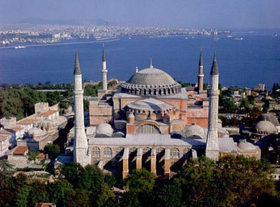
Byzantium and Eastern Europe

Slide 3
Fall of the Western Roman Empire
Diocletian splits empire (284-305 C.E.)
Attempted to make administrative issues more efficient
Constantine moves capital to Byzantium
City renamed Constantinople
western Roman empire collapses 476 C.E.
Internal issues/Germanic invasions
Eastern part will survive for another 1000 years

Slide 4
Statebuilding
Highly centralized state
Caesaropapism
Justinian 527-565 C.E and Theodora
Rebuilt Constantinople, including Hagia Sophia
The Body of the Civil Law
Dealt with prolonged sieges of Constantinople
Byzantium & Western Europe:
ecclesiastical and political tensions

Slide 5
Society
Byzantine society reorganized
Provinces (themes) under generals
Armies of free peasants helped agricultural economy
Urban life
Voluntary class segregation
Hippodrome
Chariot races most popular; Greens and Blues rivalry
Hippodrome

Slide 6
Economy
Large agricultural economy
Industry and trade
Constantinople was major site to industry
Glass, linen, textiles, gems, jewelry, and
Silk
Banks and partnerships supported commercial economy
Revived Western role within Silk Road

Slide 7
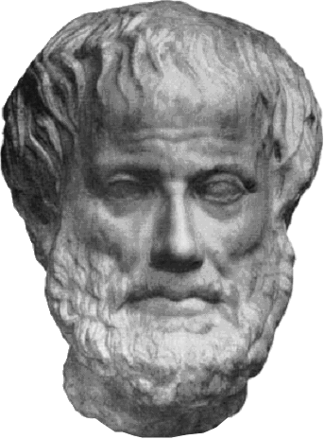
Culture
Official language went from Latin to Greek
State-organized school system trained workforce
Primary education: reading, writing, grammar
Later education: classical Greek, literature, philosophy, science
Preserved and transmitted Greek thought to later cultures

Slide 8
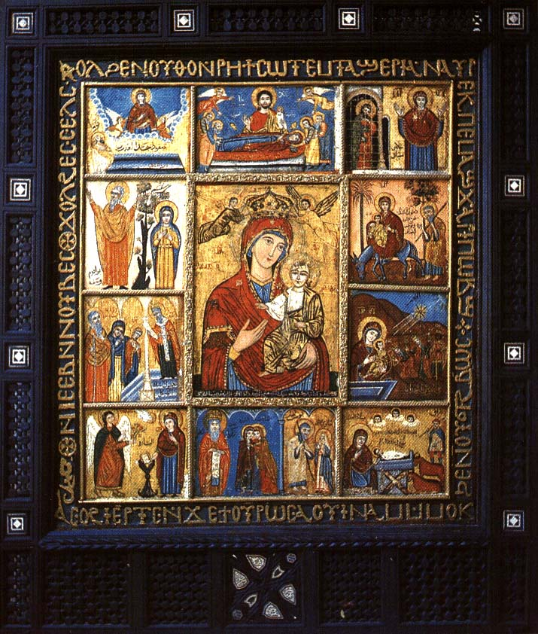
Religion
Council of Nicaea 325 C.E
Iconoclasm controversy
Greek philosophy applied to Byzantine theology
Monasticism origins in early Christian ascetics
St. Basil of Caesarea 329-379 C.E
Monks/nuns
Provided social services to the community

Slide 9
Religion
Constantinople & Rome
strains mirrored political tensions
Ritual and doctrinal differences
Split in 1054
Eastern Orthodox versus Roman Catholic

Slide 10
Interaction w/ Slavs
Began in 6th century
Slavs came from Southwestern Russia
Missions to the Slavs
Saints Cyril and Methodius
Cyrillic Alphabet
Education and religion tied together, led to more conversions

Slide 11
Emergence of Russia
Kiev
located on Dneiper River
conduit for spread of Byzantine culture and religion
Prince Vladamir, 989 CE
Cyrillic writing, literature, Orthodox missions spread Byzantine culture and art
caesaropapist control of Russian Orthodox church

Slide 12
Byzantine Decline
Domestic/Internal problems
new elite class challenged imperial power
Peasant class was declining
External Problems
Western Europe took parts of Byzantium
Crusaders sacked Constantinople (1204)
Muslim Saljuq Turks at Manzikert, 1071
Ottoman Turks captured Constantinople in 1453

Slide 13
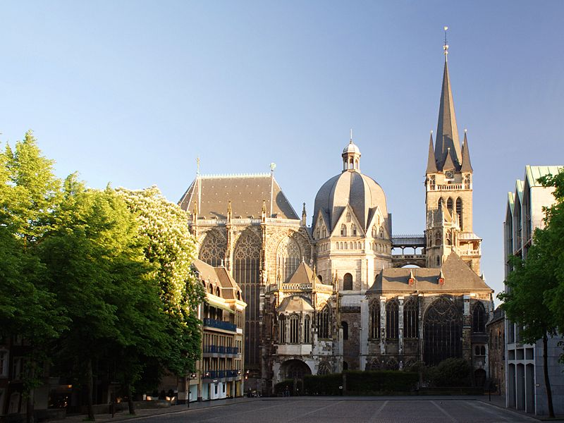
Western Europe 500 CE to 1000 CE

Slide 14
Disruption of Western Europe
Effect of Germanic Migrations
loss of centralized rule
common language
drop in population

Slide 15
Successor States to the Roman Empire c. 500

Slide 16
The Franks
Most influence on European development
Strong agricultural base
Firm alliance with western Christian church
Most powerful military and political power
Clovis (Merovingian Family) became first to unite the Franks under one political ruler
Carolingian family will displace the Merovingian family

Slide 17
Clovis (ruled 481-511)
Major Frankish leader
Paganism, Arian Christianity popular among Franks
Clovis and army chooses Roman Catholicism
Big part to due with Frankish power
Political implications:
Alliance with Roman Catholic Church

Slide 18
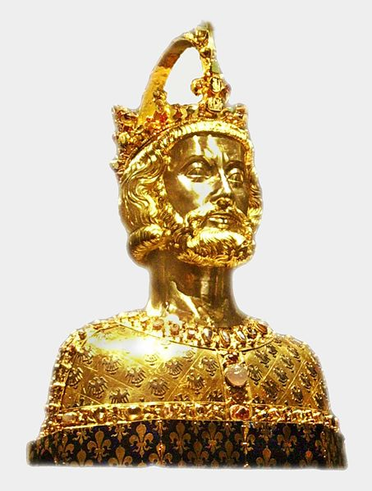
Charlemagne (r. 768-814)
decentralized rule
Could not afford a large bureaucracy
functional illiterate but…
Spoke Latin and Greek
Expansion
counts held local authority within political and legal authority
Ruled as emperor but hesitant to take title
Statue at Aachen, Germany

Slide 19
Decline
Internal
External
Son of Charlemagne, Louis the Pious, lost control of courts, local authorities
Civil war erupts between three sons
Empire divided in 843
South: Muslims
East: Magyars
North: Vikings
Norse expansion begins c. 800 CE
Driven by population pressure, hostility to spread of Christianity
Superior seafaring technology
Sailed to eastern Canada, northeastern US

Slide 20
The Vikings
From village of Vik, Norway (hence “Viking”)
Boats could travel at sea or rive
Traded w/ slavs, Byzantines via Dneiper River
Constant threat to Europe
Constantinople sacked three times
Carolingians had no navy, dependent on local defenses

Slide 21
Formation of Feudalism
Political relationship between a lord and a vassal based upon military service in exchange for land or money
Social titles emerge and are passed down from generation to generation
Evolves into a structured, hereditary hierarchy
See page 360

Slide 22
Effects of Feudalism
Benefits
Setbacks
Incentives for this relationship
land grants, income from mills, cash payments in exchange for military service
Formation of hereditary class
Rights were passed on to heirs
Also provided for..
Public works projects
Court system
Police force
Complex interrelationships
Potential for instability

Slide 23
Early Society: Feudalism
Creates a neat, structured social order
Movement between classes is near impossible
Nobility/lords become the most powerful class

Slide 24
Origins of Serfdom
Slaves, free peasants in both Roman and Germanic societies
Mid-7th century: recognition of serf class
Midway between slave and free peasant
Right to pass on land to heirs
Owed obligations to lord
Obligations
provide labor, payments in kind to lord
Unable to move from land

Slide 25
Manors
Large, diverse estates, very populated
Lord provides
governance
police
justice services
Serfs provide
Labor
Income
Had everything a city would have
Manors established a more rural Western Europe, almost no major cities

Slide 26
The Economy of Western Europe
Agricultural production will be basis of economy
manoralism
Introduced new tools
Technology
Water mill, animal breeding, iron plow
Silk Road trade will eventually die off
Maritime trade will continue despite invasions and Muslim domination of sea
Sailors were mostly from Spain and Italy
Norse or Viking Merchant Mariners
Commerce or plunder as convenient to them
Traded w/ Abbasid and Byzantine Empires

Slide 27
Christianity
Clovis’ conversion forms strong alliance with Roman Christianity
Becomes unifying force within Western Europe
Franks become the protectors of the papacy
By 1000 CE, most people were accepting Christianity

Slide 28
The Papacy
Pope Gregory I (590-604 CE)
Greatest influence on church, known as Gregory the Great
Asserted papal primacy
Pope is ultimate authority in church
Prominent theologian
Established confession
Missionary work
most significant efforts were in England

Slide 29
Monasticism
Originated in Egypt
Large variety of monastic rules
St. Benedict (480-547)
Established consistent rule for monasteries
Poverty, Chastity, Obedience
St. Scholastica (482-543)
Sister of St. Benedict
Adapts Benedictine Rule for convents

Slide 30
Church Hegemony
Influence of the Papacy
Influence of Monasticism
Leadership
Head authority within Christianity
Led to spread of Christianity throughout empire
Coronation of various political rulers
Accumulation of large landholdings, serfs
Provided social services
labor contributions
Inns
Orphanages
Hospitals
schools

Slide 31
Rise of Islam

Slide 32
Human/Environment Interaction
Arabian peninsula was mostly desert
family and clan groups
Important in long-distance trade networks between
China/India and Persia/Byzantium

Slide 33
Muhammad
Muhammad
born to a Mecca merchant family, 570 C.E.
exposed to various faiths
spiritual transformation at age forty
There was only one true god, Allah ("the god")
Revelations compiled into the Quran

Slide 34
Early History of Islam
Conflict at Mecca
Ka’ba
His teachings offended pagan believers, especially the ruling elite of Mecca
threatened shrines, especially the black rock at Ka'ba
The hijra – ‘flight’
starting point of the Islamic calendar
The umma
Nation or community
"seal of the prophets"--the final prophet of Allah
Held Hebrew scripture and New Testament in high esteem
Became determined to spread Allah's wish to all humankind

Slide 35
Establishment of Islam in Arabia
Muhammad's return to Mecca
conquered Mecca, 630
Imposed a government dedicated to Allah
The Ka'ba
the sharia
Detailed guidance on proper behavior in almost every aspect of life
Through the sharia, Islam became more than a religion, it became a way of life

Slide 36
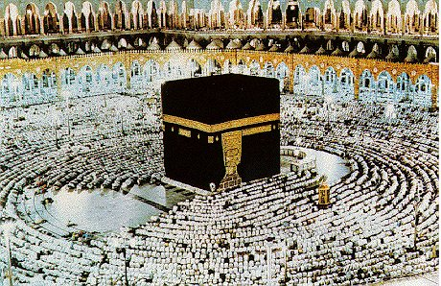
Five Pillars of Islam
Shahada
Declaration of faith
Hajj
pilgrimmage
Zakat
charity
Saum
Fasting
Salah
Prayer

Slide 37
Statebuilding: Islam
The caliph
Abu Bakr
Elected by umma
Became head of the state, chief judge, religious leader, military commander
Dramatic expansion of Islam
Through political, military efforts
The split: 632 CE
Began over succession of Muhammad
Sunni vs. Shia rivalry emerge
Different beliefs:
holy days for leaders, traditions, religious beliefs
Ongoing conflict between the two sects

Slide 38
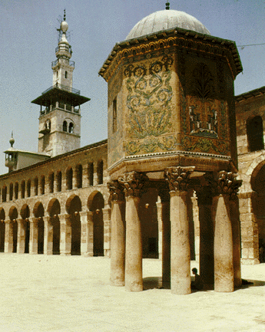
Statebuilding
The Umayyad dynasty
(661-750 C.E.)
temporarily solved problem of succession
capital city at Damascus
dar al-Islam
Policy toward conquered peoples
Levied jizya (head tax) on those who did not convert to Islam
Even the non-Arab converts were discriminated against
Umayyad decline
discontent of conquered and resistance of Shia

Slide 39
Umayyad Dynasty 661 CE to 750 CE

Slide 40
Abbasid Dynasty (750 CE to 1258 CE)
Abu al-Abbas
Established dynasty
No longer conquering, but the empire still grew
Abbasid administration
Relied heavily on Persian techniques of statecraft
court at Baghdad
Ulama and qadis ruled locally
Abbasid decline
Internal: rebellions, uprisings by governors
External: Saljuq Turks controlled the imperial family

Slide 41
Cultural Interaction
Persian influence on Islam
Most notable in literary works
Administrative techniques borrowed from Persians
wise, benevolent, absolute rulers
Veiling of women
Indian influences
Adopted "Hindi numerals," which Europeans later called "Arabic numerals"
Algebra and trigonometry
Greek influences
Muslims philosophers especially liked Plato and Aristotle

Slide 42
Trade Networks

Slide 43
Economy
In the Islamic world…
Spread of new foods and industrial crops
Effects:
Increased varieties and quantities of food
Cotton will be the most effected
Urban growth
A new industry: paper manufacture

Slide 44
Economy
Outside the Islamic World…
Trade revived silk roads
Umayyad and Abbasid rulers maintained roads for military and administration
Camels and caravans
Maritime trade
Borrowed
compass from Chinese
the lateen sail from southeast Asian & Indian mariners
astrolabe from Hellenistic mariners
Banks 0perated on large scale

Slide 45
Society
Quran
Enhanced security for women
The Quran and sharia would later reinforce male domination
Veiling of women
Adopted from Mesopotamia and Persia
Women's rights provided by the Quran were reduced through later interpretations

Slide 46
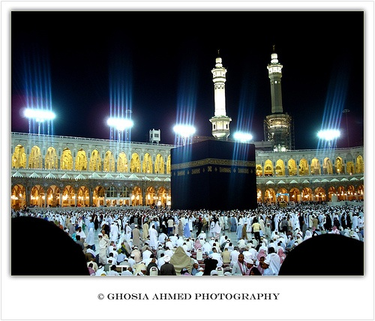
Religion and Culture
The Quran and sharia were main sources to formulate moral guidelines
Promotion of Islamic values
Ulama, qadis, & missionaries
The hajj
The Ka'ba became the symbol of Islamic cultural unity
Pilgrims helped to spread Islamic beliefs and values

Slide 47
Compare/Contrast of Mosques
Similarities
Domes
Arches
Influences by Roman architecture
Symbolic meaning of dome
Differences
The artwork
Interior setup (minbar, quibla)

Slide 48
East Asia

Slide 49
Statebuilding: Sui Dynasty, 589-618 CE
The rule of the Sui
Construction of palaces & granaries
repairing the Great Wall
Military expeditions in central Asia and Korea
High taxes and compulsory labor services
The Grand Canal
Decline
High taxes and forced labor
Military reverses in Korea
Rebellions

Slide 50
Statebuilding: Tang Dynasty, 618-907 CE
Tang Taizong
Era of stability and prosperity
Equal-field system
Bureaucracy of merit through civil service exams
Foreign relations
Tolerant of other religions, Christianity
Middle Kingdom
Tributary system
Decline
Casual and careless leadership
equal-field system deteriorated
peasant rebellion
Regional military commanders gained power

Slide 51
Statebuilding: Heian Japan
Heian Japan (794-1185 C.E.)
Moved to new capital, Heian (modern Kyoto), in 794
emperors as ceremonial figureheads and symbols of authority
Chinese learning dominated Japanese education and political thought
Decline
The equal-field system began to fail
Aristocratic clans accumulated most land like Taira and Minamoto (right)

Slide 52
Economics: China
Agricultural development
Equal-field system
Fast-ripening rice
New agricultural techniques
Population growth dramatically increased
Urbanization
Commercialized agriculture emerged
The emergence of a market economy
"flying cash" (letters of credit) and paper money
Economic surge in China promoted economic growth in the eastern hemisphere

Slide 53
Society
Patriarchal social structure
Foot binding gained popularity
A cosmopolitan society
Evident of foreign religions
Tang is great example

Slide 54
HE Interaction: Technology
Porcelain diffused rapidly
Metallurgy increased
Gunpowder
Printing developed from wood block to movable type
Naval technology
"south-pointing needle"--the magnetic compass

Slide 55
Culture
Ancestor worship became more elaborate
Neo-Confucianism
Buddhist influence on Confucianism
Religious Communities
Nestorian Christians,
Manichaeans,
Zoroastrians
Muslims
(right: Chinese Jesus)

Slide 56
Culture: Buddhism
Attraction:
moral standards
intellectual sophistication
salvation
Buddhist concepts in Daoist vocabulary
Effect will be Chan Buddhism (Zen Buddhism in Japan)
Threat to Chinese and tradition and will eventually be persecuted

Slide 57
Culture: Influence in Korea
Tributary (tax) Relationship
The Silla dynasty of Korea (669-935 C.E.)
China's influence in Korea
capital modeled on the Tang capital
Korean elite turned to neo-Confucianism
peasants turned to Chan Buddhism
Difference between Korea and China
aristocracy and royal houses dominated Korea

Slide 58
Culture: Influence on Vietnam
Tributary (tax) relationship with China for 1000 years
adopted Chinese agriculture, schools, and thought
Chinese influence in Vietnam:
bureaucracy and Mahayana Buddhism
Difference: Vietnam and China
Many Vietnamese retained their religious traditions
Women played more prominent roles in Vietnam than in China
Buddhist pagoda (right)

Slide 59
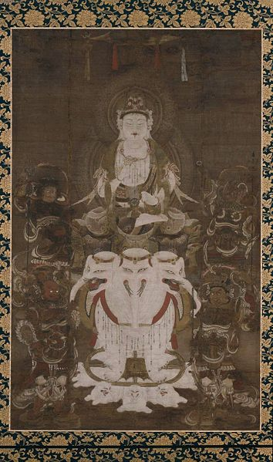
Culture Influence: Japan
Nara Japan (710-794 C.E.)
Ancestors were nomadic peoples
capital modeled on Chang'an
Adopted Confucianism and Buddhism
maintained their Shinto rites
(right) Painting of a Japanese Boddhisatva

Slide 60
Indian Ocean Basin
Islam and Hinduism

Slide 61
Statebuilding: Kingdom of Axum
Modern day Ethiopia
Example of trade-driven development
Founded 1st c. CE
Adopted Christianity
Displaces Kush as Egyptian link to the south
Major territorial expansion to late 6th c.

Slide 62
Statebuilding: East Africa
Swahili City-States
Influenced by Arab merchants
Will convert to Islam
Receives goods from all over basin
Kilwa
Mogadishu

Slide 63
Statebuilding: India
Northern India
Fragmented after Guptas
Taken over by Umayyads
Southern India
The Chola kingdom (850-1267 C.E.)
conquered Ceylon and parts of SE Asia
Navy dominated waters
decentralized

Slide 64
States of SE Asia
Angkor (889-1431 C.E.)
Modern Day Cambodia
Kingdom built by Khmers at Angkor Thom & Angkor Wat
Indian Influences:
Hinduism
Kingships
bureacracy
Did not accept caste system
Kept cultural traditions
Microcosm of Hindu influence in SE Asia

Slide 65
Indian Ocean Trade

Slide 66
Culture: Islam in India
Came in via
Military (Umayyad)
merchants
Turkish Migration
North India had established Muslim communities
South India had maintained Hindu Traditions

Slide 67
Cultural Interaction
Hinduism predominated in southern India
Decline of Buddhism benefited Hinduism
The growth of Vishnu and Shiva cults began
Vishnu

Slide 68
Culture: Islam in SE Asia
Won gradual acceptance in merchant communities
Non-Arab converts would be discriminated against
Sufis were the most effective in converting people
Bhakti movement
A cult that sought to erase the distinction between Hinduism and Islam
Melaka
Geographic location in the Strait of Melaka
Maritime trading thrived
Ruling class converted to Islam
Guru Kabir

Slide 69
Economy: Cross-Cultural Trade
Agriculture in the monsoon world
Irrigation systems were needed for dry months
Money and Temples
Had huge tracts of lands
Collected taxes, served as banks
The kingdom of Axum (Ethiopia & Sudan)
Converted to Christianity
stayed prosperous through trade
Trade goods
Silk and porcelain from China
Spices from southeast Asia
Pepper, gems, pearls, and cotton, specialized textiles from India
Incense and horses from Arabia and southwest Asia
Gold, ivory, and slaves from east Africa

