Slide 1
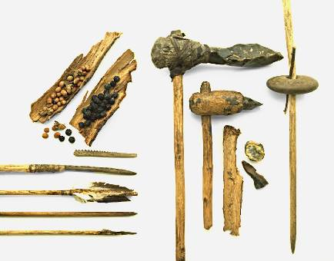
Origins of Man

Slide 2
The Early Man
Appeared in east Africa
4 million to 1 million BCE
Various forms of ‘man’ emerge; homo sapiens
Cro-Magnon people:
Early modern man
40,000 BCE
Spread throughout Eurasia in 100,000 BCE
hunters & gatherers

Slide 3
Paleolithic Society
Economy and society of hunting and gathering peoples
Economic life
Lived an egalitarian existence
Lived in small bands, about 30 to 50 members
Some permanent settlements

Slide 4
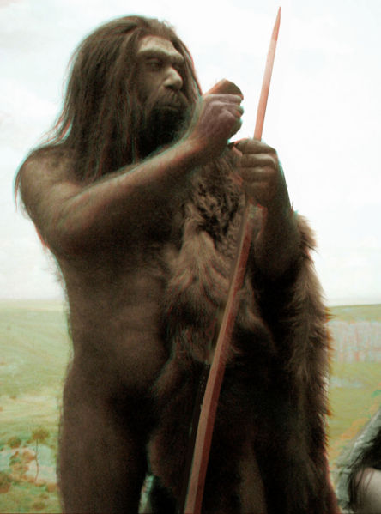
Paleolithic Culture
Careful burial rituals
Venus figurines
Sophisticated weapons
Jewelry
Cave paintings

Slide 5
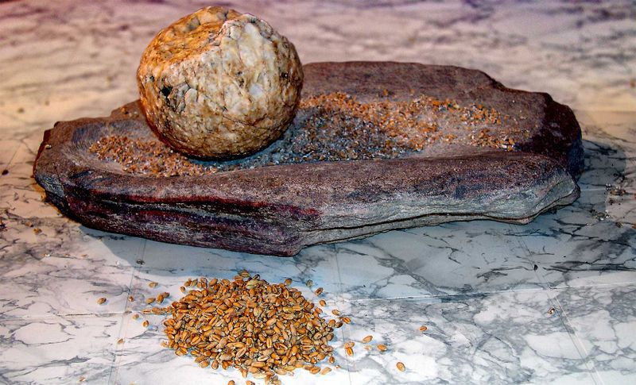
The Neolithic Era
The origins of agriculture
From about 12,000 to 6,000 years ago
Neolithic women began systematic cultivation of plants
Neolithic men began to domesticate animals
Early agriculture around 9000 B.C.E.
Agriculture emerged independently in several parts of the world
Earliest cities in Mesopotamia, 4000 to 3500 B.C.E

Slide 6
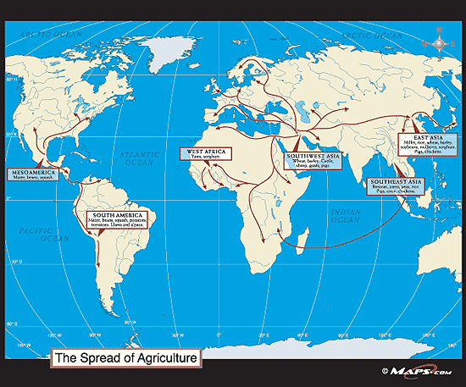
Spread of Farming

Slide 7
Rise of ‘Civilizations’ and the Complex Society

Slide 8
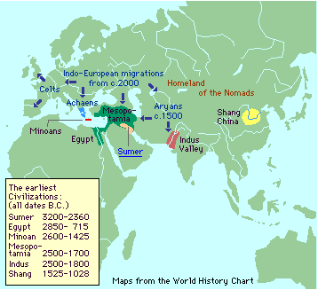
Earliest Civilizations

Slide 9
Mesoptomia

Slide 10
Mesopotamia: "the land between the rivers"
Had to use irrigation
Few natural geographic boundaries
Food supplies increase
Migrants to the area increase- mostly Semites
Cities emerge, 4000 B.C.E.
Governments sponsor building projects and irrigation
Internal problems as well as external problems
Attacks by others led to wall building and military development

Slide 11
Politics

Slide 12
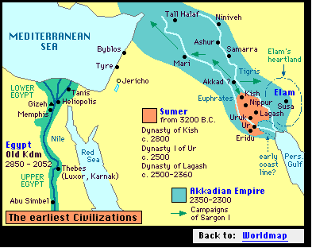
Sumer
first major city-state

Slide 13
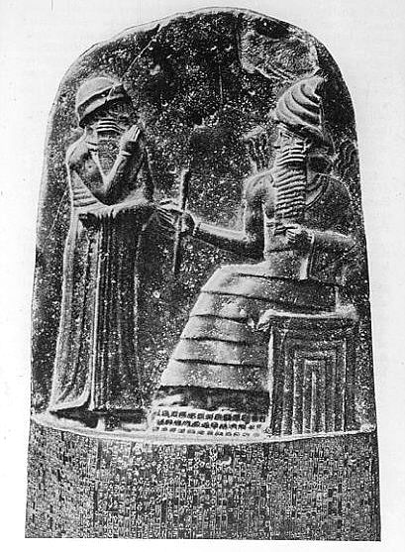
Rise of Empire
Sargon of Akkad 2370-2315 B.C.E.
Seizes trade routes and natural resources
Hammurabi 1792-1750 B.C.E.
Capital is Babylon
law of retribution and importance of social status

Slide 14
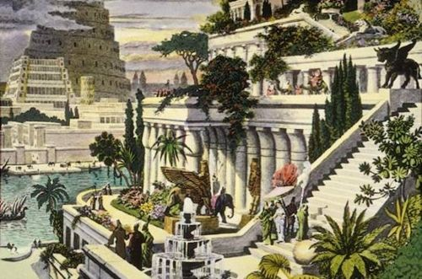
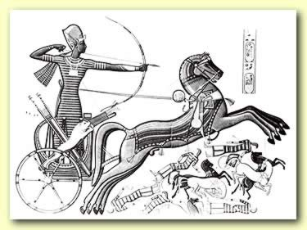
The Later Mesopotamian Empires
Assyrians 1300-612 B.C.E.
Powerful army: chariots, archers, iron weapons
Nebuchadnezzar 605-562 B.C.E.
Hanging gardens of palace shows wealth and luxury

Slide 15
Economics

Slide 16
Trade
Economic specialization and trade
Bronze (made from copper and tin)
Iron (about 1000 B.C.E.),
Wheel (3500 B.C.E.)
Shipbuilding

Slide 17
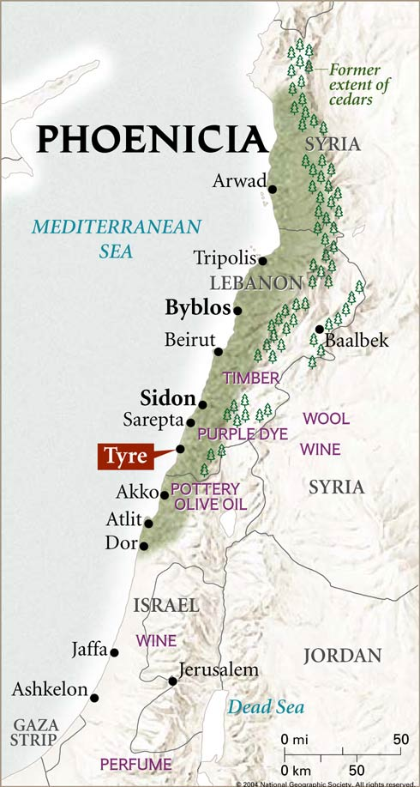
Phoenicians
Occupy land north of Palestine (Canaan)
kingdoms of independent city-states emerge in 3000 BCE
Overland trade to Mesopotamia; influence on culture
Sea trade most important; get raw materials, trade for manufactured goods
alphabetical script (1500 B.C.E.)

Slide 18
Society

Slide 19
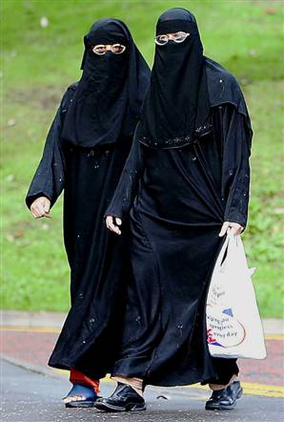
Social Classes
Social classes
Seen from Wealth
Kings and nobles
Priests and priestesses
Free commoners
Slaves
Patriarchal Society
Hammurabi's code
men are head of the household
Women; by 1500 B.C.E. are wearing veils

Slide 20
Culture

Slide 21
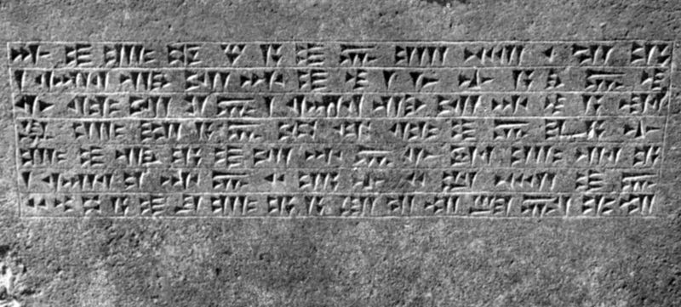
Culture
Cuneiform, writing system
Mostly commercial and tax documents
Education: scribe or government official
Literature: astronomy, mathematics, abstract
Gilgamesh

Slide 22
Hebrews, Israelites, and Jews
Pastoral nomads
Each group as their own history
Mesopotamia influence
law of retribution, flood story, political style
Abraham
Moses
Assyrian conquets
Deportees return to Judea (Palestine)
become known as Jews (586 B.C.E.)

Slide 23
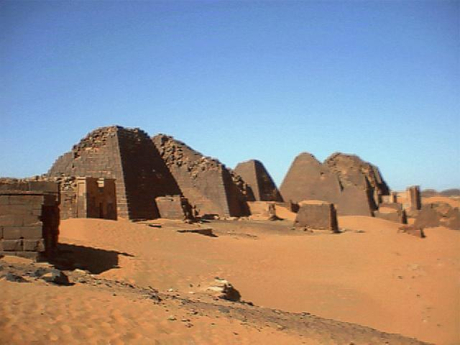
Africa

Slide 24
Human Environment Interaction

Slide 25
Africa
Sahara region used to be grassy steppe lands with water (10,000 B.C.E.)
Permanent settlements
sorghum and yams (7500 B.C.E.)
Climate becomes hotter and drier after 5000 B.C.E.
People are driven into river regions--Nile
Annual flooding

Slide 26
Egypt and Nubia: “Gifts of the Nile”
Nile River is longest river in world
Annual flooding provided fertile land
Egypt--lower third of Nile (Toward Mediterranean Sea)
Nubia--middle third of Nile
Both groups would come under the influence of other neighboring groups
Agriculture is easy in Egypt

Slide 27
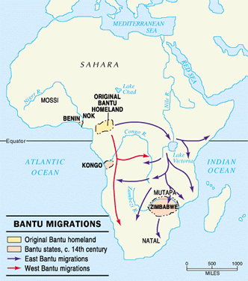
Sub-Sahara Africa: Bantu Migration
The dynamics of Bantu expansion
Bantu--language group from west central Africa
Cultivate yams and oil palms
Trade with hunting/gathering forest people

Slide 28
Early Migrations of the Bantu
Begins in 3000-1000 B.C.E.
By 1000 B.C.E. occupy most of Africa south of the equator
Agricultural surplus causes them to move inland from rivers; become involved in trade
migration increases due to iron

Slide 29
Politics

Slide 30
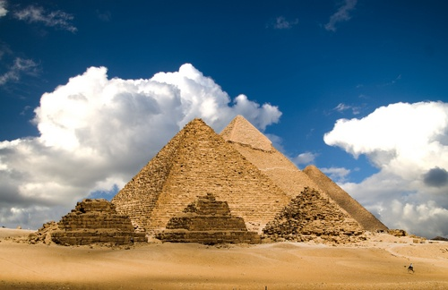
The Unification of Egypt
Egypt, large and prosperous state by 3100 B.C.E.
Pharaoh, absolute ruler and owns all land
Menes (Narmer) unites kingdoms around lower Nile
Great pyramids of Giza built during this period; Khufu the largest

Slide 31
Turmoil and Empire
Hyksos
Nomadic horseman invade Egypt
Probably introduced horses
Conquer Memphis in 1674 BCE
Eventually pushed out
The New Kingdom (1550 – 1070 B.C.E)
Using bronze weapons and chariots
Building projects: temples, palaces, statues
Empire including Palestine, Syrian, Nubia
Post 6th century: Egyptians fell to Assyrians as well as other foreigners

Slide 32
Society

Slide 33
Complex Societies in Egypt
The emergence of cities and stratified societies
Cities are not as prominent in Egypt as in Mesopotamia
Cities: Memphis, Thebes, Heliopolis
Nubian cities
Meroë, most influential city after Assyrian invasion because it is farther south

Slide 34
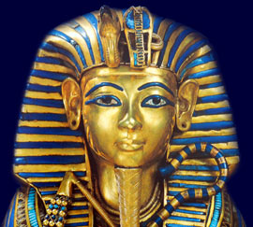
Social Classes
Patriarchal Society
Professional army
Administrators
Peasants
Absent noble class
Women act as regents
Hatshepsut
Nubia: women serve as queens, priestesses, and scribes

Slide 35
Sub-Saharan Societies and Culture
Spread of agriculture by 1000 B.C.E.
Small communities, led by chiefs
Religion
Some worship single, impersonal divine force representing good and bad
Ancestoral worship, local gods
Much mixing and intermingling of cultures

Slide 36
Economics

Slide 37
Economic Specialization and Trade
Bronze
copper & tin rare and expensive
Iron metallurgy develops independently in Sudan
Transportation: sailboats, carts, and donkey caravans
Trade networks
from Nubia: ebony, gold, gems, slaves
From Egypt: pottery, wine, linen, decorative items
Egypt and Lebanon: wood, like cedar

Slide 38
Culture

Slide 39
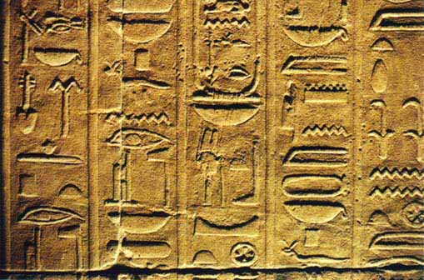
Early Writings in the Nile Valley
Hieroglyphics found on monuments and papyrus by 3200 B.C.E.
Scribes live very privileged lives

Slide 40
Religion
Principal gods: sun gods Amon and Re
Brief period of monotheism: Aten
Cult of Osiris
Osiris judges the heart of the dead against the feather of truth
Nubians combine Egyptian religions with their own

Slide 41
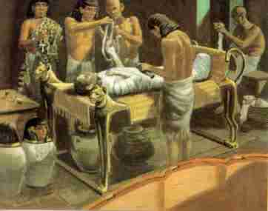
Mummification
At first only pharaohs are mummified (Old Kingdom)
Later ruling classes and wealthy can afford it
Eventually commoners have it too

Slide 42
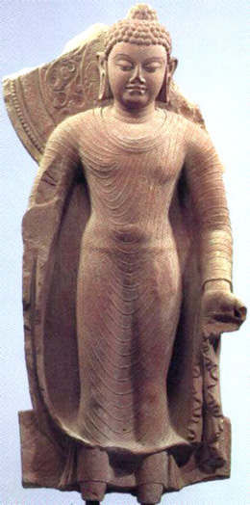
India

Slide 43
India and Human/Environment Interaction

Slide 44
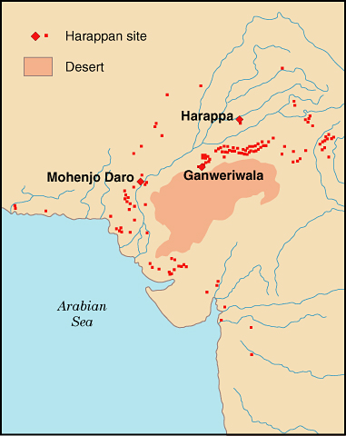
Early Societies
Neolithic Villages: 3000 B.C.E.
The Indus River
Annually flooding
Runs through north India, with sources at Hindu Kush and the Himalayas
Wheat and barley were cultivated; cotton before 5000 B.C.E.

Slide 45
Indo-European Migrations
The Aryans and India
The early Aryans
Depended heavily on a pastoral economy
orally transmitted works called the Vedas
Sacred language (Sanskrit) and daily-use language (Prakit)
Aryan migrations in India: first Punjab and by 500 B.C.E. in northern Deccan
Used iron tools and developed agriculture
Lost tribal organizations but established regional kingdoms

Slide 46
Ancient India
State building, expansion, and politics

Slide 47
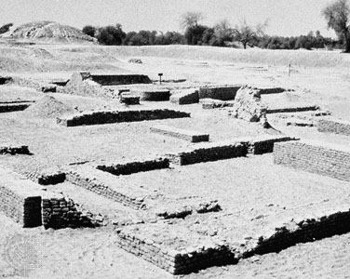
Harappa and Mohenjo-daro
two main cities
Each city had a fortified citadel; large granary
Broad streets, marketplaces, temples, public buildings
Standardized weights, measures, architectural styles, and brick sizes
Harappan society declined from 1900 B.C.E.

Slide 48
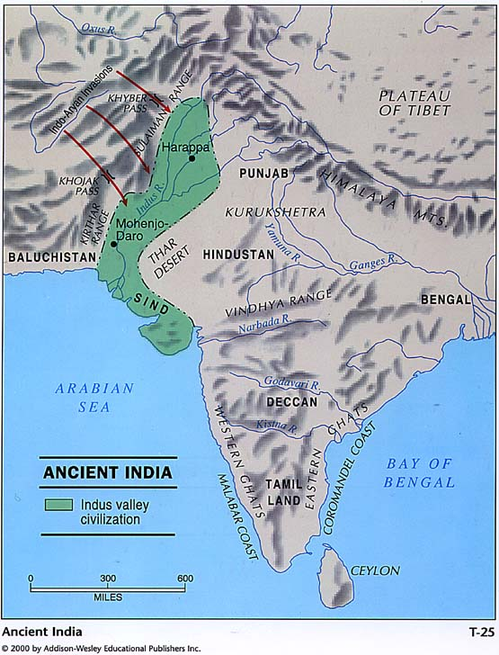

Slide 49
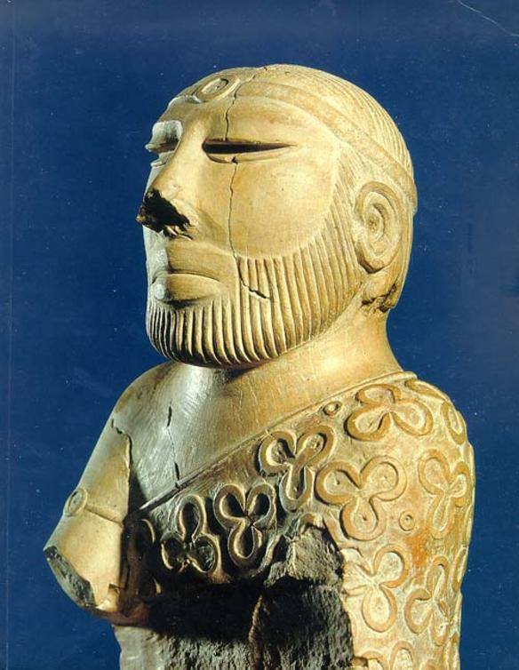
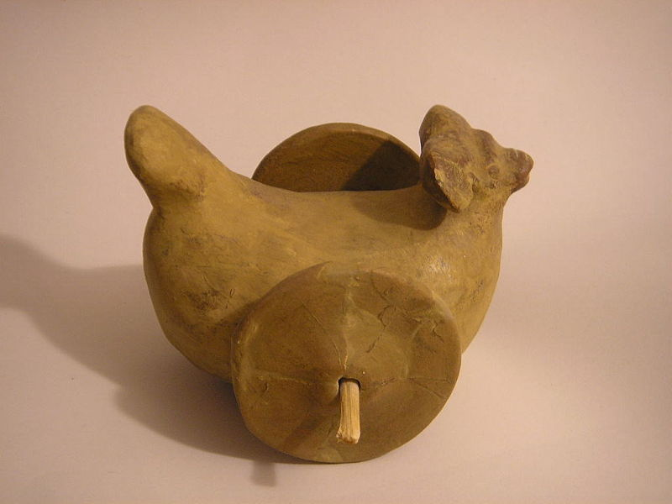
Indian Society and Culture

Slide 50
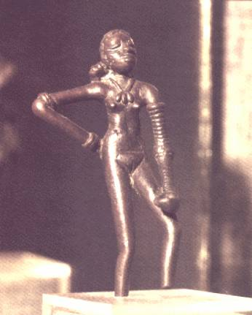
Harapan Society and Culture
Social distinctions
Based on wealth, seen from living styles
Religious beliefs strongly emphasized fertility
Trees and animals were sacred
Some similarities found between Harappan religion and Hinduism

Slide 51
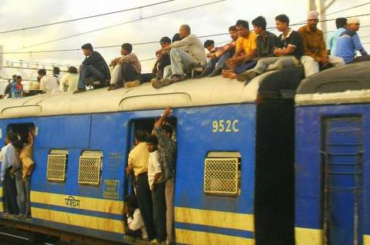
Origins of the Caste System
Caste and varna
caste: hereditary, unchangeable social classes
Subcaste, or jati
6th century BCE
determined by occupations
social mobility difficult but still possible

Slide 52
Patriarchal Society
The Lawbook of Manu
1st century BCE
moral behavior and social relationships
Subjected women to the control and guidance of men
Women's duties
to bear children and maintain the household
Sati

Slide 53
Religion
Aryan religion
polytheistic
Ritual sacrifices were more important than ethics
Priests were specialists of the ritual sacrifices
Shift after about 800 B.C.E.
Dravidian notions of transmigration and reincarnation were adapted

Slide 54
Cultural Diffusion
The blending of Aryan and Dravidian Culture
The Upanishads, works of religious teachings (800-400 B.C.E.)
Brahman: the universal soul
Highest goal: to escape reincarnation and join with Brahman
Karma
Moksha
Religion and Vedic society
Samsara and karma reinforced caste and social hierarchy
Respect for all living things, a vegetarian diet

Slide 55
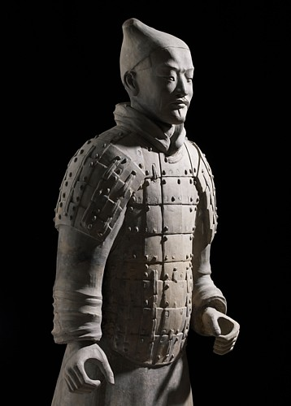
China

Slide 56
Human Environment Interaction

Slide 57
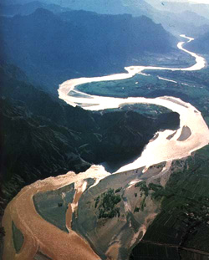
China
The Yellow River
Annually flooding
"China's Sorrow"
Loess provided rich soil, soft and easy to work
Neolithic societies after 5000 B.C.E.
Isolated from the rest of the major civilizations
The Yangzi valley; dependable river; two crops of rice per year

Slide 58
Politics

Slide 59
Chinese Dynasties
The Xia dynasty 2200 B.C.E.
Shang Dynasty 1766-1122 BCE
written records and material remains discovered
Bronze metallurgy, monopolized by ruling elite
Horses and chariots traveled with Indo-European migrants to China
Agricultural surpluses supported large troops
A vast network of walled towns

Slide 60
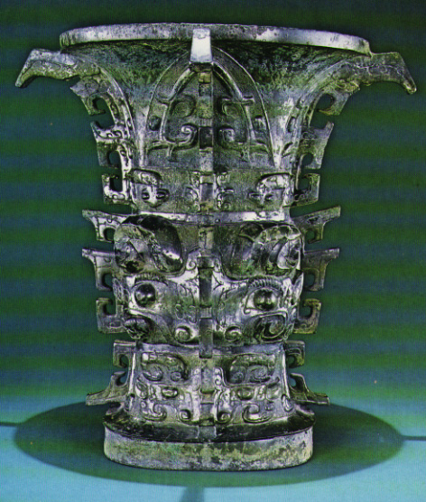
The Zhou Dynasty 1122-256 BCE
Creation of Mandate of heaven
The Zhou needed to justify the overthrow
Mandate of heaven only given to virtuous rulers
decentralized administration
Iron metallurgy spread
Decline
Nomadic invasion sacked capital in 711 B.C.E.
The Warring States (403-221 B.C.E.)
Wine vessel

Slide 61
Culture

Slide 62
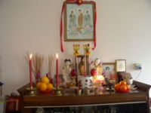
Family and Patriarchy
Veneration of ancestors
Belief in ancestors' presence and their continuing influence
Family heads presided over rites of honoring ancestors' spirits
Patriarchal society evolved out of matrilineal one
The rise of large states brought focus on men's contribution
After the Shang, females devalued

Slide 63
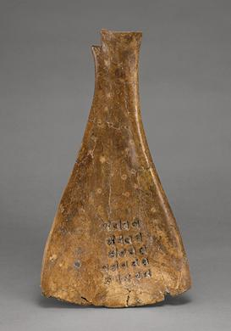
Culture
Absence of organized religion and priestly class
Oracle bones used by fortune-tellers
Early Chinese writing, from pictograph to ideograph
Modern Chinese writing is direct descendant of Shang writing
Oracle bone from Shang

Slide 64
Cultural Exchange
Nomadic peoples of the steppe lands--herders
Traded with Chinese
frequently invaded
did not imitate Chinese ways
relied on grains and manufactured goods of the Chinese

Slide 65
Chinese Society

Slide 66
Society
The social order: based on wealth
Hereditary aristocrats
Administrative and military offices
Free artisans and craftsmen mostly worked for elites
Peasants
Women's work
wine making, weaving, silkworm raising
Slaves, mostly war prisoners

Slide 67
China’s Economic Systems

Slide 68
Economics
Merchants and trade are significant
Under the Zhou:
Roads and canals will be built
Money is coined
Blast furnaces built for iron
Traded with:
Nomadic people People to the west (central Asia) to the south (SE Asia)
Korea and offshore islands
Maritime neighbors included India

Slide 69
The Americas and Oceania
Worlds Apart

Slide 70
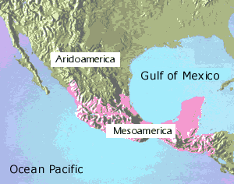
Mesoamerica

Slide 71
Migration
Large wave of humans traveled from Siberia to Alaska around 13,000 B.C.E.
Agriculture began 7500 B.C.E.
Early agriculture
beans, squashes, chilis
maize became the staple; 5000 B.C.E.
no large domesticated animals
no wheeled vehicles
Olmecs “the rubber people” 1200 B.C.E.
Influence
maize, pyramids, calendar, human sacrifice, ball game

Slide 72
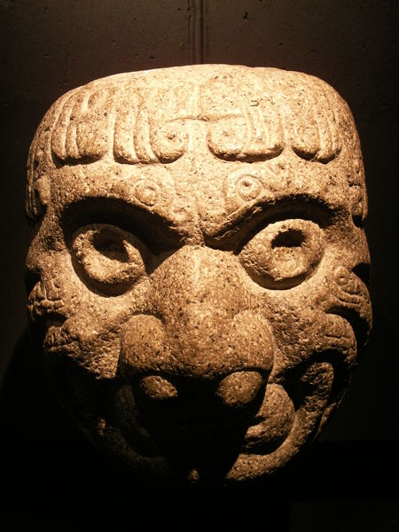
South America
Migration
By 12,000 B.C.E. peoples reached South America
By 8000 B.C.E. they began to experiment with agriculture
Complex societies 1000 B.C.E.
located in modern-day Peru

Slide 73
The Chavin Cult
900 to 300 B.C.E.
Main crops
Beans, sweet potatoes, peanuts, cotton
Devised techniques of producing cotton textiles and fishing nets
Discovered gold, silver, and copper metallurgy
Irrigation, trade, military, no writing
Artistic legacy

Slide 74
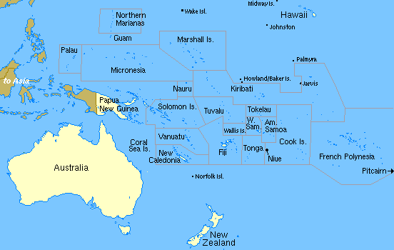
Oceania

Slide 75
Oceania
Early societies in Australia and New Guinea
Human migrants 60,000 BCE
Australia: hunting and gathering until the 19th and 20th centuries C.E.
New Guinea: Turned to agriculture about 3000 B.C.E.; root crops and herding animals
Eventual migrations to Micronesia and Madagascar

