Slide 1
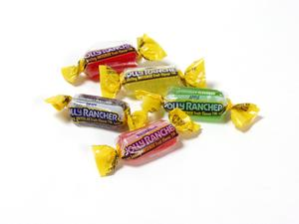
CANDY COMPARISON Which one should I purchase?

Slide 2
KEY WORDS TO USE…
COMPARING
CONTRAST
LIKE
SAME
BOTH
SIMILAR
ALTHOUGH
HOWEVER
WHEREAS
EVEN THOUGH
DIFFER

Slide 3
EXAMPLES
BOTH CHRISTIANITY AND ISLAM HAD POLITIC LEADERS THAT HELPED TO SPREAD AND EMBRACE EACH RELIGION
BUDDHISM AND HINDUISM DIFFER IN THEIR BELIEFS OF GODS. HINDIUSIM IS POLYTHEISTIC WHEREAS BUDDHISM IS MONOTHEISTIC

