Slide 1
Classical Society
500 BCE to 500 CE

Slide 2
HE Interaction
Indo-European speakers
Medes, Persians
share cultural traits with Aryans
Largest extent of empire: 35 million people

Slide 3
Politics
The Achaemenid Empire
23 satrapies
Local officials were of native origin
Persian Royal Road and postal stations
law, justice, administration, toleration led to political stability
Darius
Xerxes (r. 486-465 B.C.E.)
Persian Wars (500-479 BCE)
Persian rulers failed to put down a rebellion, sparred for 150 years
Alexander of Macedon invaded Persia in 334 B.C.E.
Later empires would borrow Persian government techniques

Slide 4
Society
Social development in classical Persia
Influence of
Nomadic society
importance of family and clan relationships
Imperial administration
called for educated bureaucrats
Free classes were bulk of society
Largest class: slaves
prisoners of war and debtors

Slide 5
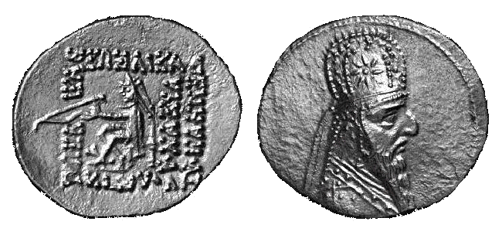
Economy
Agriculture was the economic foundation
Trade from India to Egypt
Standardized coins, good trade routes, markets, banks
Specialization of production in different regions

Slide 6
Culture - Zoroastrianism
Zarathustra
Ahura Mazda (good) vs. Angra Mainyu (evil)
Believed in heavenly paradise and hellish realm
Moral formula: good words, good thoughts, good deeds
Popularity grows; 6th century B.C.E.
Most popular in Iran
Zoroastrianism influenced other monotheistic religions

Slide 7
Mediterranean Society

Slide 8
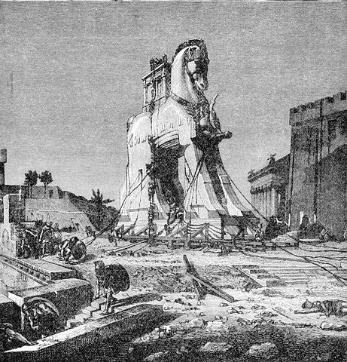
HE Interaction
Minoan society arose on the island of Crete, 2000 B.C.E.
was the center of Mediterranean commerce
Received early influences from Phoenicia and Egypt
Indo-European immigrants (Mycenaeans) settled in Greece, 2000 B.C.E.
Trojan War 1200 B.C.E.
Greek peninsula is ¾
mountains
City-states are located
near farming land; fragmented

Slide 9
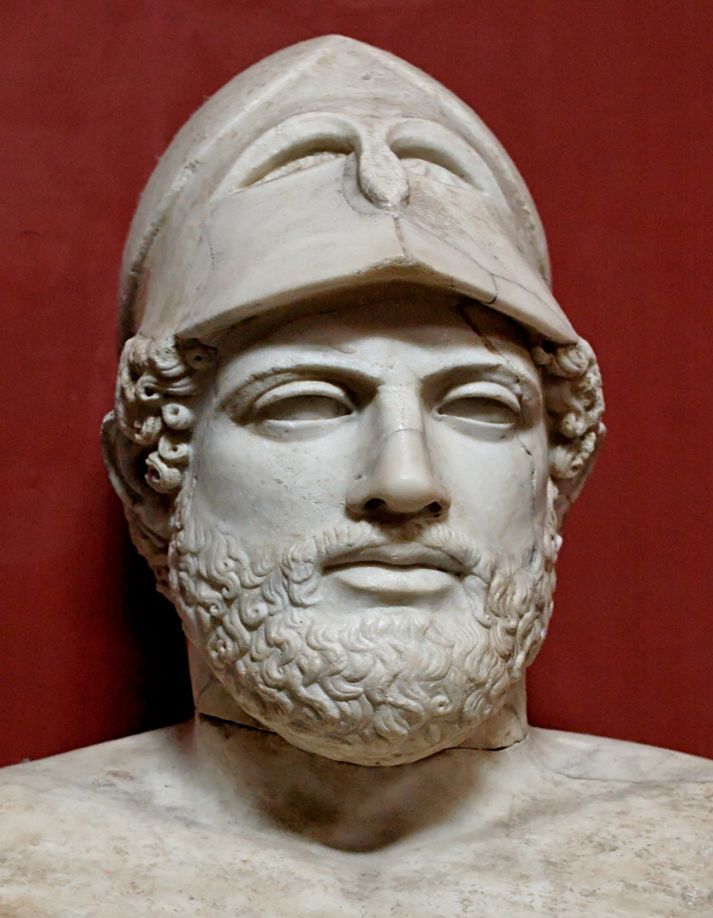
Politics
Geography prevented a unified ‘Greece’
Athens and Sparta
Two most dominant city-states
Sparta
oligarchy
Athens gradually broadened base of political participation
Solon
Citizenship was open to free adult males
Pericles

Slide 10
Politics
Colonization
Greeks founded more than 400 colonies
Facilitated trade among Mediterranean lands and people
Spread of Greek language and cultural traditions

Slide 11
Persian War
The Persian War (500-479 B.C.E.)
Greek cities (located in Turkey)revolted against Persia, 500 B.C.E.
Battle of Marathon and Salamis

Slide 12
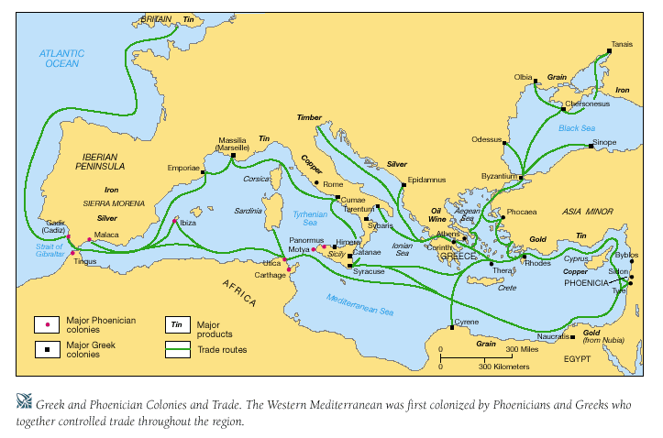
Greek Economy
Trade resulted in population growth & more colonies
Production of olive oil and wine, in exchange for grain and other items

Slide 13
Society
Patriarchal throughout city-states
Athenian society
Maritime trade brought about prosperity
Aristocratic landowners were primary beneficiaries
Class tension became intensified in the 6th century B.C.E.
Spartan Society
Discouraged social distinction
Distinction was drawn by prowess, discipline, and military talent
women enjoyed higher status than women of other poleis
Slavery: property of their owners
Worked as cultivators, domestic servants
Educated or skilled slaves worked as craftsmen and business managers

Slide 14
Greek Philosophy
Philosophy based on human reason
Socrates
Plato
Aristotle
Legacy of Greek philosophy
Intellectual authorities for European philosophers until 17th century
Intellectual inspiration for Christian and Islamic theologians

Slide 15
Culture
Works of Homer
Religion
Cult of Dionysus
Drama
was performed at annual theatrical festivals
tragedians
Comic drama took delight in lampooning the public figures
Olympic Games
Panhellenic festivals (like Olympic Games) became popular

Slide 16
Hellenistic World

Slide 17
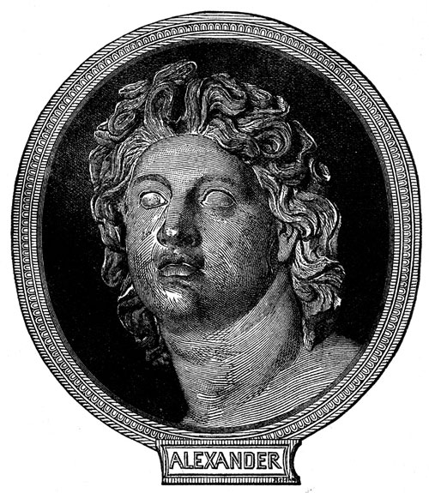
Politics
Philip of Macedon (reigned 359-336 B.C.E.) brought Greece under control
Alexander of Macedon
By 331 B.C.E., controlled Syria, Egypt, Mesopotamia
Invaded Persia and burned Persepolis
Crossed Indus River by 327 B.C.E.
Sudden and Unexpected death at age 33

Slide 18
Political…
Hellenistic Empire
Antigonid empire (from General Antigonus)
Greece and Macedon
Smallest of Hellenistic Empire
Economy of Athens and Corinth flourished through trade
The Ptolemaic empire (from General Ptolemy)
Egypt
Rulers did not interfere with Egyptian society
Alexandria, capital at mouth of the Nile
Alexandria Museum and Alexandria Library
The Seleucid empire (from General Seleucus)
Turkey, Middle East, Afghanistan
Saw greatest of Greek influence
Colonists created a Mediterranean-style urban society

Slide 19
Culture
Hellenistic Religion
The Hellenistic philosophies
each addressed individual needs through inner peace
Epicureans
Skeptics
Stoics
Religions of salvation spread through trade routes
Cult of Osiris
Speculation about a single, universal god emerged

Slide 20
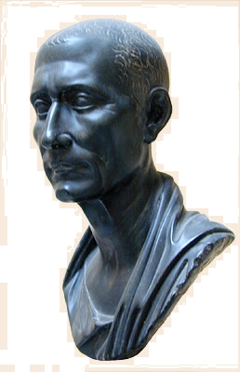
Rome
From Republic to Empire

Slide 21
HE Interaction
The Etruscans
The Etruscans dominated Italy 8th to 5th B.C.E.
Tiber River
Climate and time is similar to that of Greece

Slide 22
Politics: The Roman Republic
Establishment of the republic
Consuls
Senate advised the consuls and ratified major decisions
Both Senate and consuls represented the interests of the patricians
Conflicts between patricians and plebeians

Slide 23
Republic to Empire
Punic Wars
Imperial expansion and domestic problems
land redistribution
Military commanders recruited rural and urban poor--intensely loyal armies
Gaius Marius & Lucius Cornelius Sulla
Civil war

Slide 24
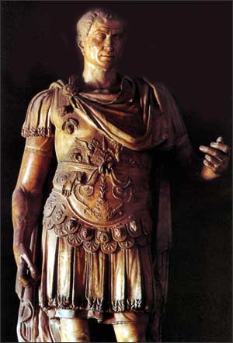
Foundation of Empire
Julius Caesar
Seized Rome in 49 B.C.E.
"dictator for life," 46 B.C.E.
Social reforms and centralized control
Pax romana
Well-engineered Roman roads
postal system
twelve tables 450 B.C.E.

Slide 25
Economy
Trade
Owners of latifundia focused on specialized production for export

Slide 26
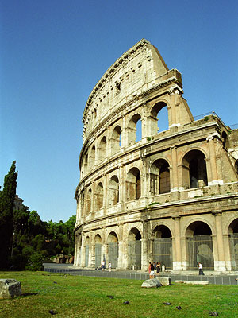
Achievements
Rome itself
Statues, pools, fountains, arches, temples, stadiums
concrete
Rome attracted numerous immigrants

Slide 27
Family and Society
Patricians and Plebians
The pater familias
Women
Wealth and social change
Cultivators and urban masses
"bread and circuses"
Slavery
one-third of the population

Slide 28
Culture: Influence of Greece
Roman deities
Stoicism
Appealed to Roman intellectuals
Cicero (106-43 B.C.E.)
Religions of salvation gave sense of purpose and promised afterlife
Roman roads
Mithraism
Cult of Isis

Slide 29
Christianity
Jesus of Nazareth
Jewish teacher
Attracted large crowds through his wisdom and miraculous powers
Crucifixion in early 30s C.E.
The New Testament and the Old Testament became the holy book of Christianity
Paul of Tarsus
Rapid growth of early Christianity
Strong appeal to lower classes, urban population, and women

Slide 30
The Rise of Christianity
Christianity was the most prominent survivor of the collapse of Roman Empire
Edict of Milan
Christians could openly practice their faith
Emperor Theodosius
official religion in Rome
The Church became increasingly institutionalized
hierarchy of church officials
The bishop of Rome;
served as a cultural and political foundation
Notes:
30

Slide 31
Silk Road

Slide 32
Origins
Basics
Effects
Classical Empires
Investment in roads & bridges
Borders were expanded
Mariners from Ptolemaic Egypt learned about the monsoon system in India
One of the principal commodities was silk
Trade took place in stages
Cultural exchanges involved religions like Hinduism, Christianity, and Buddhism
Biological exchanges involved smallpox and the plague

Slide 33
The Silk Roads
Trade goods
Silk and spices traveled west
Central Asia produced horses
Roman empire provided glassware, jewelry, textiles
The organization of long-distance trade
long-distance trade existed in stages
On the seas, long-distance trade was dominated by different empires

Slide 34
Cultural Exchanges: Buddhism & Hinduism
Buddhism in central Asia and China
Spread by foreign merchants
Buddhism and Hinduism eventually spread to Southeast Asia
‘Rajas’ in SE Asia
Example of Hindu influence
Vietnam

Slide 35
Cultural Exchange: Christianity
Christianity
Followed trade routes
Missionary work
Spread throughout Roman Empire
Formation of sects
Nestorian Christianity in SW Asia
Ascetic lifestyles
Communities will be seen through the Silk Routes
Stone tablet found in X’ian in 781

Slide 36
Cultural Exchanges: Manichaeism
Mixture of Zorasterianism, Christianity, and Buddhism
Prophet Mani
Dualism
means to achieve personal salvation
Ascetic lifestyle and high ethical standards
Spread of Manichaeism
appealed to merchants
Appeared in all large cities of Roman empire, 3rd century C.E.

Slide 37
Biological Exchanges
smallpox, measles, bubonic plague
Aided by long-distance travelers
33% drop in population
Effects of epidemic diseases
economies contracted
Small regional economies emerged
Epidemics weakened Han and Roman empires

Slide 38
Classical China

Slide 39
Politics
Qin Dynasty
Centralized gov’t
adopted Legalist policies
Organized a powerful army equipped with iron weapons
Built 4,000 miles of roads
Qin Shihuangdi 221 B.C.E.
Great Wall
Buried 460 scholars alive
The collapse
rebellions due to public works

Slide 40
Politics
Han Dynasty
Early Han policies
Sought a middle way between Zhou and Qin
Han Wudi 141-87 B.C.E
adopted Legalist policies
Confucian educational system for training bureaucrats
colonized northern Vietnam and Korea

Slide 41
Collapse of the Han
Variety of reasons
economic
political
Factions at court paralyzed the central government
social
Yellow Turban Uprising
empire dissolved; China was divided into regional kingdoms

Slide 42
Confucius
Confucius (551-479 B.C.E.)
Educator and political advisor
Analects
Confucian ideas
Advocated government by benevolence and humanity
Believed that humans selfishly pursue own interests
harsh social discipline to bring order to society
Advocated moral education and good public behavior

Slide 43
Daoism
Laozi (500s BCE)
Advocated a life in harmony
with nature
The Dao
the way of nature, the way of the cosmos
Ambition and activism had only brought the world to chaos
wuwei
Action through inaction
Advocated small, self-sufficient communities
served as counterbalance to Confucian activism

Slide 44
Legalism
Late 300s BCE
The doctrine of practical and efficient statecraft
Legalist doctrine
The state's strength was in agriculture and military force
Discouraged commerce, education, and the arts
Harnessing self-interest of the people for the needs of the state
Called for harsh penalties
Advocated collective responsibility before the law

Slide 45
Society
Patriarchal social structure
Ban Zhao's Admonitions for Women
Confucians ideal of children obey and honor parents
Social Hierarchy
See chart on page 202

Slide 46
Economy and Society
Economy
majority of population: peasants/farmers
Silk textiles
Paper production
Expeditions consumed the empire's surplus
Raised taxes
Social tensions arise
Problems of land distribution
Wang Mang 9-23 C.E.

Slide 47
Decline of Rome and Han
Internal decay: Roman empire
coups(235-284 CE)
Diocletian splits empire (284-305 C.E.)
Constantine moves capital to Constantinople
External Issues
Germanic migrations
western Roman empire collapses (476 C.E.)
Imperial authority survived in the eastern half of the empire for 1000 years
Internal decay: Han state
Yellow Turban Uprising
Unequal land distribution
Generals usurped political authority
divided the empire
External Issues
Nomadic invasions
Cultural change
Withering of Confucianism
Popularity of Buddhism

Slide 48
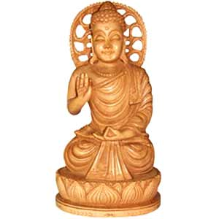
India

Slide 49
Politics - Mauryan Empire
Unification of India
Chandragupta Maurya began conquest in 320s B.C.E.
Ashoka Maurya 268-232 B.C.E.
Ruled through tightly organized bureaucracy
Converted to Buddhism
Policies were written on rocks or pillars

Slide 50
Politics – Gupta Dynasty
Gupta Dynasty
Crucial role in Silk Road trading network
The Gupta dynasty
founded by Chandra Gupta (375-415 C.E.)
Smaller and more decentralized than Mauryan
Invasion of Nomadic Group weakened the empire

Slide 51
Economy
Towns and trade
Towns provided manufactured products and luxury goods
Active marketplaces, Ganges River
Vaishyas(merchants) and shudras(peasants) benefited
Trading partners
Persia, China, Indian Ocean basin, Indonesia, SE Asia, Mediterranean basin

Slide 52
Society - Caste System
Family life and the caste system
patriarchal families
female subordination
child arranged marriage
Social distinctions in the late Vedic Age
Four main varnas
untouchables was added later

Slide 53
Culture - Jainism
Inspired by the Upanishads
everything in universe has a soul
Striving to purify one's selfish behavior to attain a state of bliss
Very demanding
Appeal of Jainism
Social implication
did not recognize social hierarchies of caste

Slide 54
Culture - Buddhism
Siddhartha Gautama (563-483 B.C.E.)
The Four Noble Truths
Doctrine
Eightfold Path - vehicle to reach enlightenment
nirvana
Appealed strongly to members of lower castes
Ashoka converted

Slide 55
Culture – Schism in Buddhism
Split occurs
Mahayana & Theravada
Early Buddhism made heavy demands on individuals
Buddha became a god
boddhisatva--"an enlightened being"
Educational institutions promoted new faith

Slide 56
Culture – Evolution of Hinduism
Hinduism
Bhagavad Gita “The Gita”
A short poetic work
Illustrated expectations of Hinduism and promise of salvation
Ethics
Achieve salvation through meeting caste responsibilities
Hinduism gradually replaced Buddhism in India

Slide 57
Classical American - Mayan

Slide 58
Politics
Divided into city-kingdoms
Tikal – political center
40,000 people
Mayan kingdoms fought constantly with each other
Decline began around 800 CE
Invasions, civil war, water control

Slide 59
Society
Kings, ruling families
Priests
Transmitted knowledge of writing, math, astronomy
Hereditary nobility
Owned most of the land
Free artisans, professionals
Slaves and peasants

Slide 60
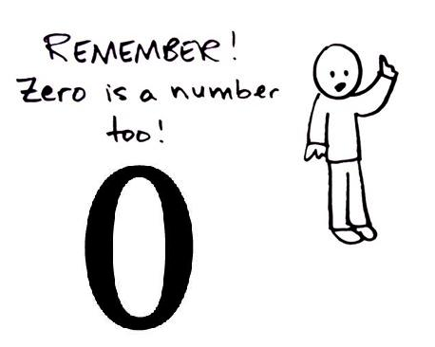
Culture
Complex math
Invention of “Zero”
Calendar of 365.242 days
Ideographs and a syllable-alphabet
Most writings destroyed by Spanish conquerors
Popol Vuh: Mayan creation myth

Slide 61
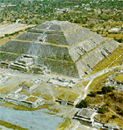
Mayan Religion
Ritual calendar of 260 days
Management of calendar lends authority to priesthood
Importance of bloodletting rituals
Human sacrifices follow after removal of fingers, piercing to allow blood flow
Self-mutilation

Slide 62
The Maya Ball Game
Ritual form of ball game
High-ranking captives, prisoners of war contestants
Execution of losers immediately follows the match
Bloodletting ritual for the gods

