Slide 1
The End of Empire
Decolonization in the world

Slide 2
South Asia
India

Slide 3
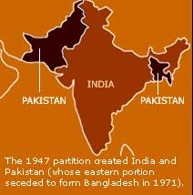
India
Deep divisions: Muslims vs. Hindus
  Muhammad Ali Jinnah, Muslim League
  Jawaharlal Nehru, Congress Party
1947 partition
  500,000 killed
  10 million refugees
India moves toward nonalignment position
  The “third path”

Slide 4
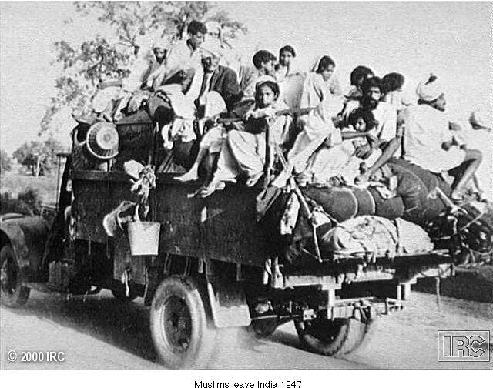
Muslims leave India, 1947

Slide 5
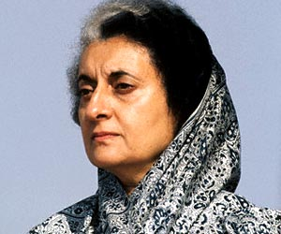
Indian Democracy
Indian democracy flourishes under Indira Ghandi (1917-1984)
  -Daughter of Nehru,
  -“Green Revolution” increases agricultural yields
  -Repressive policies to slow population growth, including forced sterilization
Assassinated by Sikh bodyguards after attack on Sikh extremists in Amritsar, 1984

Slide 6
Southeast Asia
Vietnam

Slide 7
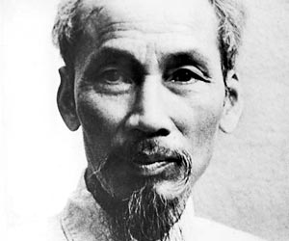
Vietnam
French reassert control after WW II
Ho Chi Minh (1890-1969), Communist leader mounts guerilla war, defeats France in 1954
Vietnam divided at 17th parallel
Civil war between north (Communist) and south
President Lyndon Johnson (1908-1973) begins increasing US involvement

Slide 8
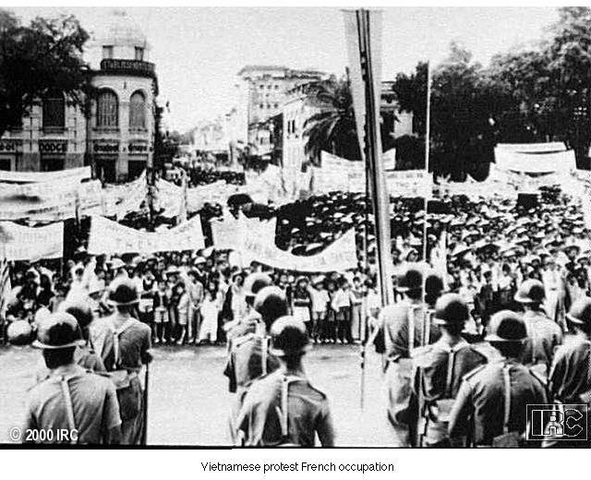
Vietnamese Protest French Occupation

Slide 9
Middle East

Slide 10
Independence Movements
Arab states controlled by Britain and France as mandates after WWI
Had little difficulty getting independence
  Iraq in 1947
  Israel in 1948
  Palestine in 1948
U.S. and Soviets involvement
  oil

Slide 11
Palestine
ruled as mandate by Britain
GB proclaims support for Jewish “homeland” in Palestine (Balfour Declaration, 1917)
Growing Jewish immigration from Europe from 1880s
Arab protests in 1920s and 1930s
Formation of pan-Arab nationalism by surrounding Arab nations

Slide 12
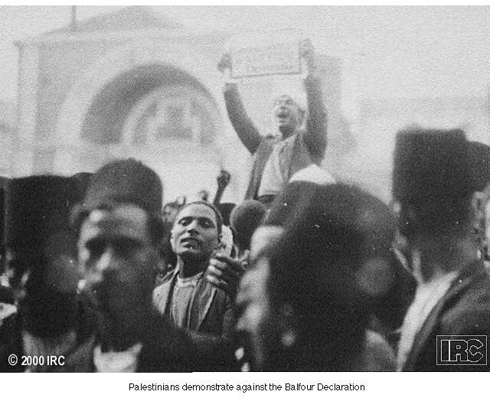
Demonstration against the Balfour Declaration

Slide 13
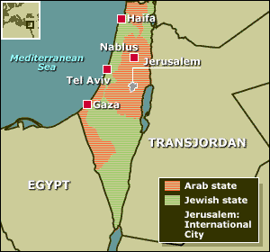
Creation of Israel
Jewish, Arab pressure drives British to hand Palestine over to United Nations for a resolution
Partition Plan of 1947 divides Palestine into seven regions: 3 Jewish, 3 Arab, Jerusalem internationalized
May 1948 Jews declare independence of State of Israel
Arab states invade, Israel successfully defends itself

Slide 14
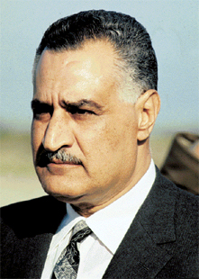
The Six-Day War
Gamal Abdel Nasser (Egypt, 1918-1970) takes leadership position in Arab world
Attempts to block Suez traffic, conflict with Israel
Threatens invasion of Israel in 1967, Israel launches hugely successful pre-emptive strike
  Conquers Gaza Strip and West Bank, status unresolved

Slide 15
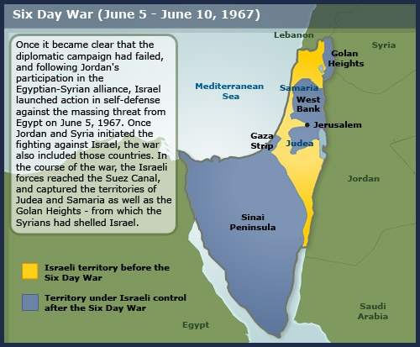

Slide 16
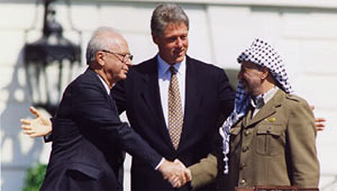
Peace in the Middle East
Israeli Prime Minister Yitzhak Rabin (1922-1995) signs peace accord with Palestinian Liberation Organization chairman Yasser Arafat (1929-2004)
  Yitzhak Rabin assassinated by Jewish extremist
Creation of Palestine Authority in West Bank and Gaza

Slide 17
Islamism
Muslims increasingly regard America in negative terms, move towards radicalism
Jihad: holy war
CIA support of Iranian Shah Mohammed Reza Pahlavi (1919-1980), overthrown in Iranian Revolution of 1979
  Led by Ayatollah Ruhollah Khomeini
  Held U.S. diplomats hostage for two years
  Shut down US facilities, confiscated economic ventures

Slide 18
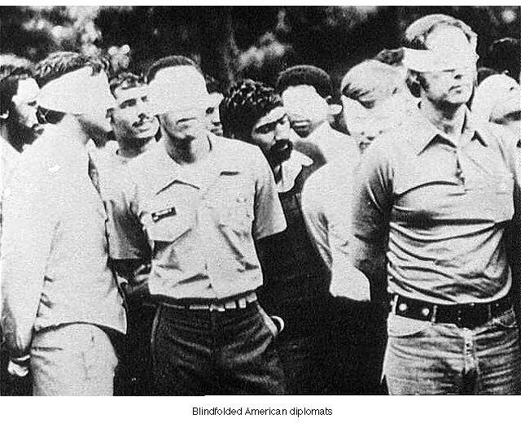
Blindfolded U.S. Diplomats during Iranian Hostage Crisis

Slide 19
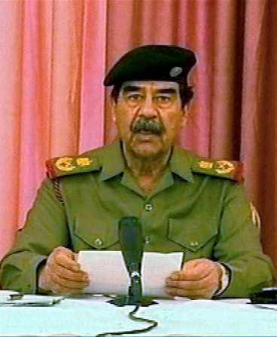
War and Iraq
Saddam Hussein uses oil, US support to build huge military machine
Attacks Iran, 1980
Massive destruction, ends in stalemate
Gulf War (1991)
  US-led coalition drives him out, imposes sanctions
President George W. Bush (1946- ) attacks in search of WMD in 2003, occupies Iraq

Slide 20
Africa

Slide 21
Decolonization in Africa
19th century “scramble for Africa”
Legacy of colonial competition
Internal divisions
  Tribal
  Ethnic
  Linguistic
  religious

Slide 22
Négritude: “Blackness”
Influence of “black is beautiful” from USA
Revolt against white colonial values, reaffirmation of African civilization
Connection with socialism, Communism
Geopolitical implications for Western nations

Slide 23
Algeria
France abandons most territories
  13 colonies in 1960
But determination to retain Algeria
  Longer period of French colonization
  2 million French citizens born or settled in Algeria by WWII
Independence movement begins in 1954
FLN
  Uses guerilla warfare
  Wins independence in 1962
  100,000 Algerians died
Victory supported violent methods for indpendence

Slide 24
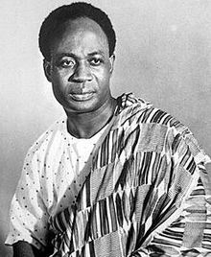
Ghana
Controlled by Britain
Independence movement led by Kwame Nkrumah
  Became figure for pan-African unity
Helped spark other African movements

Slide 25
Organization of African Unity (OAU)
Formed 1962
Declared boundaries permanent
  Despite arbitrary nature, necessary to forestall conflicts
Promotion of Pan-Africanism
Failure to prevent ethnic strife, even Nkrumah deposed 1966

Slide 26
South Africa
Apartheid (1948)
  87% of territory for whites
  Division of Africans into tribes, settlement in “homelands”
Release of Nelson Mandela, 1990
Negotiation of end of white minority rule
Relatively calm transition to democratic society

Slide 27
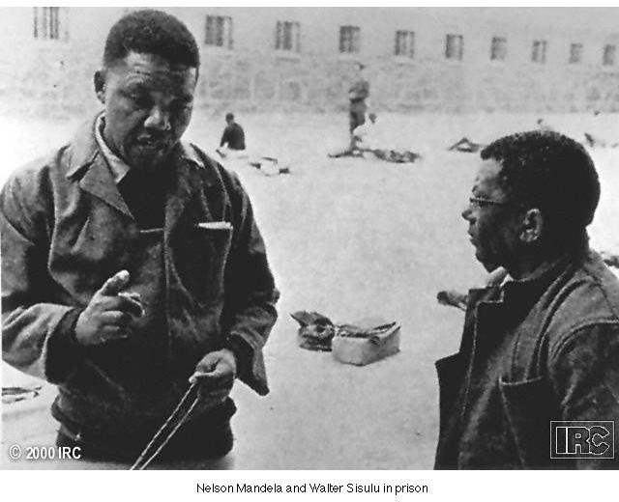
Nelson Mandela

Slide 28
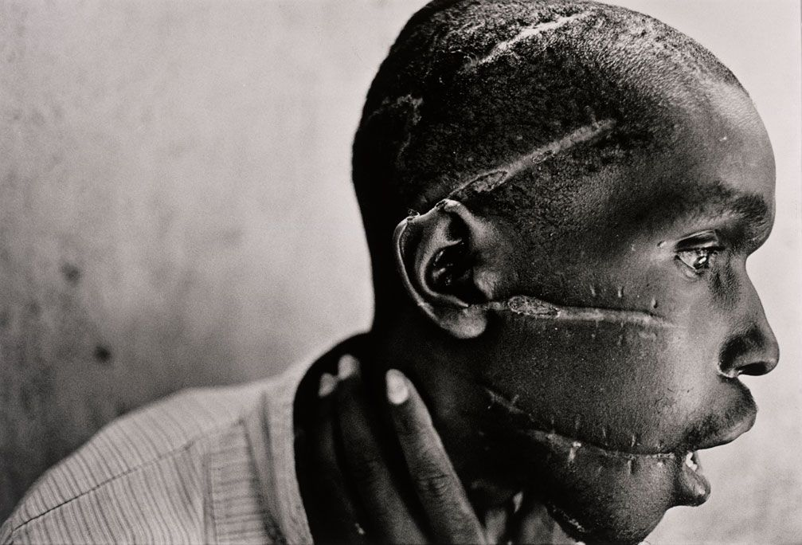
Rwanda
Characteristic of ethnic divisions in African societies
Civil war in 1994 after moderate President killed
Hutu extremists vs. Tutsis, Hutu moderates
Nearly one million killed

