Slide 1
The Emergence of the Early Modern World
1450 to 1750

Slide 2
Recovery and Transformation of Europe
Rebirth of Learning and Religion

Slide 3
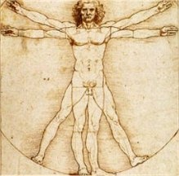
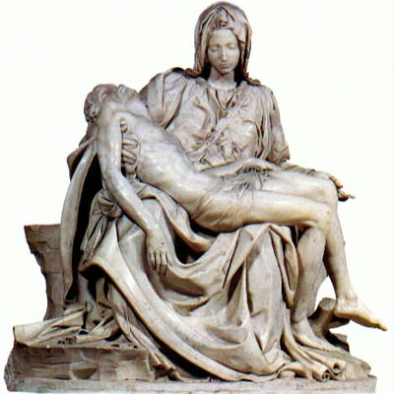
Culture: Renaissance
Begin in Italian city-states
Wealthy merchants
Medici family
Greek & Roman influence
Artists searched for realistic depictions of humans
Humanism
Focus on humanity
Baldassare Castiglione
Wrote The Courtier
Taught how to become a ‘Renaissance Man’

Slide 4
Spread of Renaissance
Spread to Northern Europe
Flourished in England during the Elizabethan Age
William Shakespeare
Printing press
Invented by Johann Gutenberg

Slide 5
Reforming the Church

Slide 6
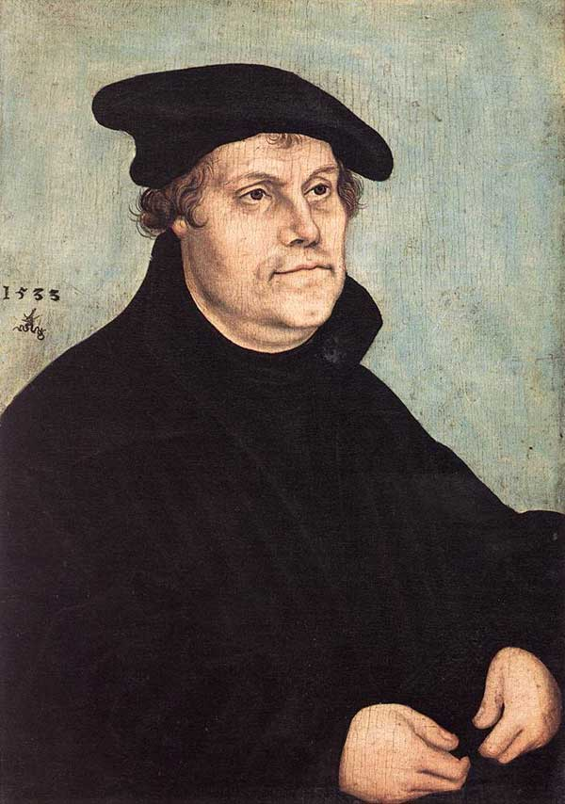
Challenging the Church The Protestant Reformation
Dissention had existed through Wycliffe and Huss
Martin Luther (1483-1546) attacks Roman Catholic church practices, 1517
Notably indulgences
Translate Bible into vernacular
Ninety-Five Theses
1520s-1530s dissent spread throughout Central Europe

Slide 7
Reform outside Germany
Switzerland
France
John Calvin (1509-1564) codifies Protestant teachings while in exile in Geneva
Scotland, Netherlands, Hungary also experience reform movements

Slide 8
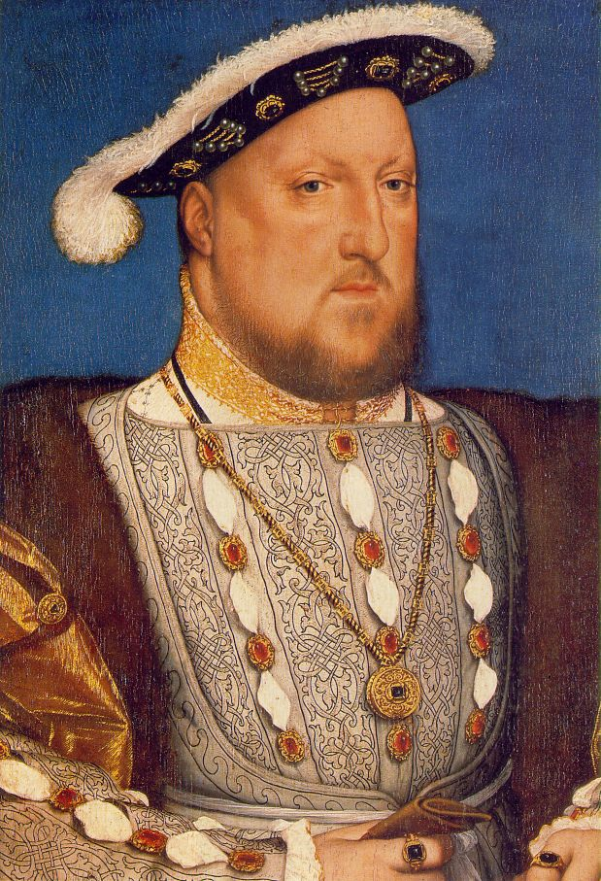
England’s Reform
King Henry VIII (r. 1509-1547) has conflict with Pope over requested divorce
England forms its own church by 1560
Known as Anglican Church

Slide 9
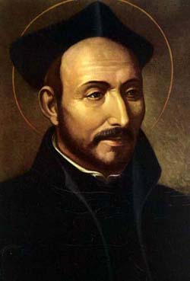
The Catholic Reformation
Council of Trent (1545-1563)
Reform theology
Society of Jesus
St. Ignatius Loyola (1491-1556)
Rigorous religious and secular education
Effective missionaries

Slide 10
Conflict
Witch hunts
Most prominent in regions of tension between Catholics and Protestants
belief in devil and human assistants
16th-17th centuries
110,000 people put on trial, some 60,000 put to death
Vast majority females, usually single, widowed

Slide 11
Conflict
Minor Conflicts
Protestants and Roman Catholics fight in France (1562-1598)
1588 Philip II of Spain attacks England to force return to Catholicism
Netherlands rebel against Spain, gain independence by 1610
Thirty Years War (1618-1645)
All of Europe becomes involved in conflict
Principal battleground: Germany
Approximately 1/3 of German population killed
Ended with Peace of Westphalia

Slide 12
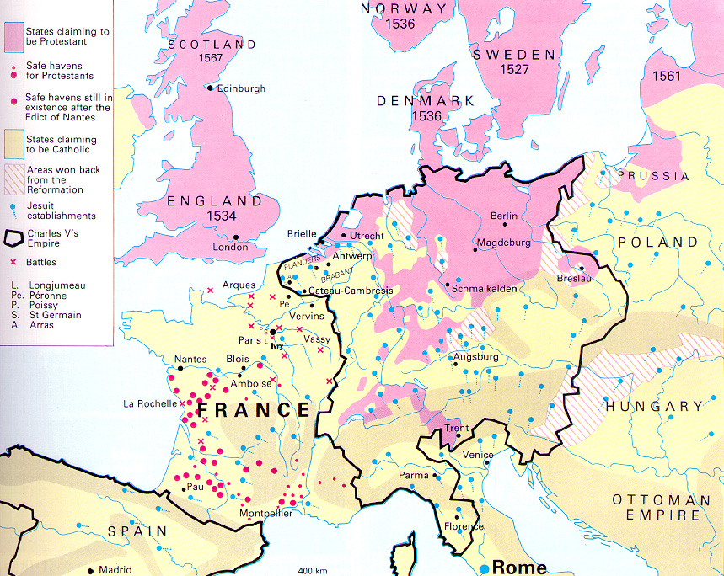

Slide 13
Statebuilding in Europe

Slide 14
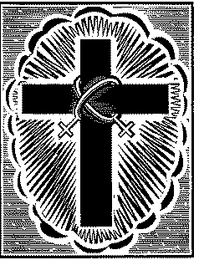
Statebuilding: Europe
Italian city-states, Spain, France and England began to enhance their power
taxation
standing armies except England
Adoption of religion
Balance of power
military development

Slide 15
16th century Europe

Slide 16
Statebuilding: Holy Roman Empire
Confederation
Emperor is figure head who is appointed
Emperor Charles V (r. 1519-1556) attempts to revive HRE
Protestant vs. Catholic Tension
Peace of Westphalia established sovereignty in each state

Slide 17
Europe after the Peace of Westphalia, 1648.

Slide 18
Statebuilding: England
Tudor Dynasty
innovative new tax revenues
Build up of English navy
Religious conflict
Separates from Catholic Church
Defeats and destroys Spanish Armada
Political conflict: crown vs. parliament

Slide 19
Statebuilding: The Dutch Republic
King Philip II of Spain controls Netherlands
Large-scale rebellion follows Calvinist suppression by Philip
New Government
Based on a representative parliamentary system
Will be a global economic giant

Slide 20
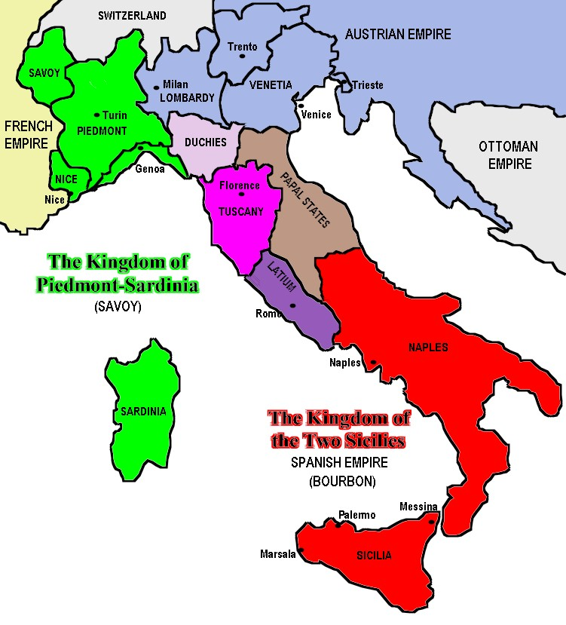
Statebuilding: Italian States
Political unit: City-states
Italy well-developed as economic power through trade, manufacturing, banking

Slide 21
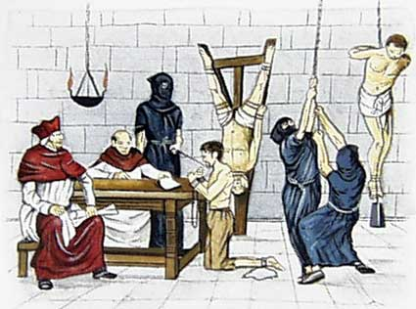
Statebuilding: Unification of Spain
marriage of Ferdinand of Aragon &Isabel of Castile
powerful standing army
Religious conflict: Spanish Inquisition
search for those ‘who oppose the church’
Spread to western hemisphere

Slide 22
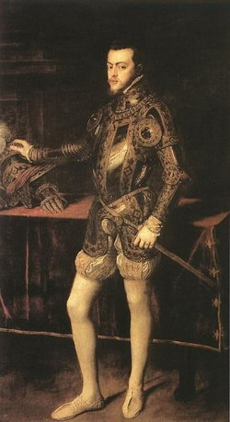
Statebuilding: Spain
Philip II (1556 – 1598)
Most powerful monarch ever in Spain
Global power
Will marry Mary Tudor of England
Madrid becomes capital
Intolerant of religious minorities
Spanish Armada is defeated by England

Slide 23
Statebuilding: Russia
Early influence from Byzantines
Paid tribute to Mongols until 1450s
Moscow princes began building a powerful state
Moscow “Third Rome”
Romanov Dynasty
(1613-1917)

Slide 24
Statebuilding: Russia
Peter I “the Great,”
r. 1682-1725
Worked to modernize on western European model
Developed
modern army and navy
reformed bureaucracy
Placed church under state control
Imposes heavy tax
Built new capital at St. Petersburg
Expanded territory

Slide 25
Beginning of Absolutism
Divine Right of Kings
Power comes from God
Provides justification for monarchs to assume all power
Works in theory, not reality

Slide 26
Statebuilding: France
Cardinal Richelieu (under King Louis XIII, 1624-1642)
Built bureaucracy to bolster royal power base
Louis XIV 1643-1715
Versailles
Crown vs. nobility
Builds standing army
Fights costly wars
Implemented new taxes
Repeals Edict of Nantes

Slide 27
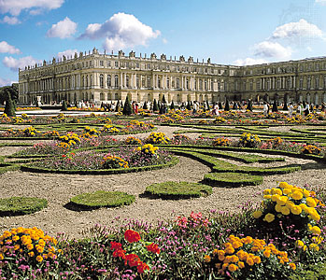
Versailles

Slide 28
Urbanization

Slide 29
Exploration, Transoceanic Encounters and Global Connections

Slide 30
Beginnings
Revival of trade networks from the plague
China & western Europe were most active
Motives
China
Diplomacy and reputation
Europeans
Roman Catholicism and profit

Slide 31
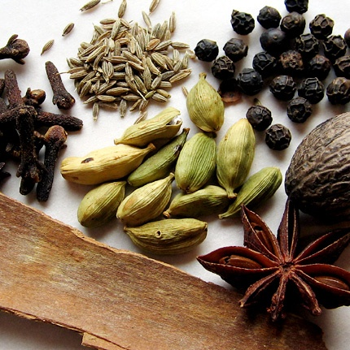
Economics: The Lure of Trade
Maritime routes to Asia
Spices, silk, porcelain
Silk roads more dangerous since spread of Bubonic Plague
Indian pepper, Chinese ginger essential to diet of European wealthy classes
African gold, ivory, slaves

Slide 32
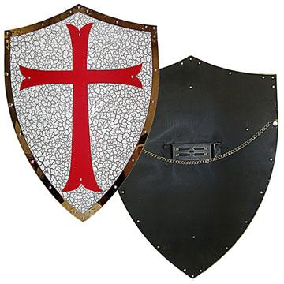
Culture: Missionary Efforts
missionaries sent to India, central Asia and China
violent efforts with
Crusades
Spanish Reconquista

Slide 33
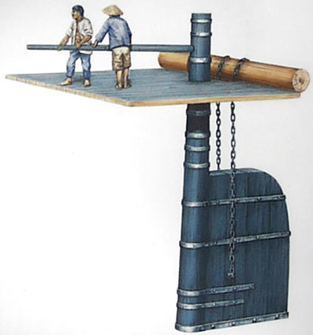
The Technology of Exploration
Chinese rudder introduced in 12th century
Square sails replaced by triangular lateen sales
Able to determine latitude and direction
Knowledge of winds, currents

Slide 34
Wind and current patterns in the world's oceans

Slide 35
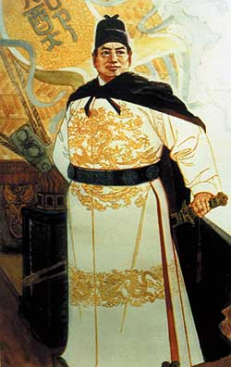
China
Zheng He
Financed by Ming Dynasty
Fleet consisted of 317 ships, 28,000 troops
Seven Expeditions from 1405-33
Traveled all the way to Africa
Brought back envoys to pay respects to Ming
Ming abruptly end finance and support of expeditions

Slide 36
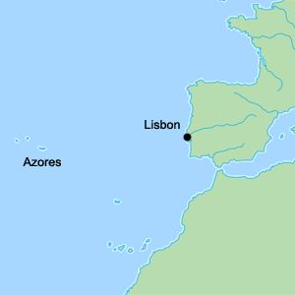
Europe: Portugal
Long tradition of mariners
Prince Henry the Navigator (1394-1460)
Promoted exploration
Island colonization
Began planting sugarcane
traded with Africa, guns, textiles, manufactured goods for gold and slaves
Others follow
Dias, de Gama

Slide 37
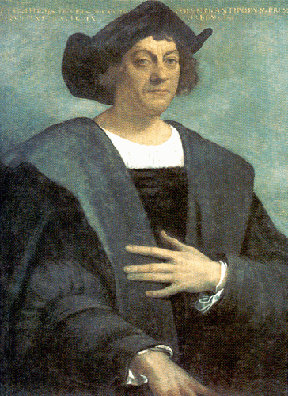
Europe: Spain
Christopher Columbus (1451-1506)
Sell west for Asian markets
Estimated Japan approximately 2,500 miles west of Canaries
actually 10,000 miles
Fernando and Isabel of Spain underwrite voyage
Discovers Bahamas, Cuba
Other nations will follow his lead

Slide 38
European exploration

Slide 39
Europe: Additional Voyages
Balboa finds Pacific Ocean while searching for gold in Panama, 1513
Ferdinand Magellan (1480-1521) circumnavigate globe in 1519-1522
Spanish build Philippines-Mexico trade route
English, Russians look for Northwest Passage to Asia
Sir Frances Drake (England) explores west coast of North America
Vitus Bering (Russia) sails through Bering Strait
James Cook (England) explores southern Pacific

Slide 40
European Exploration: Magellan and Cook

Slide 41
Statebuilding: Commerical Empires
Portuguese first to set up trading posts
charge taxes; declines at end of 1500s
English concentrate on Indian trade
Establish East India Company (EIC)
First corporation in world
Dutch in Cape Town, SE Asia
Establish United East India Company (VOC)
Claim Indonesia for spice trade
Spain claims the Philippines
Chinese silk sent to Mexico

Slide 42
European trading posts in Euraisa

Slide 43
Portuguese Brazil
1494 Treaty of Tordesillas divides entire (non-Christian) world between Spain and Portugal
Portugal claims Brazil
Exploited for sugarcane production

Slide 44
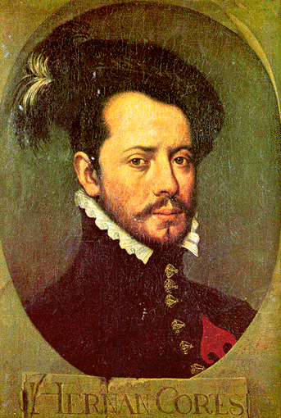
Spanish Mexico
Conquistador
Hernán Cortés
Conquers Aztecs
Smallpox destroys besieged Tenochtitlan

Slide 45
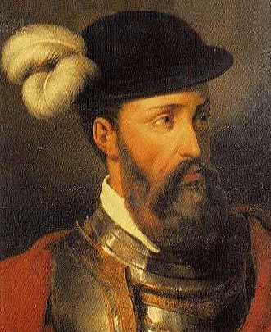
Spanish Peru
Francisco Pizarro
Calls conference of warring Inca rulers, massacres them all
Captures king, empire falls

Slide 46
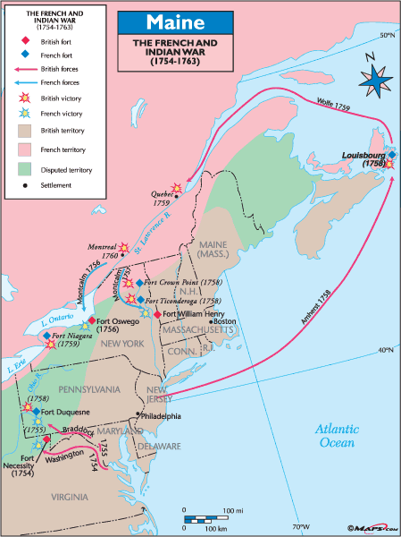
Statebuilding: Commerical Competition
Commercial rivalries between empires at sea
Global conflict erupts
The Seven Years’ War (1756-1763)
British emerge victorious, establish primacy in India, Canada

Slide 47
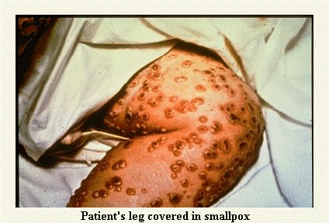
The Columbian Exchange
Global diffusion:
Plants and crops
Animals
Human populations
Disease
Smallpox
Permanently alters human geography, natural environment

Slide 49
Population Growth and Urbanization
Rapidly growing population due to Columbian Exchange
Improved nutrition
Role of the potato
Replaces bread as staple of diet
Epidemic disease becomes insignificant for overall population

Slide 50
World Population Growth, 1500-1800 CE

Slide 51
The Triangular Trade
1. European manufactured goods (especially firearms) sent to Africa
2. African slaves purchased and sent to Americas
3. Cash crops purchased in Americas and returned to Europe

Slide 52
Triangular Trade

Slide 53
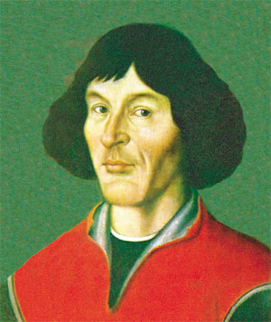
Intellectual: Europe’s Scientific Revolution
Existing Theory
geocentric universe
Reliance on Greek scholar Ptolemy
Reinforced by Christianity and the Church
Nicholas Copernicus
breaks theory
Notion of moving Earth challenges Christian doctrine

Slide 54
New Worlds The Americas and Oceania

Slide 55
North America
Spanish have forts
Permanent colonies in North America
France: Nova Scotia (1604), Quebec (1608)
England: Jamestown (1607)
Massachusetts Bay Colony (1630)
Netherlands: New Amsterdam (1623)

Slide 56
The Spanish Caribbean
Columbus uses Hispaniola (Haiti-Dominican Republic) as base for trading with natives
Encomienda: Forced labor plantation system
Smallpox epidemics begin 1518
Native society disappears by middle of 16th century
new interest in exploiting Caribbean for sugarcane production
Requires massive importation of slaves

Slide 57
Colonial Administration
Spanish
Royal backing and oversight
based in New Spain (Mexico) and New Castile (Peru)
Viceroys rule
French & English
private merchants invest heavily in expansion of colonies
settler-cultivators displaced natives from traditional lands
self-government

Slide 58
North America: Indigenous Peoples
Europeans arrive seeking land
negotiate treaties
traded fur pelts for wool blankets, iron pots, firearms, alcohol
Military conflict
Natives also devastated by epidemic disease

Slide 59
North American Populations

Slide 60
The Social Hierarchy
South America
migrants are primarily men
mixed societies formed
People of Spanish and native parentage (‘’mestizo”)
Descendants of Spaniards and African slaves (“mulattoes”)
Descendants of African slaves and natives (“zambos”)
North America
Higher ratio of French, English female migrants
Some mix
(metis)
Higher social stigma attached to relationships with natives, African slaves

Slide 61
Society: Slavery in Portugal Brazil
Sugarcane to molasses & sugar
Portuguese rely on imported African slaves
Large-scale importing of slaves begins 1580s

Slide 62
Society: Slavery in North America
African slaves replace European indentured laborers
Products made through slave labor
Rum
Tobacco (Virginia)
Rice
Indigo
Cotton
Products sent to European Markets

Slide 63
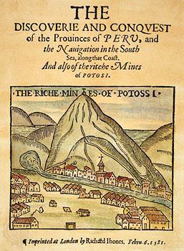
Economics: Mining
Spanish Empire
Silver relatively plentiful
Potosi
Major resource of income for Spanish crown
Stimulated world economy
American silver traveled across Atlanta and Pacific

Slide 64
Manila galleon route 1500-1800

Slide 65
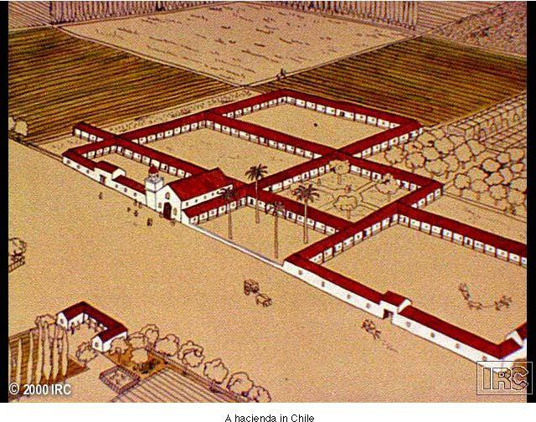
Economics: Farming
Haciendas produced products of European origin like Wheat, grapes, meat
Encomienda system of utilizing native labor

Slide 66
Africa and the Atlantic World

Slide 67
The Triangular Trade
1. European manufactured goods (especially firearms) sent to Africa
2. African slaves purchased and sent to Americas
3. Cash crops purchased in Americas and returned to Europe

Slide 68
Triangular Trade

Slide 69
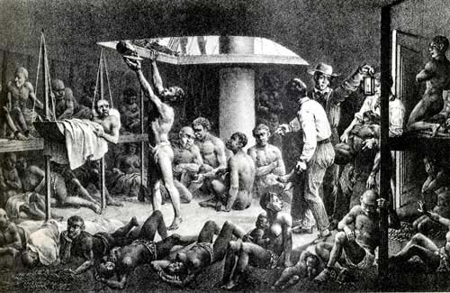

Slide 70
Statebuilding: Africa
West Africa
Kingdoms of Ghana, Mali, and Songhai
major gold trader
effective army, navy
East Africa: Swahili
South Africa
Dutch build Cape Town in 1652
British colonies develop

Slide 71
The King of Kongo and European Ambassadors

Slide 72
Foundations of the Slave Trade
Distinct from Asian & European slavery
Wealth defined by human labor potential
Expansion with Arab traders
European arrival increases demand
Portugal and Spain lead way

Slide 73
African Slave Export per Year

Slide 74
Effects of Slave trade
Africa
population expands due to importation of American crops
depleted regional populations
Introduction of firearms increases violence of pre-existing conflicts
Americas
Most slaves in tropical and subtropical regions
Plantations heavily dependent on slave labor; sugar
Racial divisions of labor due to interracial relationships
Culture blends with European and American cultures
Creole languages

Slide 75
Destinations of African Slaves

Slide 76
East Asia
Tradition and Change

Slide 77
Statebuilding
Restoration of Chinese Dynasties
Hongwu establishes Ming dynasty (1368-1644)
Means ‘brilliant’
Eliminated Mongol influence
Reestablished Confucian educational and civil service systems

Slide 78
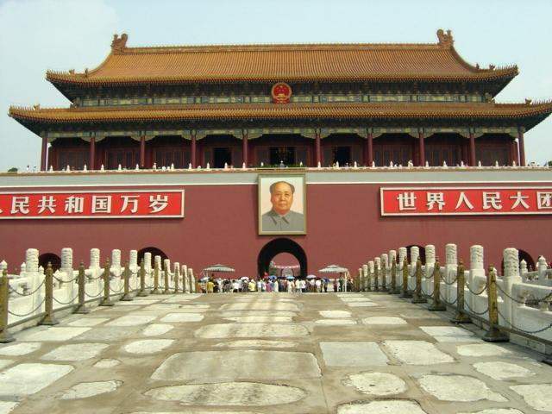
Statebuilding: Ming Dynasty
Ming, Qing Emperors considered quasi-divine
Clothing designs, name characters forbidden to rest of population

Slide 79
Ming China, 1368-1644

Slide 80
Statebuilding
Decline/Collapse of Ming
Famine, peasant rebellions in early 17th century
Manchu fighters enter from the north and retake city
Manchus refuse to allow reestablishment of Ming dynasty
Establish Qing (“Pure”) Dynasty

Slide 81
Qing (Manchu) Empire, 1644-1911

Slide 82
Statebuilding
The Qing Dynasty (1644-1911)
Manchus originally pastoral nomads
Establishes control over Korea, Mongolia, China
War with Ming loyalists to 1680
Support from many Chinese
Manchus forbid
Intermarriage with Chinese
study of Manchu language by Chinese

Slide 83
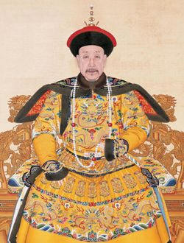
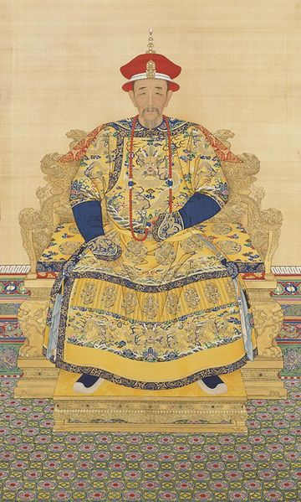
Statebuilding
Kangxi (r.1661-1722)
Military conquests: island of Taiwan, Tibet, central Asia
Qianlong (r. 1736-1795)
expands territory

Slide 84
Tokugawa Japan, 1600-1867

Slide 85
The Unification of Japan
Shoguns rule Japan, 12th-16th centuries
Large landholders with private armies
Constant civil war
Tokugawa Ieyasu (r. 1600-1616) establishes military government
Establishes Tokugawa dynasty (1600-1867)
daimyos forced to spend every other year at court
Controlled marriage, socializing of daimyo families
Beginning 1630s, shoguns restrict foreign relations
Travel, import of books forbidden

Slide 86
Society
Privileged Classes
Scholar-bureaucrats, gentry
Distinctive clothing with ranks
Immunity from some legal proceedings, taxes, labor service
Working classes
Peasants, artisans/workers, merchants
Confucian doctrine gives greatest status to peasants
Merchant activity not actively supported
Lower classes
Military, beggars, slaves

Slide 87
Society
Patriarchal Society
Filial piety
Males receive preferential status
Female Infanticide common
Widows strongly encouraged not to remarry
Chaste widows honored with ceremonial arches
Men control divorce
Grounds: from infidelity to talking too much

Slide 88
Chinese Population Growth

Slide 89
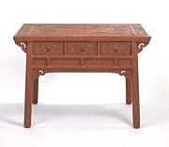
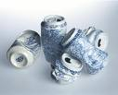
Economics
Exports: Silk, porcelain, tea, lacquerware
Chinese in turn import relatively little
silver bullion, crops introduced in 17th century
Maize, sweet potatoes, peanuts
from Americas
Ming dynasty abandons large-scale maritime trade plans
Extensive dealings with Dutch VOC

Slide 90
Technology
Tang and Song dynasties (7th-13th centuries)
world leader in technology
Ming and Qing dynasties
suppressed technological advancement, fearing social instability would result

Slide 91
Culture
Christianity
Jesuits return under Matteo Ricci (1552-1610),
Brought prisms, harpsichords, clocks
Christian absolutism difficult for Chinese to accept
Emperor Kangxi bans Christian preaching in China
Version of Confucian thought promoted by Zhu Xi (1130-1200 CE)
Confucian morality with Buddhist logic

Slide 92
Japan

Slide 93
Neo-Confucianism in Japan
Chinese cultural influence extends through Tokugawa period
Chinese language essential to curriculum
Zhu Xi and Neo-Confucianism remains popular
“Native Learning” also popular in 18th century
Includes folk traditions, Shinto

Slide 94
Christianity in Japan
Jesuit Francis Xavier in Japan, 1549
Government backlash
Fear of foreign intrusion
Confucians, Buddhists resent Christian absolutism
Anti-Christian campaign 1587-1639 restricts Christianity
Sometimes by crucifixion

Slide 95
The Islamic Empires

Slide 96
The Islamic empires, 1500-1800

Slide 97
The Ottoman Empire (1289-1923)
Osman is founder
ghazi
devshirme
Often grew up to be exceptionally loyal Janissaries

Slide 98
Mehmed II r. 1451-1481
Capture of Constantinople, 1453
Renamed Istanbul
Transformation from warrior sultan to emperor of “two lands” (Europe, Asia) and “two seas” (Black Sea, Mediterranean)

Slide 99
Suleyman the Magnificent r. 1520-1566
Expanded into Asia, Europe
Besieged Vienna, 1529
Develops Ottomans into naval power

Slide 100
The Safavid Empire
Ismail is founder
Becomes Shah
proclaims official religion of realm Twelver Shiism
Twelve infallible imams after Muhammad
12th imam in hiding, ready to take power
Empire called Safavid, after Safi al-Din (1252-1334), Sufi thinker

Slide 101
Shiite Pilgrims at Karbala

Slide 102
The Mughal Empire
Zahir al-Din Muhammad (Babur the Tiger) is founder
Gunpowder technology gives Babur advantage
Founds Mughal (Persian for Mongol) dynasty
Expands through most of Indian subcontinent

Slide 103
Akbar (r. 1556-1605)
Created centralized government
Destroyed Hindu kingdom of Vijayanagar
Religiously tolerant
“Divine Faith”
Syncretic form of Islam and Hinduism

Slide 104
Aurangzeb (r. 1659-1707)
Expands Mughal empire into southern India
Hostile to Hinduism
Demolished Hindu temples, replaced with mosques
Tax on Hindus to encourage conversion

Slide 105
Similarities
“gunpowder empires” based on military conquest
dependent on piety and military prowess of the ruler
Close relations with Sufism, ghazi tradition
Steppe Turkish traditions
Intra-family conflicts over power
1595 Sultan massacres 19 brothers (some infants), 15 expectant women (strangulation with silk)

Slide 106
Agriculture and Trade
American crops effect less dramatic change in Muslim empires
Coffee, tobacco important
feared lax morality of coffee houses
Population growth also reflects territorial additions and losses
Trade with English East India Company, French East India Company, and Dutch VOC

Slide 107
Religious Diversity
Ottoman Empire: Christians, Jews
Safavid Empire: Zoroastrians, Jews, Christians
Mughal Empire: Hindus, Jains, Zoroastrians, Christians, Sikhs

Slide 108
Status of Religious Minorities
Non-Muslim protected people
Payment of special tax: jizya
Freedom of worship, property, legal affairs
Ottoman communities: millet system of self-administration
Mughal rule: Muslims supreme, but work in tandem with Hindus

Slide 109
Capital Cities
Istanbul cultural capital of Ottoman empire,
Hagia Sofia church as Aya Sofiya mosque
Ishafan major Persian city
Akbar builds magnificent Fatehpur Sikri
Taj Mahal example of Mughal architecture

Slide 110
Ottoman Decline
Interior Decline
Ottoman princes become lazy through luxury
Religious tensions
Janissaries mutiny
Military, administrative network expensive
Exterior
Foreign trade controlled by Europeans
Unproductive wars
European military technology advances faster

Slide 111
Cultural Conservatism
Islamic empires less interested in outside world, Europeans very interested in Islamic World
Swiftly fell behind in technological development
But printing of books in Turkish and Arabic forbidden until 1729
Handwritten books preferred, but weak levels of dissemination

