Slide 1
Revolutions and National States in the Atlantic World

Slide 2
Overall Causes
Questioning of old beliefs
“divine right of kings”
Scientific Revolution
Philosophes begin to use reason and scientific approach to advocate their beliefs

Slide 3
Enlightenment Thinkers
John Locke
rulers derive power from consent of ruled
Natural rights: life, liberty, property
Voltaire
“erase the infamy:” Roman Catholic Church
Freedom of speech and religion
Jean-Jacques Rousseau
equality of all individuals, regardless of class
The Social Contract (1762), argues that society is collectively the sovereign and free

Slide 4
Revolution in the North America

Slide 5
French and Indian War 1754-1763
France vs. Great Britain
Conflict over land and colonies
Extension of Seven Years’ War (1756-1763)
Global war
British victory ensured global dominance, North American prosperity
Last of the Mohicans
Notes:
Washington in French and Indian War

Slide 6
French and Indian War

Slide 7
Increased Taxation in 1760s
Financial burden of Seven Years’ War (French and Indian War)
Tax burden falls to the colonies
Sugar Act (1764)
Stamp Act (1765)
Quartering Act (1765) (Housing British Troops)
Tea Act (1773)
Enforcement of taxes was issue
Britain (parent) vs. Colonies (child)

Slide 8
The Declaration of Independence
British products boycotted, officials attacked
Protests
Boston Tea Party (1773
“no taxation without representation”-Patrick Henry
July 4, 1776, Declaration of Independence
Influence of Locke: retention of individual rights, sovereignty based on consent of the ruled

Slide 9
Revolutionary War
Colonies:
Logistic advantage
Popular support
Supported by French
George Washington provides imaginative military leadership
Britain:
Strong central government
Navy, army
Loyalist population

Slide 10
The American Revolution

Slide 11
Building an Independent State
War-weariness sets in by 1780
British forces surrounded at Yorktown, VA
British surrender in October 1781
Treaty of Paris, 1783
Recognition of American independence
1787 Constitution drafted
Political and legal equality for men of property

Slide 12
French Revolution

Slide 13
Causes
Social
aristocracy held power over king, middle class wanted change from the aristocracy, peasants wanted change from feudal past
Political
king could not raise taxes nor pay bills
Economics
huge unemployment, poor harvests, bread riots
serious financial problems in France
War debts, 1780s
50% of tax revenues to war debts
25% of tax revenues to standing military

Slide 14
The Estates General
Three Estates
1st Estate: Roman Catholic Clergy
100,000
2nd Estate: Nobles
400,000
3rd Estate: Everyone else
24,000,000 serfs, free peasants, urban residents
Estates General founded 1303, had not met since 1614
One vote per estate

Slide 15
1789
May
Protest of nobility forces King Louis to call Estates General for new taxes
3rd Estate demands greater social change
June
3rd Estate then secedes; Renamed “National Assembly”
July
Bastille, Great Fear, bread riots by women
August
Declaration of Rights of Man and of Citizen

Slide 16
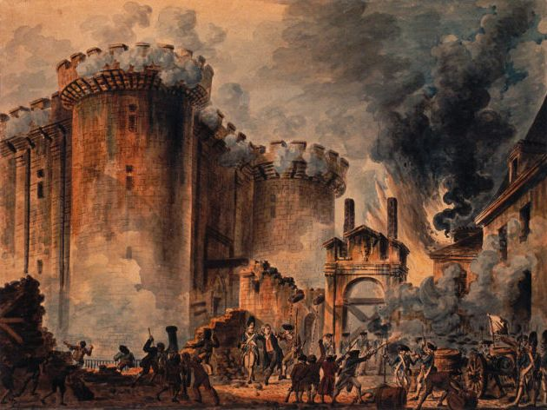
Attacking the Bastille

Slide 17
Radical Revolution
National Assembly abolishes old social order
Seizes church lands, redefines clergy as civilians
New constitution retains king, but subject to the new Legislative Assembly
elected by universal male suffrage
Divisions with Legislative Assembly: radicals, moderates, and conservatives
Radicals gain control; abolish new government
Guillotine invented to execute domestic enemies
1793: King Louis and Queen Marie Antoinette

Slide 18
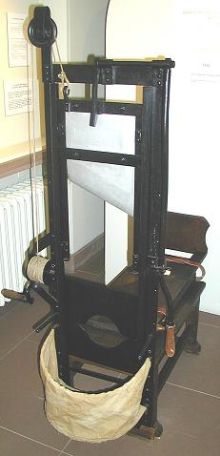
Reign of Terror & Civil War
Formation of Committee of Public Safety
Dominated by Robespierre
Persecuted traitors, counterrevolutionaries
Used the guillotine
Civil War
200,000 estimated dead

Slide 19
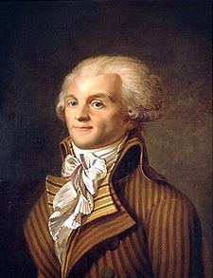
Maximilien Robespierre
“the Incorruptible,” leader of Committee of Public Safety”
Dominated Convention, 1793-1794
Churches closed, priests forced to marry
Promoted “Cult of Reason” as secular alternative to Christianity
Executed 40,000; imprisoned 300,000

Slide 20
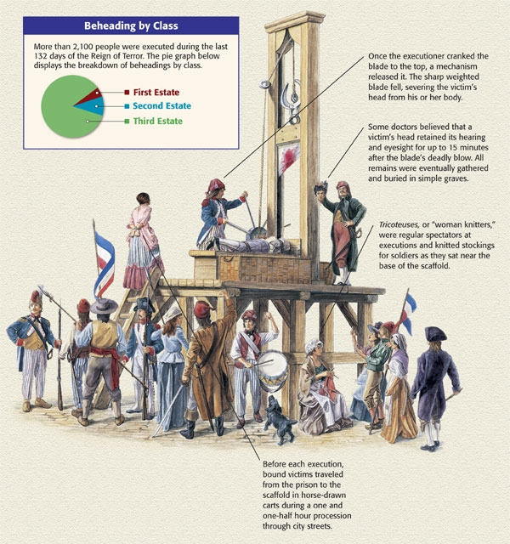

Slide 21
The Directory (1795-1799)
Revolutionary enemies of the Jacobins
1794 Robespierre arrested, sent to guillotine
Men of property take power in the form of the Directory
Unable to solve economic and military problems of revolutionary France

Slide 22
Napoleon Bonaparte
Army officer under King Louis XIV, general at 24
Brilliant military strategist
Joins Directory 1799, then overthrew it
Imposed new constitution,
named self “Consul for life” in 1802

Slide 23
Napoleonic France
Concludes agreement with Pope
France retains church lands, but pay salaries to clergy
Freedom of religion, also for Protestants, Jews
1804 -Napoleonic Code
Patriarchal authority
Became model for many civil codes
State above individual
Tight control on newspapers, use of secret police
Eventually declared himself Emperor

Slide 24
Napoleon’s Empire
Conquered much of Europe
Disastrous invasion of Russia in 1812
Burned Moscow
“General Winter”
Coalition forced Napoleon to abdicate, 1814
Exiled to Island of Elba, escaped
Defeated at Waterloo, exiled to St. Helena, dies 1821

Slide 25
Napoleon’s Empire in 1812

Slide 26
Revolution in the Caribbean

Slide 27
The Revolution in Haiti
Only successful slave revolt in Americas
Island of Hispaniola
Spanish colony Santo Domingo in east (now Dominican Republic)
French colony of Saint-Domingue in west (now Haiti)
Rich Caribbean colony
Sugar, coffee, cotton
Almost 1/3 of France’s foreign trade

Slide 28
Haitian Society
1790:
40,000 white French settlers
Dominated social structure
30,000 gens de couleur (free people of color, i.e. mixed-race, freed slaves)
Holders of small plots
500,000 black slaves of African descent
High mortality rate, many flee to mountains
“Maroons,” escaped slaves

Slide 29
Causes and Issues
Inspired by American and French revolutions
1789 white settlers demand self-rule, but with no equality for gens de couleur
1791 civil war breaks out
Slave revolt
French, British, Spanish forces attempt to intervene
French troops driven out, 1804 Haiti declares independence

Slide 30
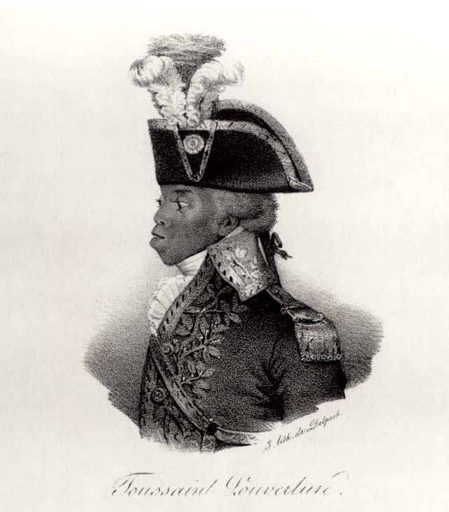
François-Dominique Toussaint (1744-1803)
Renames self Louverture (“the opening”), 1791
Descendant of slaves, freed in 1776
Helped his original owners escape, then joined rebel forces
Built army of 20,000
1801 promulgated constitution of equality
1802 arrested by Napoleon’s, died in jail

Slide 31
Revolution in Latin America

Slide 32
Latin American Society
30,000 peninsulares, colonial officials from Iberian peninsula
3.5 million creoles
Privileged class, but grievances with peninsulares
1810-1825 led movements for creole-dominated republics
10 million others
Mestizoes, mulattoes, zambos, African slaves

Slide 33
Causes of the Revolutions
Internal
Power centered with peninsulars
Spanish control of Latin American economies
Divided social classes
External
Ideals of Enlightenment
American and French Revolutions
Napoleon’s conquest of Spain

Slide 34
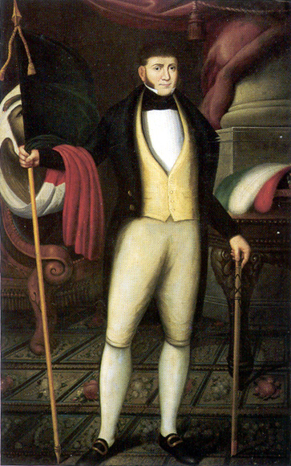
Mexican Independence
Napoleon’s invasion of Spain and Portugal (1807) weakens royal authority in colonies
Priest Miguel de Hidalgo (1753-1811)
Creole general Augustin de Iturbide (1783-1824) declares independence in 1821
Installs self as Emperor, deposed in 1823, republic established

Slide 35
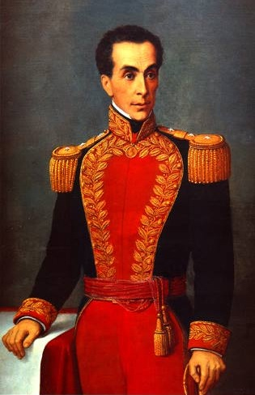
Simón Bolívar (1783-1830)
Led independence movement in South America
influenced by Enlightenment, George Washington
Forms alliances with many creole leaders
José de San Martín (Argentina, 1778-1842)
Bernardo O’Higgins (Chile, 1778-1842)
Spanish rule destroyed in South America by 1825

Slide 36
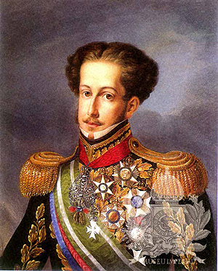
Brazilian Independence
Napoleon’s invasion sends Portuguese royal court to exile in Rio de Janeiro
1821 King returns, son Pedro left behind as regent
Pedro negotiates with creoles, declares independence of Brazil
Becomes Emperor Pedro I (r. 1822-1844)
Social structure remains largely intact
Only peaceful revolution in Americas

Slide 37
Latin America in 1830

Slide 38
Challenges to Growth
Obstacles
Geography
Exposure to authoritarian rule
Weak checks and balances
Church and gov’t were closely tied
Divided social classes

Slide 39
Effects of Revolutions in the Atlantic World

Slide 40
Emergence of Ideologies
Conservativism
Edmund Burke (England, 1729-1797)
Disavowed rapid revolutionary change
Favored slow evolution of society
Liberalism
Viewed conservatives as defenders of illegitimate status quo
Manage, not stifle, social change
John Stuart Mill (England, 1806-1873)

Slide 41
The End of the Slave Trade
Campaign to end slavery begins in 18th century
Olaudah Equiano (1745-1797)
Gains momentum after American, French and Haitian revolutions
William Wilberforce (England, 1759-1833), philanthropist, succeeds in having Parliament outlaw slave trade, 1807
illegal trade continued globally until 1867

Slide 42
End of the Institution of Slavery
Haiti: slavery ends with revolution
Mexico slavery abolished 1829
Partially to stop U.S. development of slave-based cotton industry in Mexico
1833 Britain abolishes slavery
Other states follow, but offer freedom without equality
Property requirements, literacy tests, etc. block voting

Slide 43
Enlightenment Ideals and Women
Enlightenment thinkers remained conservative regarding women’s rights
Rousseau argues women should receive education to prepare for lives as wives and mothers
Mary Astell (England, 1666-1731) argues that women essentially born into slavery
Mary Wollstonecraft (England, 1759-1797)
A Vindication of the Rights of Woman (1792)

Slide 44
Women and Revolution
Women active in all phases of French revolution
Women storm Versailles in 1789, demands for food
Republican Revolutionary Women patrol streets of Paris with firearms
Yet hold few official positions of authority
Revolution grants equality in education, property, legalized divorce
Yet women not allowed to vote, major task of 19th century
Elizabeth Cady Stanton (U.S., 1815-1902)

Slide 45
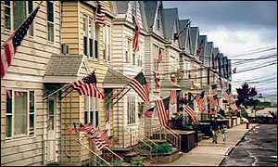
Rise of Nationalism

Slide 46
Nations and Nationalism
“Nation” a type of community, especially prominent in 19th century
Distinct from clan, religious, regional identities
Usually based on shared language, customs, values, historical experience
Sometimes common religion

Slide 47
Types of Nationalism
Statebuilding
Russia
Seperation
Movement for political independence of nation from other authorities
Greece
Austrian Empire
Unification
Italy
Germany

Slide 48
Nationalism and Anti-Semitism
Nationalist ideologies distrustful of indigenous minorities
Pogroms
violent attacks on Jewish communities in Russian Empire beginning 1881
Anti-Semitism rallying cry of many European nationalists

Slide 49
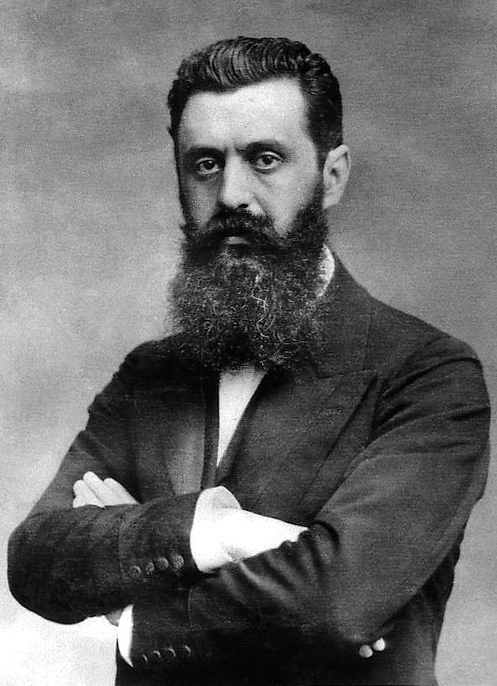
Zionism
Theodor Herzl (Austria, 1860-1904) journalist at Dreyfus trial
Worked to create refuge for Jews by re-establishing Jewish state in Palestine
Zion synonymous with Jerusalem
1897 convened first World Zionist Congress

Slide 50
1815 – Congress of Vienna Issue: How to restore the Old Regime?
Questions and issues to consider:
- who will rule
- boundaries
-balance of power
-opposing nationalism
Questions and issues that are addressed:
-establishment of absolute monarchs, old families
-boundaries of 1792
-speech and press limited
-set up alliance system

Slide 51
National Rebellions
Greeks in Balkan peninsula seek independence from Ottoman Turks, 1821
Gained sympathy from European powers
Greece achieves independence in 1830
Revolutions of 1848
Rebels take Vienna, Metternich resigns and flees
But rebellions put down by 1849

Slide 52
Unification of German States 1871
Causes
French Revolution – 1792
Social uprisings
Otto von Bismarck
War with Austria and France
Outcome
A German Empire
Immediate European Power

Slide 53
Unification of Italian States - 1871
Causes
Rise of nationalism under Napoleon
Division of Italian states via Congress of Vienna
Influence of Mazzini, Cavour, and Garibaldi
Outcome
Creation of nation-state
Constitutional Monarch
King of Italy – Victor Emmauel

Slide 54
Unification of Germany and Italy

