Slide 1
HOW TO STUDY AND PREPARE FOR AP WORLD HISTORY

Slide 2
WHAT TYPE OF LEARNER AM I?
Visual
Kinesthetic
Auditory
One size DOES NOT fit all people!!

Slide 3
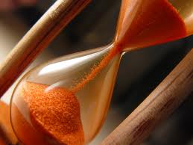
TIME
In class
90 minutes
Outside of class
60-90 minutes on average per day

Slide 4
TIME EFFICIENCY
What are you doing in class?
Paying attention
Taking notes
Asking questions
What are you doing at home?
Cornell notes
Study
Do you have a plan?

Slide 5
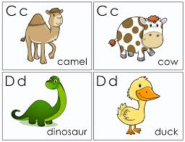
STUDY METHOD
Technology or hand written
Framework and foundation
Variation in categorizing information and processing information
DO NOT DRILL!!
Study partners and groups
Create your own quizzes
Are you using the available resources?
Continue to review past material and apply our skills
Periodization
Compare/contrast
Change/Continuity
Themes

Slide 6
LOCATION OF STUDYING/READING
Somewhat quiet
Comfortable
Lighting
Smell
Noise
Effective

Slide 7
SCHEDULE
Do i study at the same time and place everyday?
If not, why do i change?
Am i managing my schedule in the best possible way?
Do i stay ahead of the class calendar?

