Slide 1
The Building of Global Empires

Slide 2
Imperialism
Control of a country or territory by a stronger more dominant country
‘Imperialism’ is in popular discourse by 1880s
Starts with Military
Later on…
Economic
Cultural

Slide 3
Motives
Geopolitical
Strategic locations (Egypt, Panama)
Economic
European capitalism
Religious
Christian missions (French in Indochina)
Demographic
criminal populations (Australia)
Dissident populations

Slide 4
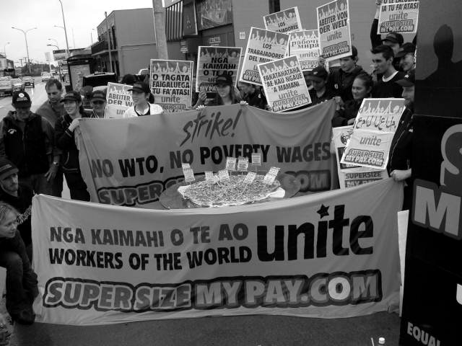
Motives
Socialists critics of Industrialization
Imperial policies distract proletariat from domestic politics
Cecil Rhodes - ‘imperialism alternative to civil war’
European leaders sought to inspire the people
Patriotism
Expansion provides benefits for all

Slide 5
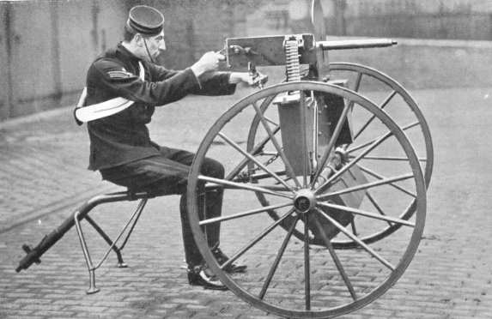
Technological
Transportation
Steamships
Railroads
Infrastructure
Suez Canal (1859-1869)
Panama Canal (1904-1914)
Weaponry
Early-1800s: muzzle-loading muskets
1 round per minute
Mid-1800s: rifles
1880s: Maxim gun
11 rounds per second

Slide 6
Technology: Communications
Travel
1830 - A response to a letter from Britain to India… 2 years
After Suez Canal…2 weeks
Telegraph
1870s, development of submarine cables
Britain-India correspondence…5 hours

Slide 7
Statebuilding: Imperialism and Management Methods
Colony
Somaliland in East Africa by French
Protectorate
Nigeria by Britain
Sphere of influence
Liberia by United States
Economic imperialism
Dole Fruit Company in Hawaii
Indirect control
British colonies
U.S. colonies
Direct control
French colonies

Slide 8
Imperialism in Asia

Slide 9
Europe in Asia
How it happened…
Involuntary trade led to…
western influence led to…
direct rule and occupation
Nationalism and dissent grew from conquered nations
India: Sepoy Rebellion
China: Boxer Rebellion

Slide 10
Imperialism in Asia, ca. 1914

Slide 11
India: ‘The Jewel of the British Crown’
British East India Company begins involvement in India
Monopoly on India trade
Original permission from Mughal emperors
Conquest begins
Protection of economic interests through political conquest
Use of British and Indian troops, called sepoys

Slide 12
Society: Sepoy Rebellion, 1857-58
Causes
Cartridges in wax paper greased with animal fat
Problem for Hindus: beef
Problem for Muslims: pork
Sepoys capture garrison
60 soldiers, 180 civilian males massacred (after surrender)
later, 375 women & children murdered
Effect
Britain establishes direct rule
Called the ‘Raj’
Established civil service staffed by English
Growing distrust by Indians and British, nationalism
Indian National Congress
Muslim League

Slide 13
Statebuilding: Early Japanese Expansion
Resentment over Unequal Treaties of 1860s
1876 Japanese purchase warships from Britain, dominate Korea
Sino-Japanese War (1894-1895) over Korea results in Japanese victory
Russo-Japanese War (1904-1905) also ends in Japanese victory

Slide 14
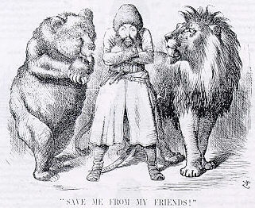
Imperialism in Central Asia
The “Great Game”: Russian vs. British intrigue in Afghanistan
Preparation for imperialist war
Russian Revolution of 1917 forestalled war
Political Cartoon

Slide 15
Imperialism in Southeast Asia
Spanish and the U.S: Philippines
Dutch: Indonesia (Dutch East Indies)
British establish presence from 1820s
Burma (Myanmar) 1820s, established colonial authority by 1880s
estbalish Singapore for trade in Strait of Melaka
Base of British colonization in Malaysia, 1870s-1880s
French: Vietnam, Cambodia, Laos, 1859-1893
Encouraged conversion to Christianity

Slide 16
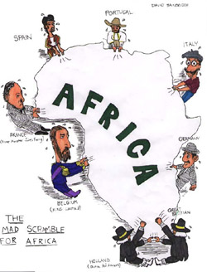
Imperialism in Africa

Slide 17
Europe in Africa
How it happened…
slave trade –15th century
Scientific Interest and exploration – 18th century
European exploration of rivers
(Nile, Niger, Congo, Zambesi)
Information on interior of Africa from adventurers

Slide 18
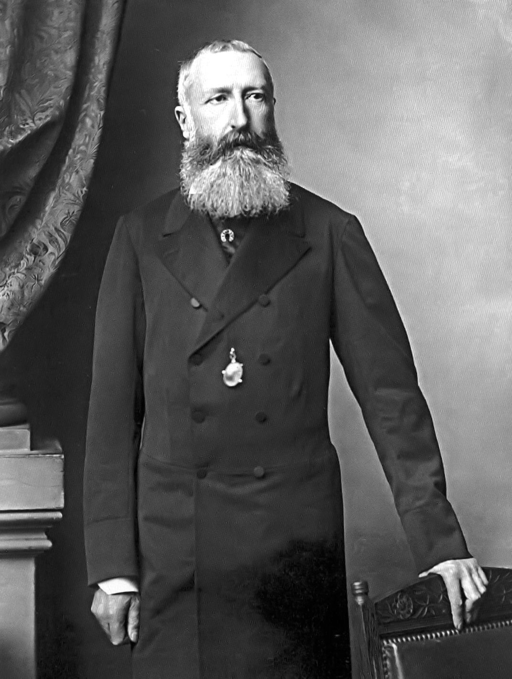
King Leopold II
King Leopold II of Belgium starts Congo Free State
Free trade to all European countries
Takes some land for personal colonization
Brutal and harsh conditions
renamed Belgian Congo

Slide 19
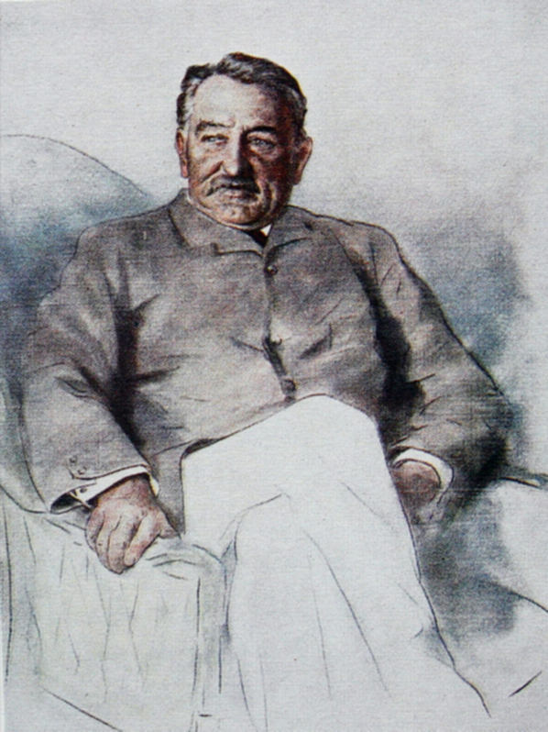
Cecil Rhodes
British Imperialist - Founds DeBeers diamond Co.
Acquires tracts of land in modern day Zimbabwe and Zambia
Country called Rhodesia
Rhodes Scholarship funded from his estate

Slide 20
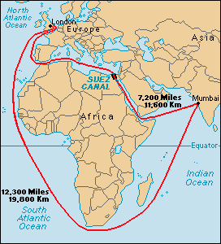
The Scramble for Africa (1875-1900)
French, Portuguese, Belgians, and English competing for “the dark continent”
Britain establishes strong presence in Egypt, Rhodesia
Suez Canal
Rhodesian gold, diamonds

Slide 21
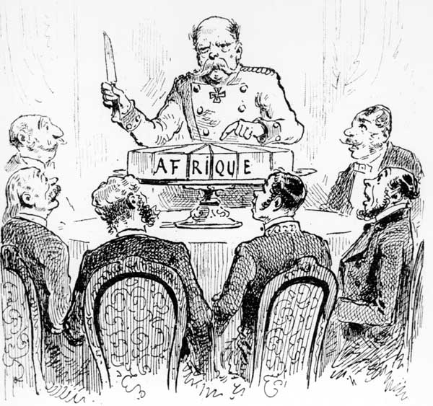
The Berlin Conference (1884-1885)
Fourteen European states, United States
No African states present
Rules of colonization: any European state can take “unoccupied” territory after informing other European powers

Slide 22
South African (Boer) War 1899-1902
Dutch East India Co. establishes Cape Town (1652)
Farmers (Boers) follow to settle territory, later called Afrikaners
Competition and conflict with indigenous people
British takeover in 1806
Dutch establish independent Republics
British tolerate this until gold is discovered
White-white conflict, black soldiers and laborers

Slide 23
Imperialism in Africa, ca. 1914

Slide 24
Imperialism in Oceania

Slide 25
European Imperialism in Australia
How it happens for Australia…
English use as a penal colony from 1788
Voluntary migrants follow
gold discovered 1851
Smallpox, measles devastate natives

Slide 26
Imperialism in Oceania, ca. 1914

Slide 27
European and Native Population in Australia and New Zealand

Slide 28
Europe in the Pacific Islands
How it happens…
Whalers seeking ports
Missionaries seeking souls
British, French, German, American powers carve up Pacific islands

Slide 29
Imperialism in the Americas

Slide 30
US Imperialism
How it happens…
Monroe Doctrine - warns Europeans not to engage in imperialism in western hemisphere (1823)
1867 purchased Alaska from Russia
1875 established protectorate over Hawai’i
Locals overthrow queen in 1893, persuade US to acquire islands in 1898

Slide 31
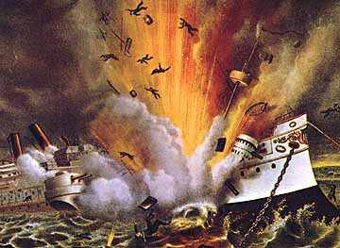
Spanish-American War (1898-1899)
US declares war in Spain after battleship Maine sunk in Havana harbor, 1898
Takes possession of Cuba, Puerto Rico, Guam, Philippines
US intervenes in other Caribbean, Central American lands
occupies Dominican Republic, Nicaragua, Honduras, Haiti
Nationalist feelings:
Filipinos revolt

Slide 32
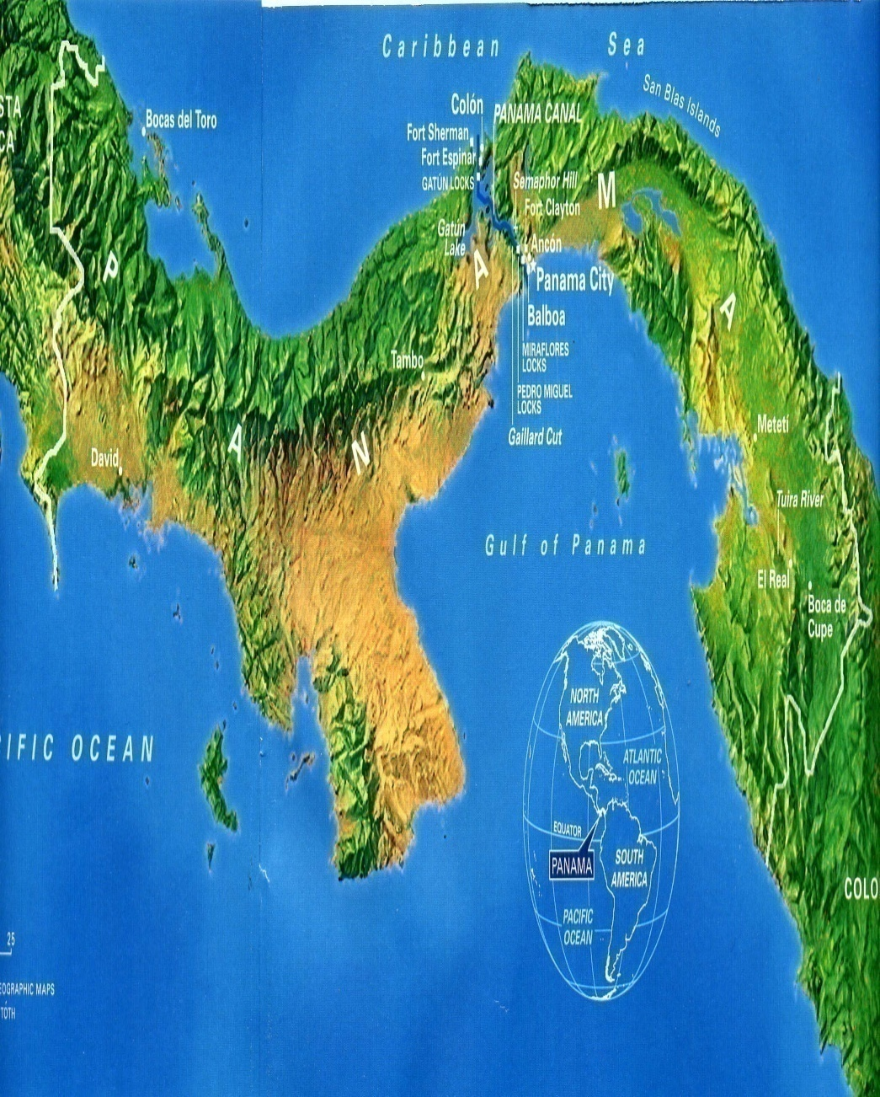
The Panama Canal
President Theodore Roosevelt supports insurrection against Colombia (1903)
Rebels win, establish state of Panama
U.S. gains territory to build canal
Roosevelt Corollary of Monroe Doctrine
U.S. right to intervene in domestic affairs of other nations if U.S. investments threatened

Slide 33
The Aftermath of Imperialism

Slide 34
Economic Effects
Exploitation of natural resources
No emphasis on industrialization
dependency on imperial power for manufactured goods made from native raw product
Indian cotton
Introduction of new crops
Tea in Ceylon

Slide 35
Social Effect
Scientific Racism
Based on Charles Darwin’s theory of ‘survival of the fittest’

Slide 36
Migration

Slide 37
Labor Migrations
Europeans move to temperate lands
Work as free cultivators, industrial laborers
32 million to the US 1800-1914
Africans, Asians, and Pacific islanders move to tropical/subtropical lands
Indentured laborers, manual laborers
2.5 million between 1820 and 1914

Slide 38
Nationalism and Anticolonial Movements
Colonial reformers call for self-government
Influence of Enlightenment thought, often obtained in European universities
Examples
Indian National Congress formed 1885
1906 joins with All-India Muslim League

Slide 39
Overall Effects
Exploitation of people and resources
Impoverished nations
Greater economic success with both countries
Destruction of traditional cultures
Spread of Western culture
Rise of Nationalism

Slide 40
Imperialist Statistics
****
Great Britain
France
Belgium
Netherlands
Germany (1914)
Country area in Square Miles
94,000
212,600
11,800
13,200
210,000
Population
45,500,100
42,000,000
8,300,000
8.500,000
67,500,000
Area of Colonies
13,100,000
4,300,000
940,000
790,000
1,100,000
Population of Colonies
470,000,000
65,000,000
13,000,000
66,000,000
13,000,000

