Slide 1
The Americas in the Age of Independence

Slide 2
United States

Slide 3
Statebuilding
Expansion
Britain cedes territories from war
Louisiana Territory, 1803
Settlers move west
“Manifest Destiny” to occupy all lands between Atlantic and Pacific
Native peoples resist incursions
U.S. Indian Removal Act of 1830 drives natives into Oklahoma

Slide 4
Statebuilding

Slide 5
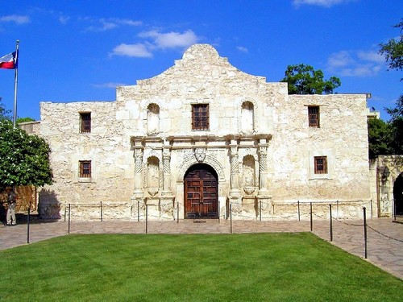
Statebuilding: The Mexican-American War (1845-1848)
Mexico then included Texas, California, New Mexico
Texas declares independence from Mexico in 1836
Small armed conflict begins
Treaty of Guadalupe Hidalgo (1848)

Slide 6
Culture
U.S. population most culturally diverse in the hemisphere
Indigenous peoples subject to formal policy of forced assimilation
Dawes Security Act of 1887
Native children taken from families, enrolled in white-controlled boarding schools

Slide 7
Economy
Tobacco cultivation on decline, but cotton industry spurs new demand for slaves
U.S. slave population rises from 500,000 in 1770 to 2 million in 1820
British capital spurs vast expansion of U.S. industry
Massive expansion of rail system:
200,000 miles by 1900, coast to coast
Necessitates division of U.S. into four time zones
Massive expansion of economy, 1870-1900
Electrification
Trade unions

Slide 8
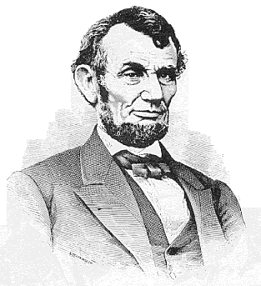
Statebuilding: The U.S. Civil War (1861-1865)
Abraham Lincoln elected president, 1860
Committed to anti-slavery position
principle of states’ rights vs. federal authority
11 southern states withdraw from Union
Southern agriculture vs. northern manufacturing
Emancipation Proclamation
Battle of Gettysburg
North wins

Slide 9
Society: Freed Slaves
social discrimination remains
forced social program of Reconstruction (1867-1877)
Land-poor freed slaves forced to work as sharecroppers
Violence and intimidation continue

Slide 10
Canada

Slide 11
The Dominion of Canada 19th century

Slide 12
Statebuilding: Independence
Regional divisions
British and French Canadians
Concessions made to large French population from British
British North America Act of 1867
Dominion of Canada
Joins Quebec, Ontario, Nova Scotia and New Brunswick

Slide 13
Economy
British investments in Canada
Policy of economic development
The National Policy
Attract migrants, promote start-up industries, build transportation infrastructure
U.S. also invests in Canada, owning 30% of Canadian industry by 1918

Slide 14
Latin America

Slide 15
Latin America in the nineteenth century

Slide 16
Statebuilding: Mexico
reform government of Benito Juárez (1806-1872)
Attempts to limit power of military, church
forced out of Mexico City
Europeans intervene to collect investments
French, Mexican forces clash in 1862

Slide 17
Statebuilding: The Mexican Revolution (1911-1920)
overthrow dictator Porfirio Díaz (1830-1915)
Revolutionary leaders
Emiliano Zapata
Francisco (Pancho) Villa
Popular, but unable to take major cities
Mexican Constitution of 1917

Slide 18
Economics
Limited foreign investment
Small size of Latin American markets
Foreign interest in exploiting raw materials
Limited industrializing initiatives foiled by government corruption

Slide 19
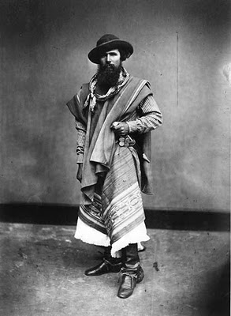
Culture
Complex social structure, based on racial background
Europeans, natives, African slaves, and combinations thereof
Increasing migration in from Asia
Symbol of rural culture: the gaucho cowboy

