Slide 1
Making of Industrial Society

Slide 2
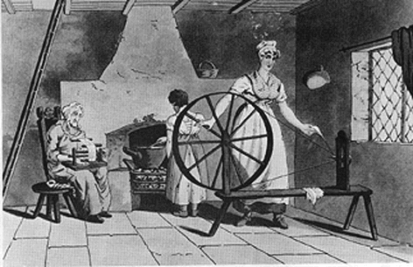
Pre – Industrial Revolution
Life expectancy – 40 yrs
25% of Europeans lived in towns
Most families farmed, members had a role
Domestic system, system of labor used inside the home

Slide 3
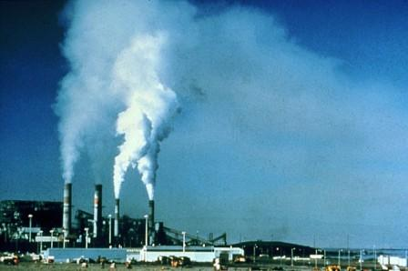
The Beginning
Industrialization:
The process that transformed agrarian and handicrafted-centered economies into economies distinguished by industry and machine manufacture

Slide 4
Leading into the Industrial Revolution…
Invention of the steam engine
James Watt

Slide 5
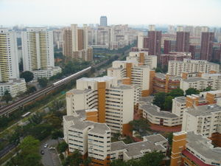
Population growth
Vital Revolution
Improvement of diet
conquering of disease
Led to the growth of cities -urbanization

Slide 6
Genesis of the Industrial Revolution
Great Britain, 1780s
Followed agricultural revolution
Food surplus
Population increase
Market demand
Labor supply
Geographic luck
Natural resources

Slide 7
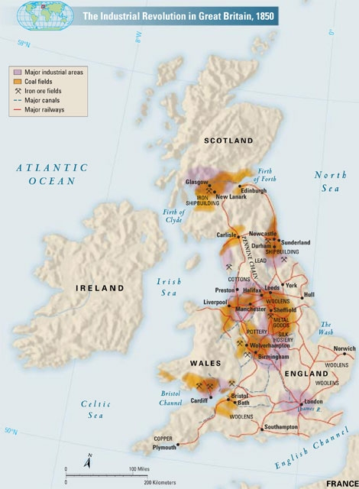

Slide 8
British Advantages
Strong banking tradition
Natural resources
Coal, iron ore
Ease of transportation
Size of country
River and canal system
Exports to imperial colonies
Starts with textiles

Slide 9
How it Works

Slide 10
The Factory System
Early modern Europe adopts domestic system
Rising prices cause factories to replace both guilds and domestic system
Machines too large, expensive for home use
Large buildings could house specialized laborers
Urbanization guarantees supply of cheap unskilled labor
Creation of the assembly line and the division of labor

Slide 11
The Growth of Factories
Massive machinery
Supply of labor
Assembly line
Transport of raw materials, finished product to markets
Concentration in newly built factory towns on rivers

Slide 12
King Cotton
1760: 2.5 million pounds of raw cotton imported
1787: 22 million
1840: 360 million

Slide 13
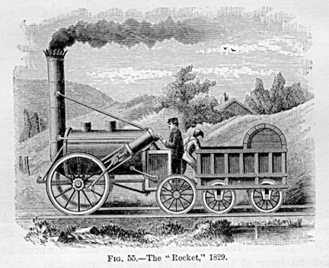
Rail Transport
1804 first steam-powered locomotive called the Rocket
Ripple effect on industrialization
Engineering and architecture

Slide 14
Mass Production
Eli Whitney
invents cotton gin
interchangeable parts for firearms
“the American system”
Applied to wide variety of machines
Henry Ford, 1913, develops assembly line approach
Complete automobile chassis every 93 minutes
Previously: 728 minutes

Slide 15
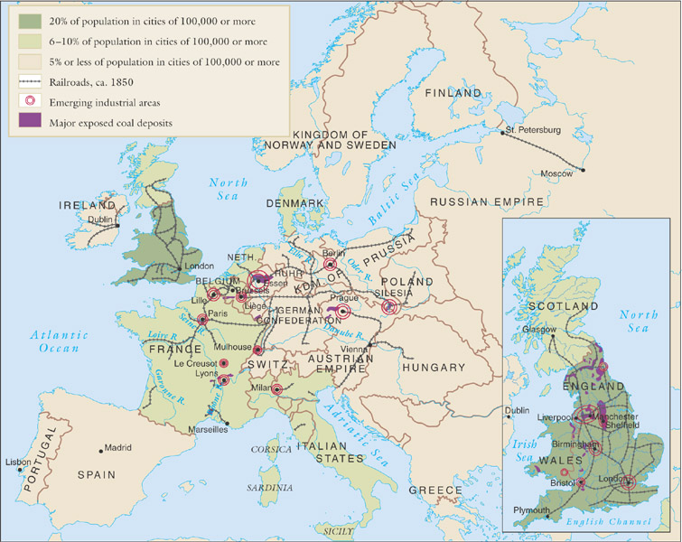
Industrial Europe ca. 1850

Slide 16
Social Effects of Industrialization

Slide 17
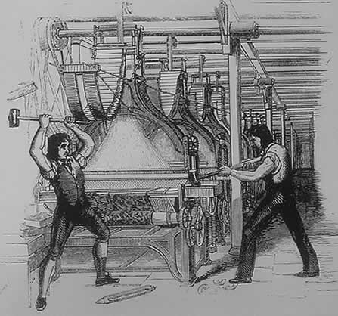
Poor working conditions
Dramatic shift from rural work rhythms
Six days a week, fourteen hours a day
Immediate supervision, punishments
“Luddite” Protest against machines 1811-1816

Slide 18
Society
Industrialization created a new wealth and new class
Based on wealth, not land
New bourgeoisie was most influential group, but small
The biggest group was the proletariat or working class

Slide 19
Society: The Urban Life
Saw biggest impact from industrialization
Issues that arose:
fast growth
Housing
sanitation
Paris led the way in urban renewal

Slide 20
Society: Development of Slums
London: 1 million in 1800, 2.4 million in 1850
Wealthy classes move out to suburbs
Industrial slum areas develop in city centers
Open gutters as sewage systems

Slide 21
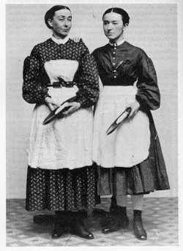
Economics and Society: Age, Gender, Family
Sexual division of labor
Textile mills favored women, children due to lower wages
Treatment of women was bad, children worse
Lowell Mill Girls

Slide 22
Distribution of Wealth in the U.S.

Slide 23
Economy: Big Business
Large factories require start-up capital
Formation of corporations
Britain and France lay foundations for the modern corporation
Private business owned by hundreds, thousands or even millions of stockholders

Slide 24
Economy: Monopolies, Trusts, and Cartels
Large corporations form blocs to drive out competition, keep prices high
John D. Rockefeller
German IG Farben controls 90% of chemical production
Governments often slow to control monopolies

Slide 25
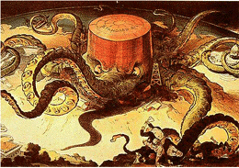
Political Cartoon depicting Standard Oil

Slide 26
Human/Environment Interaction

Slide 27
Population Growth (millions)

Slide 28
The Demographic Transition
Industrialization results in marked decline of both fertility and mortality
Costs of living increase in industrial societies
From rural to urban
Urbanization proceeds dramatically
1800: only 20% of Britons live in towns with population over 10,000
1900: 75% of Britons live in urban environments

Slide 29
Transcontinental Migrations
rapid population growth drives Europeans to Americas
50 million cross Atlantic
Britons to avoid urban slums
Irish to avoid potato famines of 1840s
Jews to abandon Tsarist persecution
United States favored destination

Slide 30
Ideas and Theories

Slide 31
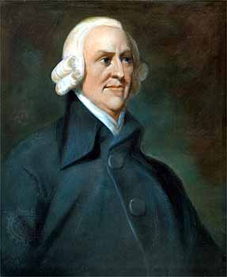
Economics: Laissez-Faire
Economic policy of business with little or no interference from government
Adam Smith argued in laws of economics
Self-interest
Competition
Supply and demand
Set foundation for capitalism

Slide 32
The Socialist Challenge
‘Socialism’ first used in context of Utopian Socialists Charles Fourier (1772-1837) and Robert Owen (1771-1858)
Defined as
Factors of production are owned by the public and operated for the welfare of all
Opposed competition of market system
Government should plan economy
Would end poverty and promote equality

Slide 33
Karl Marx (1818-1883) and Friedrich Engels (1820-1895)
Two major classes:
Capitalists, who control means of production
Proletariat, working class
Exploitative nature of capitalist system
Religion: “opiate of the masses”
“dictatorship of the proletariat”

Slide 34
Social Reform and Trade Unions
Socialism had major impact on 19th century reformers
Addressed issues of medical insurance, unemployment compensation, retirement benefits
Trade unions form for collective bargaining
Strikes to address workers’ concerns
1941 Disney animators strike

Slide 35
Spread of Industrialization

Slide 36
Industrialization in Russia and Japan
Russia
Slower starts on industrial process
Russia constructs huge railway network across Siberia under finance minister Count Sergei Witte
Japan
Slower starts on industrial process
Japanese government takes initiative by hiring thousands of foreign experts
Reforms iron industry
Opens universities, specializing in science and technology

Slide 37
Global Effects
Global division of labor
Rural societies that produce raw materials
Urban societies that produce manufactured goods
Uneven economic development
Developing export dependencies of Latin America, sub-Saharan Africa, south and south-east Asia
Low wages, small domestic markets

