Slide 1
Revolutions and National States in the Atlantic World

Slide 2
Overall Causes
Questioning of old beliefs
“divine right of kings”
Scientific Revolution
Philosophes begin to use reason and scientific approach to advocate their beliefs

Slide 3
Scientific Revolution and the Enlightenment

Slide 4
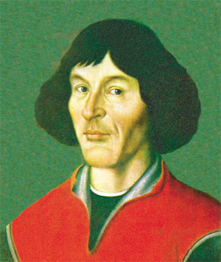
The Copernican Universe
Reconception of the Universe
Reliance on 2nd-century Greek scholar Claudius Ptolemy of Alexandria
Christians understand heaven as last sphere
1543 Nicholas Copernicus of Poland breaks theory
Notion of moving Earth challenges Christian doctrine

Slide 5
The Scientific Revolution
Johannes Kepler & Galileo Galilei reinforce Copernican model
Isaac Newton (1642-1727) revolutionizes study of physics
Rigorous challenge to church doctrines

Slide 6
Enlightenment Thinkers
John Locke
rulers derive power from consent of ruled
Natural rights: life, liberty, property
Voltaire
“erase the infamy:” Roman Catholic Church
Freedom of speech and religion
Jean-Jacques Rousseau
equality of all individuals, regardless of class
The Social Contract (1762), argues that society is collectively the sovereign and free

Slide 7
The Theory of Progress
Assumption that Enlightenment thought would ultimately lead to human harmony, material wealth
Decline in authority of traditional organized religion

Slide 8
Revolution in the North America

Slide 9
French and Indian War 1754-1763
France vs. Great Britain
Conflict over land and colonies
Extension of Seven Years’ War (1756-1763)
Global war
British victory ensured global dominance, North American prosperity
Last of the Mohicans
Notes:
Washington in French and Indian War

Slide 10
Increased Taxation in 1760s
Financial burden of Seven Years’ War (French and Indian War)
Tax burden falls to the colonies
Sugar Act (1764)
Stamp Act (1765)
Quartering Act (1765) (Housing British Troops)
Tea Act (1773)
Enforcement of taxes was issue
Britain (parent) vs. Colonies (child)

Slide 11
The Declaration of Independence
British products boycotted, officials attacked
Protests
Boston Tea Party (1773
“no taxation without representation”-Patrick Henry
July 4, 1776, Declaration of Independence
Influence of Locke: retention of individual rights, sovereignty based on consent of the ruled

Slide 12
Revolutionary War
Colonies:
Logistic advantage
Popular support
Supported by French
George Washington provides imaginative military leadership
Britain:
Strong central government
Navy, army
Loyalist population

Slide 13
The American Revolution

Slide 14
French Revolution

Slide 15
Causes
Social
aristocracy held power over king, middle class wanted change from the aristocracy, peasants wanted change from feudal past
Political
king could not raise taxes nor pay bills
Economics
huge unemployment, poor harvests, bread riots
serious financial problems in France
War debts, 1780s
50% of tax revenues to war debts
25% of tax revenues to standing military

Slide 16
The Estates General
Three Estates
1st Estate: Roman Catholic Clergy
100,000
2nd Estate: Nobles
400,000
3rd Estate: Everyone else
24,000,000 serfs, free peasants, urban residents
Estates General founded 1303, had not met since 1614
One vote per estate

Slide 17
THE LIBERAL PHASE 1789 - 1792
May
Protest of nobility forces King Louis to call Estates General for new taxes
3rd Estate demands greater social change
June
3rd Estate then secedes; Renamed “National Assembly”
July
Bastille, Great Fear, bread riots by women
August
Declaration of Rights of Man and of Citizen

Slide 18
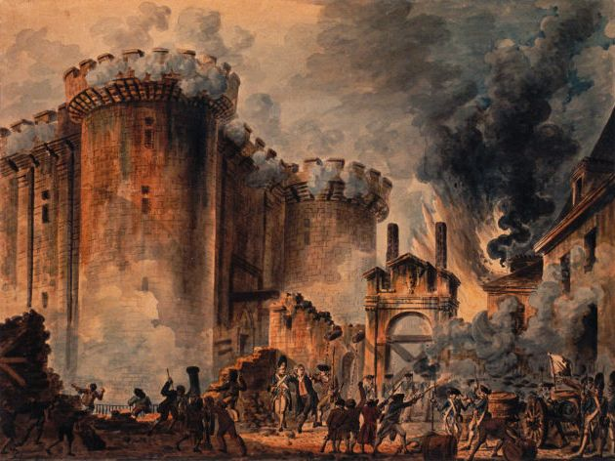
Attacking the Bastille

Slide 19
THE LIBERAL PHASE 1789-1792
National Assembly abolishes old social order
Seizes church lands, redefines clergy as civilians
New constitution retains king, but subject to the new Legislative Assembly
elected by universal male suffrage
Divisions with Legislative Assembly: radicals, moderates, and conservatives
Radicals gain control; abolish new government
Guillotine invented to execute domestic enemies
1793: King Louis and Queen Marie Antoinette

Slide 20
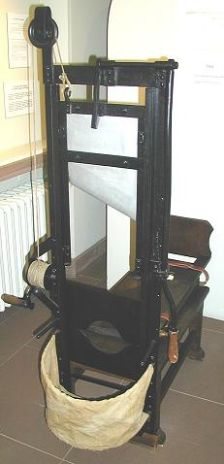
THE RADICAL PHASE 1792-1794
Formation of Committee of Public Safety
Dominated by Robespierre
Persecuted traitors, counterrevolutionaries
Used the guillotine
Civil War
200,000 estimated dead

Slide 21
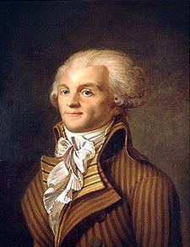
Maximilien Robespierre
“the Incorruptible,” leader of Committee of Public Safety”
Dominated Convention, 1793-1794
Churches closed, priests forced to marry
Promoted “Cult of Reason” as secular alternative to Christianity
Executed 40,000; imprisoned 300,000

Slide 22
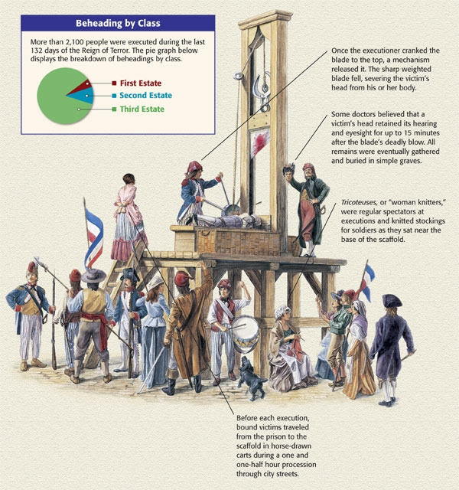

Slide 23
The Directory (1795-1799)
Revolutionary enemies of the Jacobins
1794 Robespierre arrested, sent to guillotine
Men of property take power in the form of the Directory
Unable to solve economic and military problems of revolutionary France
Napoleon eventually will be to protect it, then will take it over

Slide 24
Napoleonic France
Concludes agreement with Pope
France retains church lands, but pay salaries to clergy
Freedom of religion, also for Protestants, Jews
1804 -Napoleonic Code
Patriarchal authority
Became model for many civil codes
State above individual
Tight control on newspapers, use of secret police
Eventually declared himself Emperor

Slide 25
Napoleon’s Empire
Conquered much of Europe
Disastrous invasion of Russia in 1812
Burned Moscow
“General Winter”
Coalition forced Napoleon to abdicate, 1814
Exiled to Island of Elba, escaped
Defeated at Waterloo, exiled to St. Helena, dies 1821

Slide 26
Napoleon’s Empire in 1812

Slide 27
Revolution in the Caribbean

Slide 28
The Revolution in Haiti
Only successful slave revolt in Americas
Island of Hispaniola
Spanish colony Santo Domingo in east (now Dominican Republic)
French colony of Saint-Domingue in west (now Haiti)
Rich Caribbean colony
Sugar, coffee, cotton
Almost 1/3 of France’s foreign trade

Slide 29
Haitian Society
1790:
40,000 white French settlers
Dominated social structure
30,000 gens de couleur (free people of color, i.e. mixed-race, freed slaves)
Holders of small plots
500,000 black slaves of African descent
High mortality rate, many flee to mountains
“Maroons,” escaped slaves

Slide 30
Causes and Issues
Inspired by American and French revolutions
1789 white settlers demand self-rule, but with no equality for gens de couleur
1791 civil war breaks out
Slave revolt
French, British, Spanish forces attempt to intervene
French troops driven out, 1804 Haiti declares independence

Slide 31
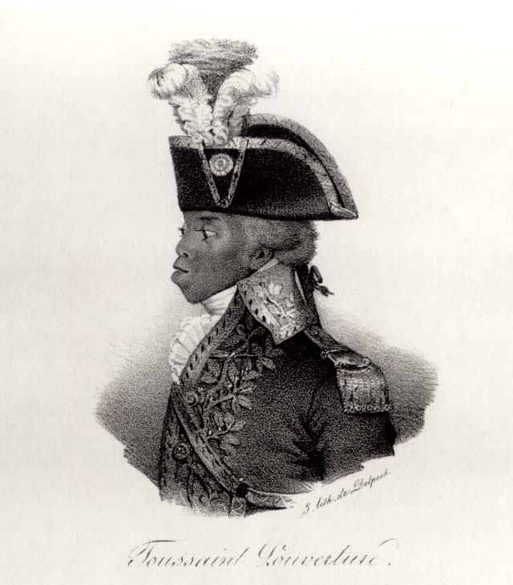
François-Dominique Toussaint (1744-1803)
Renames self Louverture (“the opening”), 1791
Descendant of slaves, freed in 1776
Helped his original owners escape, then joined rebel forces
Built army of 20,000
1801 promulgated constitution of equality
1802 arrested by Napoleon’s, died in jail

Slide 32
Revolution in Latin America

Slide 33
Latin American Society
30,000 peninsulares, colonial officials from Iberian peninsula
3.5 million creoles
Privileged class, but grievances with peninsulares
1810-1825 led movements for creole-dominated republics
10 million others
Mestizoes, mulattoes, zambos, African slaves

Slide 34
Causes of the Revolutions
Internal
Power centered with peninsulars
Spanish control of Latin American economies
Divided social classes
External
Ideals of Enlightenment
American and French Revolutions
Napoleon’s conquest of Spain

Slide 35
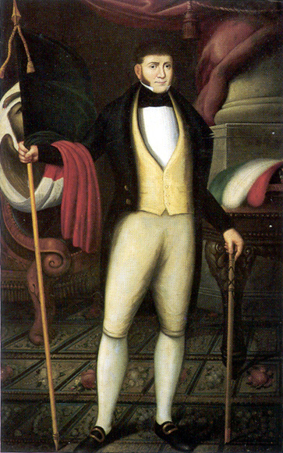
Mexican Independence
Napoleon’s invasion of Spain and Portugal (1807) weakens royal authority in colonies
Priest Miguel de Hidalgo (1753-1811)
Creole general Augustin de Iturbide (1783-1824) declares independence in 1821
Installs self as Emperor, deposed in 1823, republic established

Slide 36
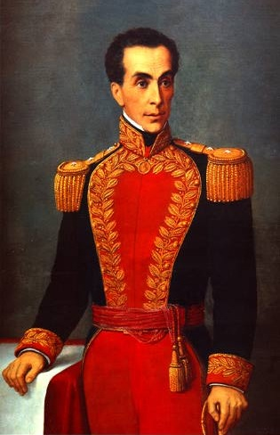
Simón Bolívar (1783-1830)
Led independence movement in South America
influenced by Enlightenment, George Washington
Forms alliances with many creole leaders
José de San Martín (Argentina, 1778-1842)
Bernardo O’Higgins (Chile, 1778-1842)
Spanish rule destroyed in South America by 1825

Slide 37
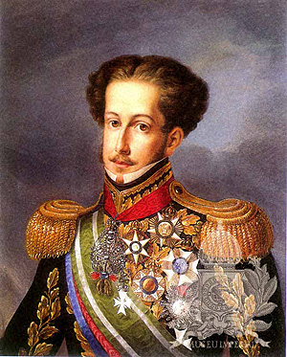
Brazilian Independence
Napoleon’s invasion sends Portuguese royal court to exile in Rio de Janeiro
1821 King returns, son Pedro left behind as regent
Pedro negotiates with creoles, declares independence of Brazil
Becomes Emperor Pedro I (r. 1822-1844)
Social structure remains largely intact
Only peaceful revolution in Americas

Slide 38
Effects of Revolutions in the Atlantic World

Slide 39
Emergence of Ideologies
Conservativism
Edmund Burke (England, 1729-1797)
Disavowed rapid revolutionary change
Favored slow evolution of society
Liberalism
Viewed conservatives as defenders of illegitimate status quo
Manage, not stifle, social change
John Stuart Mill (England, 1806-1873)

Slide 40
The End of the Slave Trade
Campaign to end slavery begins in 18th century
Olaudah Equiano (1745-1797)
Gains momentum after American, French and Haitian revolutions
William Wilberforce (England, 1759-1833), philanthropist, succeeds in having Parliament outlaw slave trade, 1807
illegal trade continued globally until 1867

Slide 41
End of the Institution of Slavery
Haiti: slavery ends with revolution
Mexico slavery abolished 1829
Partially to stop U.S. development of slave-based cotton industry in Mexico
1833 Britain abolishes slavery
Other states follow, but offer freedom without equality
Property requirements, literacy tests, etc. block voting

Slide 42
Enlightenment Ideals and Women
Enlightenment thinkers remained conservative regarding women’s rights
Rousseau argues women should receive education to prepare for lives as wives and mothers
Mary Astell (England, 1666-1731) argues that women essentially born into slavery
Mary Wollstonecraft (England, 1759-1797)
A Vindication of the Rights of Woman (1792)

Slide 43
Women and Revolution
Women active in all phases of French revolution
Women storm Versailles in 1789, demands for food
Republican Revolutionary Women patrol streets of Paris with firearms
Yet hold few official positions of authority
Revolution grants equality in education, property, legalized divorce
Yet women not allowed to vote, major task of 19th century
Elizabeth Cady Stanton (U.S., 1815-1902)

Slide 44
Nations and Nationalism
“Nation” a type of community, especially prominent in 19th century
Distinct from clan, religious, regional identities
Usually based on shared language, customs, values, historical experience
Sometimes common religion

Slide 45
Types of Nationalism
Statebuilding
Russia
Seperation
Movement for political independence of nation from other authorities
Greece
Austrian Empire
Unification
Italy
Germany

Slide 46
Nationalism and Anti-Semitism
Nationalist ideologies distrustful of indigenous minorities
Pogroms
violent attacks on Jewish communities in Russian Empire beginning 1881
Anti-Semitism rallying cry of many European nationalists

Slide 47
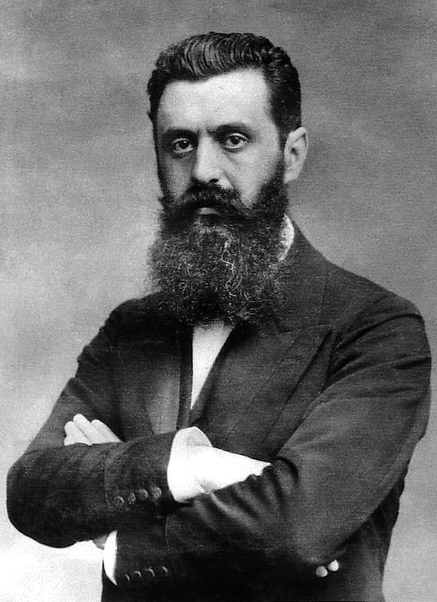
Zionism
Theodor Herzl (Austria, 1860-1904) journalist at Dreyfus trial
Worked to create refuge for Jews by re-establishing Jewish state in Palestine
Zion synonymous with Jerusalem
1897 convened first World Zionist Congress

Slide 48
National Rebellions
Greeks in Balkan peninsula seek independence from Ottoman Turks, 1821
Gained sympathy from European powers
Greece achieves independence in 1830
Revolutions of 1848
Rebels take Vienna, Metternich resigns and flees
But rebellions put down by 1849

Slide 49
Making of Industrial Society

Slide 50
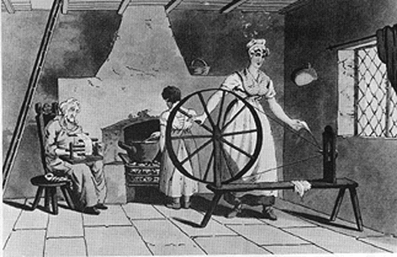
Pre – Industrial Revolution
Life expectancy – 40 yrs
25% of Europeans lived in towns
Most families farmed, members had a role
Domestic system, system of labor used inside the home

Slide 51
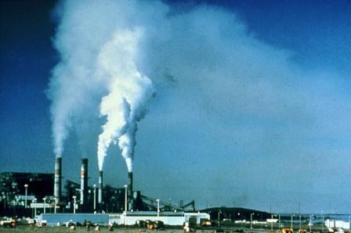
The Beginning
Industrialization:
The process that transformed agrarian and handicrafted-centered economies into economies distinguished by industry and machine manufacture

Slide 52
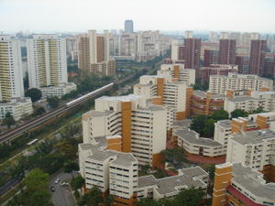
Population growth
Vital Revolution
Improvement of diet
conquering of disease
Led to the growth of cities -urbanization

Slide 53
Genesis of the Industrial Revolution
Great Britain, 1780s
Followed agricultural revolution
Food surplus
Population increase
Market demand
Labor supply
Geographic luck
Natural resources

Slide 54
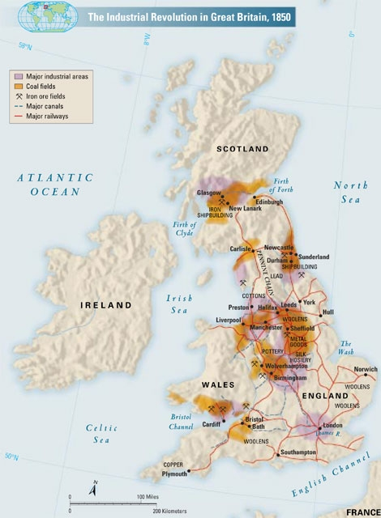

Slide 55
British Advantages
Strong banking tradition
Natural resources
Coal, iron ore
Ease of transportation
Size of country
River and canal system
Exports to imperial colonies
Starts with textiles

Slide 56
How it Works

Slide 57
The Factory System
Early modern Europe adopts domestic system
Rising prices cause factories to replace both guilds and domestic system
Machines too large, expensive for home use
Large buildings could house specialized laborers
Urbanization guarantees supply of cheap unskilled labor
Creation of the assembly line and the division of labor

Slide 58
The Growth of Factories
Massive machinery
Supply of labor
Assembly line
Transport of raw materials, finished product to markets
Concentration in newly built factory towns on rivers

Slide 59
King Cotton
1760: 2.5 million pounds of raw cotton imported
1787: 22 million
1840: 360 million

Slide 60
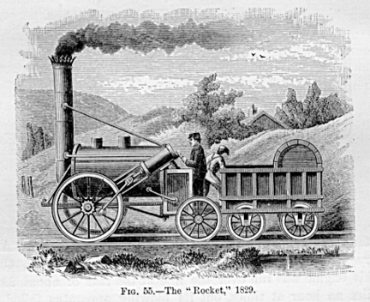
Rail Transport
1804 first steam-powered locomotive called the Rocket
Ripple effect on industrialization
Engineering and architecture

Slide 61
Mass Production
Eli Whitney
invents cotton gin
interchangeable parts for firearms
“the American system”
Applied to wide variety of machines
Henry Ford, 1913, develops assembly line approach
Complete automobile chassis every 93 minutes
Previously: 728 minutes

Slide 62
Industrial Europe ca. 1850

Slide 63
Social Effects of Industrialization

Slide 64
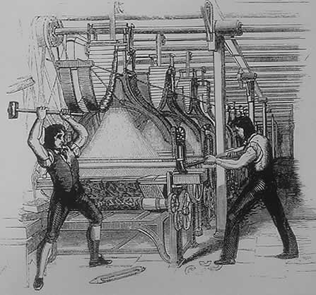
Poor working conditions
Dramatic shift from rural work rhythms
Six days a week, fourteen hours a day
Immediate supervision, punishments
“Luddite” Protest against machines 1811-1816

Slide 65
Society
Industrialization created a new wealth and new class
Based on wealth, not land
New bourgeoisie was most influential group, but small
The biggest group was the proletariat or working class

Slide 66
Society: The Urban Life
Saw biggest impact from industrialization
Issues that arose:
fast growth
Housing
sanitation
Paris led the way in urban renewal

Slide 67
Society: Development of Slums
London: 1 million in 1800, 2.4 million in 1850
Wealthy classes move out to suburbs
Industrial slum areas develop in city centers
Open gutters as sewage systems

Slide 68
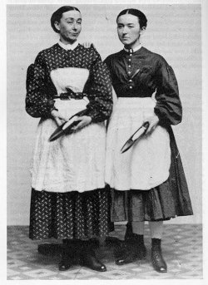
Economics and Society: Age, Gender, Family
Sexual division of labor
Textile mills favored women, children due to lower wages
Treatment of women was bad, children worse
Lowell Mill Girls

Slide 69
Distribution of Wealth in the U.S.

Slide 70
Economy: Monopolies, Trusts, and Cartels
Large corporations form blocs to drive out competition, keep prices high
John D. Rockefeller
German IG Farben controls 90% of chemical production
Governments often slow to control monopolies

Slide 71
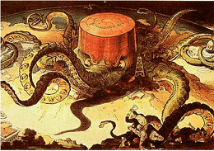
Political Cartoon depicting Standard Oil

Slide 72
Human/Environment Interaction

Slide 73
Population Growth (millions)

Slide 74
The Demographic Transition
Industrialization results in marked decline of both fertility and mortality
Costs of living increase in industrial societies
From rural to urban
Urbanization proceeds dramatically
1800: only 20% of Britons live in towns with population over 10,000
1900: 75% of Britons live in urban environments

Slide 75
Transcontinental Migrations
rapid population growth drives Europeans to Americas
50 million cross Atlantic
Britons to avoid urban slums
Irish to avoid potato famines of 1840s
Jews to abandon Tsarist persecution
United States favored destination

Slide 76
Ideas and Theories

Slide 77
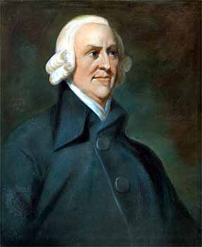
Economics: Laissez-Faire
Economic policy of business with little or no interference from government
Adam Smith argued in laws of economics
Self-interest
Competition
Supply and demand
Set foundation for capitalism

Slide 78
The Socialist Challenge
‘Socialism’ first used in context of Utopian Socialists Charles Fourier (1772-1837) and Robert Owen (1771-1858)
Defined as
Factors of production are owned by the public and operated for the welfare of all
Opposed competition of market system
Government should plan economy
Would end poverty and promote equality

Slide 79
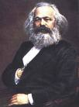
Karl Marx (1818-1883) and Friedrich Engels (1820-1895)
Two major classes:
Capitalists, who control means of production
Proletariat, working class
Exploitative nature of capitalist system
Religion: “opiate of the masses”
“dictatorship of the proletariat”

Slide 80
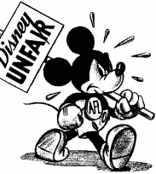
Social Reform and Trade Unions
Socialism had major impact on 19th century reformers
Addressed issues of medical insurance, unemployment compensation, retirement benefits
Trade unions form for collective bargaining
Strikes to address workers’ concerns
1941 Disney animators strike

Slide 81
Spread of Industrialization

Slide 82
Industrialization in Russia and Japan
Russia
Slower starts on industrial process
Russia constructs huge railway network across Siberia under finance minister Count Sergei Witte
Japan
Slower starts on industrial process
Japanese government takes initiative by hiring thousands of foreign experts
Reforms iron industry
Opens universities, specializing in science and technology

Slide 83
Global Effects
Global division of labor
Rural societies that produce raw materials
Urban societies that produce manufactured goods
Uneven economic development
Developing export dependencies of Latin America, sub-Saharan Africa, south and south-east Asia
Low wages, small domestic markets

Slide 84
Societies at Crossroads

Slide 85
Ottoman Empire

Slide 86
Statebuilding: The Ottoman Empire
reaches peak of military expansion in late 17th century
inferior largely due to European advances in technology and strategy
semi-independent warlords have power
Territorial losses from Russia and in Balkans
Napoleon’s unsuccessful attack on Egypt spurs local revolt against Ottomans under

Slide 87
Territorial losses of the Ottoman empire, 1800-1914

Slide 88
Economy
Imports of cheap manufactured goods
place stress on local artisans, urban riots result
Export-dependent Ottoman economy increasingly relies on foreign loans
unable to pay even interest on loans, forced to accept foreign administration of debts
Capitulations: agreements that exempted Europeans from Ottoman law

Slide 89
Statebuilding: Early Reforms
taxation, increase agricultural output, and reduce corruption
Sultan Selim III remodeled army on European lines
Janissaries revolt, kill new troops, imprison Sultan
Sultan Mahmud II (r. 1808-1839), has Janissaries massacred
reforms schools, taxation, builds telegraph, postal service

Slide 90
Statebuilding: Tanzimat Era (1839-1876)
Pace of reform accellerated
Drafted new law codes
Undermined power of religious elite
Fierce opposition from religious conservatives, bureaucracy
opposition from radical Young Ottomans, who wanted constitutional government

Slide 91
Statebuilding: Young Turk Rule
Founded by Ottomans in exile in Paris
Called for rapid, secular reforms
Attempted to establish Turkish hegemony over far-flung empire
Turkish made official language, despite large numbers of Arabic and Slavic language speakers

Slide 92
Russia

Slide 93
Statebuilding: Russian Empire in Decline
Russia a massive, multi-cultural empire
Only approximately half speak Russian, observe Russian Orthodox Christianity
Romanov Tsars rule autocratic empire
Powerful class of nobles exempt from taxation, military duty
Exploitative serfdom

Slide 94
The Russian empire, 1801-1914

Slide 95
Statebuilding: The Crimean War, 1853-1856
Russian expansion into Caucasus in larger attempt to establish control over weakening Ottoman empire
Threatens to upset balance of power, Europeans become involved
Russia driven back from Crimea in humiliating defeat
Demonstration of Russian weakness in the face of western technology, strategy

Slide 96
Statebuilding: Reform
Emancipation of the Serfs
Serfdom source of rural instability and peasant revolt
Tsar Alexander II emancipates serfs in 1861, without alleviating poverty, land hunger
Forced to pay for lands they had farmed for generations
Limited attempts to reform administration, small-scale representative government
Network of elected district assemblies called zemstvos

Slide 97
Economy
Industrialization
Count Sergei Witte, minister of finance 1892-1903
Massive railroad construction
Trans-Siberian railroad
But massive industrial discontent
Peasants uprooted from rural lifestyle to work for low wages, long hours

Slide 98
Statebuilding
Spread of radical ideas for social change
Socialists, anarchists
Terror tactics, assassinations
Attempt to connect with the mistrustful peasantry in 1870s
Tsarist authorities turn to censorship, secret police
Nationalist sentiment seething in Baltics, Poland, Ukraine, Georgia, central Asia

Slide 99
Statebuilding: Radicalization
1881 radical People’s Will movement assassinates Tsar Alexander II
Prompted widespread pogrom attacks on Jews
Increased repression
Nicholas II (r. 1894-1917) enters into war with Japan (1904-1905)
Humiliating defeat exposes government weaknesses
Social discontent boils over in Revolution of 1905
Strikes force government to make concessions

Slide 100
China

Slide 101
Economy
Since 1759, European commercial presence limited to one port
Foreign merchants forced to deal solely with licensed Chinese firms
currency of trade: silver bullion
British East India Company heavily involved in opium trade
Opium grown in India, sold in China for silver, silver used to buy other Chinese products
Opium War

Slide 102
Opium Factory

Slide 103
Statebuilding: Unequal Treaties
forced into a series of disadvantageous treaties
Hong Kong ceded to British in Treaty of Nanjing (1842), ports opened to British traders
Extraterritorial status to British subject
Other countries conclude similar treaties

Slide 104
East Asia in the 1800s

Slide 105
Society
Large-scale rebellions in later 19th century reflect poverty, discontent of Chinese peasantry
Population rises 50% between 1800-1900, agriculture remains stagnant
Nian Rebellion (1851-1868), Muslim Rebellion (1855-1873), Tungan Rebellion (1862-1878), and the Taiping Rebellion (1850-1864)

Slide 106
Statebuilding: Taiping Rebellion
led by Hong Xiuquan, schoolteacher, called for destruction of Qing dynasty
Platform
Abolition of private property
Creation of communal wealth
Prohibition of footbinding, concubinage
Free public education, simplification of written Chinese, mass literacy
Defeat came in 1864 via regional militaries

Slide 107
Statebuilding: The Self-Strengthening Movement (1860-1895)
Blend of Chinese cultural traditions with European industrial technology
Shipyards, railroads, academies
Change to Chinese economy and society superficial
Empress Dowager Cixi (1835-1908)
diverted funds for her own aesthetic purposes

Slide 108
Spheres of Influence
Qing dynasty loses influence in south-east Asia, losing tributary states to Europeans and Japanese
Vietnam: France, 1886
Burma: Great Britain, 1885
Korea, Taiwan, Liaodong Peninsula: Japan, 1895
China itself divided into spheres of influence, 1895

Slide 109
Hundred Days Reforms (1898)
Interpreted Confucianism to allow for radical changes to system
Pro-industrialization
Emperor Guangxu attempts to implement reforms
Empress Dowager Cixi nullifies reforms, imprisons emperor

Slide 110
Society: The Boxer Rebellion
Cixi supports Boxers
anti-foreign militia units
Misled to believe European weapons would not harm them, 140,000 Boxers besiege European embassies in 1900
Crushed by coalition
China forced to accept stationing of foreign troops

Slide 111
Boxers

Slide 112
Death of the Dowager Empress
Emperor dies a mysterious, sudden death
Cixi dies one day later, November 1908
2-year old Puyi placed on the throne
Revolution in 1911
Puyi abdicates, 1912

Slide 113
Japan

Slide 114
Transformation
Japanese society in turmoil
Poor agricultural output, high taxes
Daimyo, samurai classes decline, peasants starve
Tokugawa government attempts reforms, 1841-1843
Cancelled daimyo, samurai debts
Compelled peasants to return to cultivating rice
Reforms ineffective
Japan only allowed Dutch presence in Nagasaki
1853 Matthew Perry forces Japanese to open port

Slide 115
Statebuilding: The Meiji Restoration (1868)
Brief civil war between imperial and Tokugawa forces
1868 Emperor Mutusuhito (Meiji, 1852-1912) takes power
Goals of prosperity and strength: “rich country, strong army”
Resolved to learn western technology

Slide 116
Meiji Reforms
Travelers Fukuzawa Yukichi (1835-1901) and Ito Hirobumi (1841-1909) travel to U.S., Europe
Argue for adoption of western legal proceedings, technology
Meiji government removes privileges for daimyo, samurai
Conscript army replaces samurai mercenaries
Samurai rebellion crushed by national army
Tax reform: payment in cash, not kind

Slide 117
Statebuilding: Constitutional Government
1889 constitution promulgated
Conservative: only 5 % of male population allowed to vote in 1890 election
Economic reforms to promote rapid industrialization
Dramatic improvement in literacy rates
Government holdings sold to private investors

Slide 118
The Building of Global Empires

Slide 119
Imperialism
Control of a country or territory by a stronger more dominant country
‘Imperialism’ is in popular discourse by 1880s
Starts with Military
Later on…
Economic
Cultural

Slide 120
Motives
Geopolitical
Strategic locations (Egypt, Panama)
Economic
European capitalism
Religious
Christian missions (French in Indochina)
Demographic
criminal populations (Australia)
Dissident populations

Slide 121
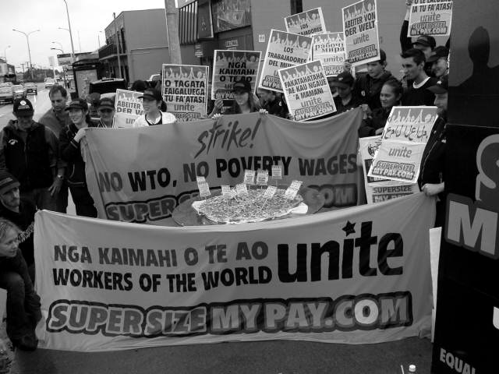
Motives
Socialists critics of Industrialization
Imperial policies distract proletariat from domestic politics
Cecil Rhodes - ‘imperialism alternative to civil war’
European leaders sought to inspire the people
Patriotism
Expansion provides benefits for all

Slide 122
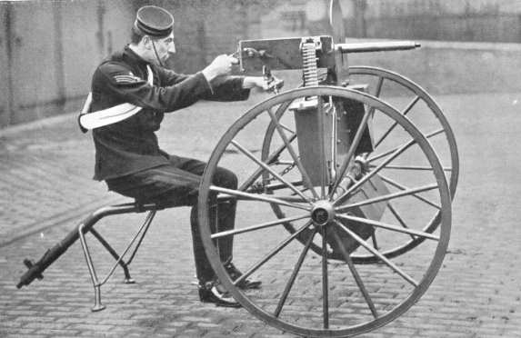
Technological
Transportation
Steamships
Railroads
Infrastructure
Suez Canal (1859-1869)
Panama Canal (1904-1914)
Weaponry
Early-1800s: muzzle-loading muskets
1 round per minute
Mid-1800s: rifles
1880s: Maxim gun
11 rounds per second

Slide 123
Technology: Communications
Travel
1830 - A response to a letter from Britain to India… 2 years
After Suez Canal…2 weeks
Telegraph
1870s, development of submarine cables
Britain-India correspondence…5 hours

Slide 124
Statebuilding: Imperialism and Management Methods
Colony
Somaliland in East Africa by French
Protectorate
Nigeria by Britain
Sphere of influence
Liberia by United States
Economic imperialism
Dole Fruit Company in Hawaii
Indirect control
British colonies
U.S. colonies
Direct control
French colonies

Slide 125
Imperialism in Asia

Slide 126
Europe in Asia
How it happened…
Involuntary trade led to…
western influence led to…
direct rule and occupation
Nationalism and dissent grew from conquered nations
India: Sepoy Rebellion
China: Boxer Rebellion

Slide 127
Imperialism in Asia, ca. 1914

Slide 128
India: ‘The Jewel of the British Crown’
British East India Company begins involvement in India
Monopoly on India trade
Original permission from Mughal emperors
Conquest begins
Protection of economic interests through political conquest
Use of British and Indian troops, called sepoys

Slide 129
Society: Sepoy Rebellion, 1857-58
Causes
Cartridges in wax paper greased with animal fat
Problem for Hindus: beef
Problem for Muslims: pork
Sepoys capture garrison
60 soldiers, 180 civilian males massacred (after surrender)
later, 375 women & children murdered
Effect
Britain establishes direct rule
Called the ‘Raj’
Established civil service staffed by English
Growing distrust by Indians and British, nationalism
Indian National Congress
Muslim League

Slide 130
Statebuilding: Early Japanese Expansion
Resentment over Unequal Treaties of 1860s
1876 Japanese purchase warships from Britain, dominate Korea
Sino-Japanese War (1894-1895) over Korea results in Japanese victory
Russo-Japanese War (1904-1905) also ends in Japanese victory

Slide 131
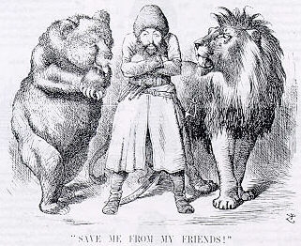
Imperialism in Central Asia
The “Great Game”: Russian vs. British intrigue in Afghanistan
Preparation for imperialist war
Russian Revolution of 1917 forestalled war
Political Cartoon

Slide 132
Imperialism in Southeast Asia
Spanish and the U.S: Philippines
Dutch: Indonesia (Dutch East Indies)
British establish presence from 1820s
Burma (Myanmar) 1820s, established colonial authority by 1880s
estbalish Singapore for trade in Strait of Melaka
Base of British colonization in Malaysia, 1870s-1880s
French: Vietnam, Cambodia, Laos, 1859-1893
Encouraged conversion to Christianity

Slide 133
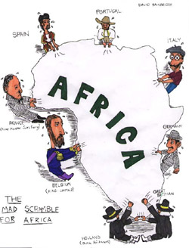
Imperialism in Africa

Slide 134
Europe in Africa
How it happened…
slave trade –15th century
Scientific Interest and exploration – 18th century
European exploration of rivers
(Nile, Niger, Congo, Zambesi)
Information on interior of Africa from adventurers

Slide 135
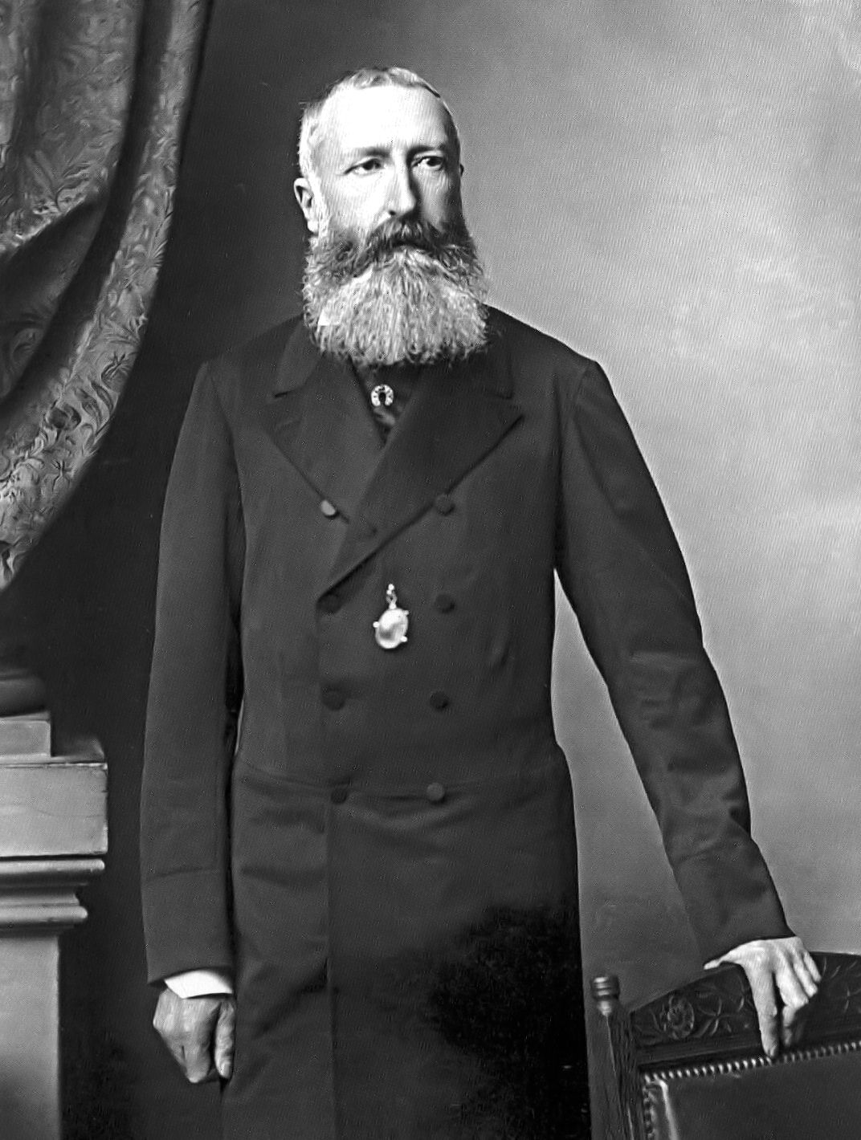
King Leopold II
King Leopold II of Belgium starts Congo Free State
Free trade to all European countries
Takes some land for personal colonization
Brutal and harsh conditions
renamed Belgian Congo

Slide 136
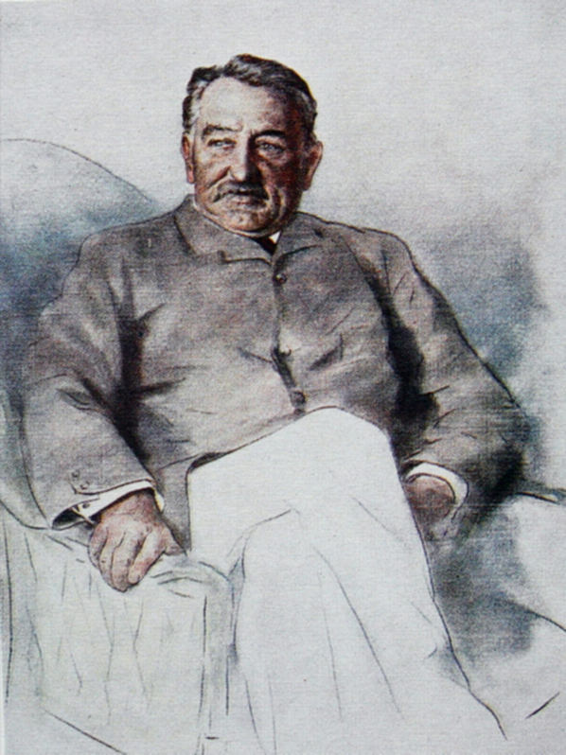
Cecil Rhodes
British Imperialist - Founds DeBeers diamond Co.
Acquires tracts of land in modern day Zimbabwe and Zambia
Country called Rhodesia
Rhodes Scholarship funded from his estate

Slide 137
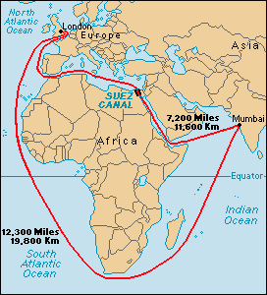
The Scramble for Africa (1875-1900)
French, Portuguese, Belgians, and English competing for “the dark continent”
Britain establishes strong presence in Egypt, Rhodesia
Suez Canal
Rhodesian gold, diamonds

Slide 138
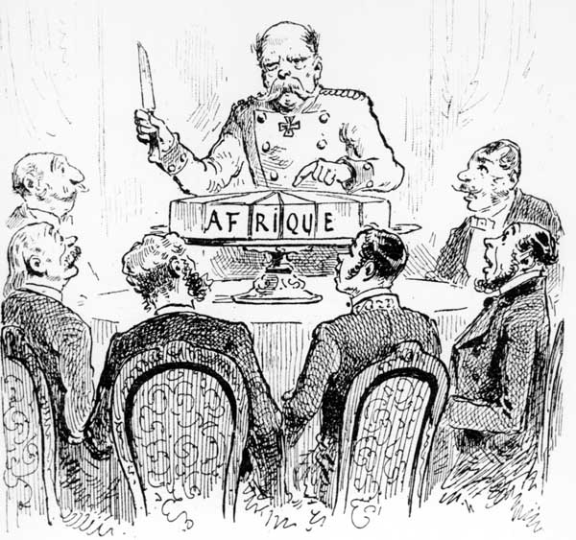
The Berlin Conference (1884-1885)
Fourteen European states, United States
No African states present
Rules of colonization: any European state can take “unoccupied” territory after informing other European powers

Slide 139
South African (Boer) War 1899-1902
Dutch East India Co. establishes Cape Town (1652)
Farmers (Boers) follow to settle territory, later called Afrikaners
Competition and conflict with indigenous people
British takeover in 1806
Dutch establish independent Republics
British tolerate this until gold is discovered
White-white conflict, black soldiers and laborers

Slide 140
Imperialism in Africa, ca. 1914

Slide 141
Imperialism in Oceania

Slide 142
Imperialism in Oceania, ca. 1914

Slide 143
European and Native Population in Australia and New Zealand

Slide 144
Europe in the Pacific Islands
How it happens…
Whalers seeking ports
Missionaries seeking souls
British, French, German, American powers carve up Pacific islands

Slide 145
Imperialism in the Americas

Slide 146
US Imperialism
How it happens…
Monroe Doctrine - warns Europeans not to engage in imperialism in western hemisphere (1823)
1867 purchased Alaska from Russia
1875 established protectorate over Hawai’i
Locals overthrow queen in 1893, persuade US to acquire islands in 1898

Slide 147
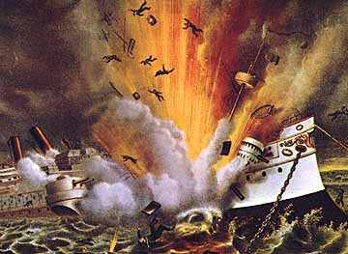
Spanish-American War (1898-1899)
US declares war in Spain after battleship Maine sunk in Havana harbor, 1898
Takes possession of Cuba, Puerto Rico, Guam, Philippines
US intervenes in other Caribbean, Central American lands
occupies Dominican Republic, Nicaragua, Honduras, Haiti
Nationalist feelings:
Filipinos revolt

Slide 148
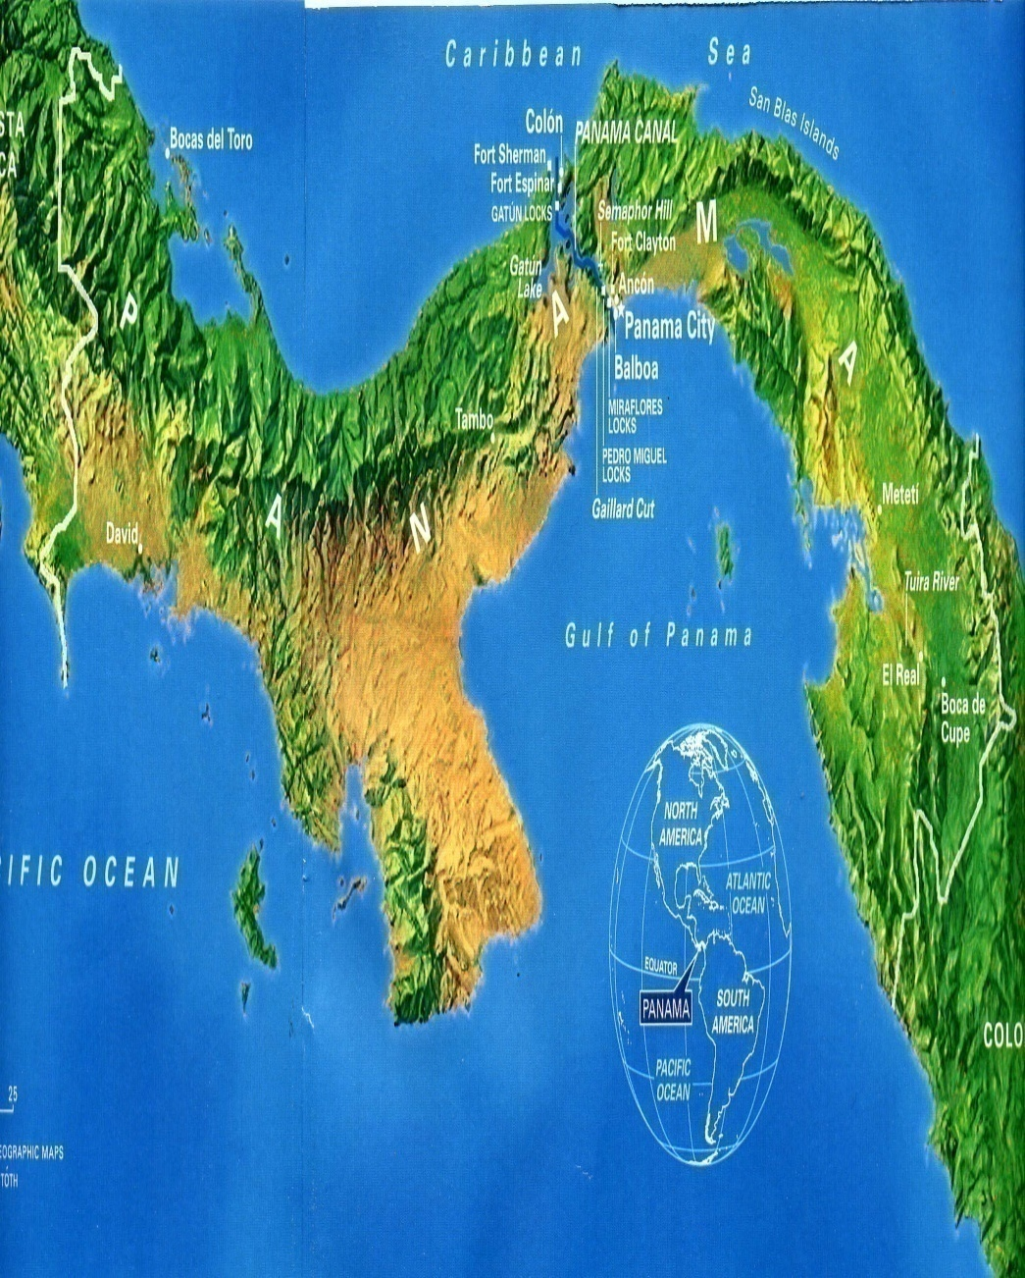
The Panama Canal
President Theodore Roosevelt supports insurrection against Colombia (1903)
Rebels win, establish state of Panama
U.S. gains territory to build canal
Roosevelt Corollary of Monroe Doctrine
U.S. right to intervene in domestic affairs of other nations if U.S. investments threatened

Slide 149
The Aftermath of Imperialism

Slide 150
Economic Effects
Exploitation of natural resources
No emphasis on industrialization
dependency on imperial power for manufactured goods made from native raw product
Indian cotton
Introduction of new crops
Tea in Ceylon

Slide 151
Social Effect
Social Darwinism
Phrase coined by British philosopher Herbert Spencer
Based on Charles Darwin’s theory of ‘survival of the fittest’

Slide 152
Migration

Slide 153
Labor Migrations
Europeans move to temperate lands
Work as free cultivators, industrial laborers
32 million to the US 1800-1914
Africans, Asians, and Pacific islanders move to tropical/subtropical lands
Indentured laborers, manual laborers
2.5 million between 1820 and 1914

Slide 154
Nationalism and Anticolonial Movements
Colonial reformers call for self-government
Influence of Enlightenment thought, often obtained in European universities
Examples
Indian National Congress formed 1885
1906 joins with All-India Muslim League

Slide 155
Overall Effects
Exploitation of people and resources
Impoverished nations
Greater economic success with both countries
Destruction of traditional cultures
Spread of Western culture
Rise of Nationalism

Slide 156
Imperialist Statistics
****
Great Britain
France
Belgium
Netherlands
Germany (1914)
Country area in Square Miles
94,000
212,600
11,800
13,200
210,000
Population
45,500,100
42,000,000
8,300,000
8.500,000
67,500,000
Area of Colonies
13,100,000
4,300,000
940,000
790,000
1,100,000
Population of Colonies
470,000,000
65,000,000
13,000,000
66,000,000
13,000,000

