Slide 1
Revolutions in Russia, China, and Mexico
20th Century Revolutions

Slide 2
Russian: Revolution and the Emergence of the Soviet Union

Slide 3
Long-term Causes
90% of population lives in country
The decline of the Romanov dynasty
Russification
Lack of modernization
Oppression of serfs
Class Inequalities
Autocratic gov’t
Defeat in Crimean War
Rise of new ideas like Marxism

Slide 4
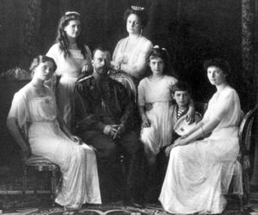
Romanov Dynasty
Alexander I (1801-25)
Introduced idea of abolishing serfdom
Nicholas I (1825-55)
Loses Crimean War
Alexander II (1855-1881)
Emancipated the serfs
Alexander III (1881-1894)
Promoted Russification
Encouraged pograms
Nicholas II (1894-1918)
Loss of Russo-Japanese War
Creation of the duma
Disaster of WWI

Slide 5
Short-Term Causes
Incompetence of Czar Nicholas II
Russo-Japanese War, 1905
St. Petersburg (Petrograd) “Bloody Sunday”, 1905
WWI

Slide 6
Revolution and Civil War
Nicholas abdicates the throne, February 1917
Imprisoned in Siberia and then assassinated
Provisional Gov’t is established
Bolsheviks lead a coup
Oct. 1917
Civil War 1918-1920
Reds and Whites
Russia signs Treaty of Brest-Litovsk , May 1918

Slide 7
War Communism, 1918-1922
Rapid collectivization
Confiscations
Massively unpopular, Lenin backtracks in 1921
New Economic Policy (NEP) partial privatization of the economy
Promotion of Agriculture
Promotion of Industry
“Kulaks” and speculation
“one step backward, two steps forward”

Slide 8
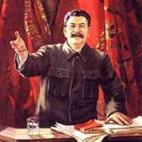
1922 Events
Formation of Soviet Union (U.S.S.R)
Emergence of Joseph Stalin

Slide 9
The Purges
mechanics of a purge
“confession”
the show-trial
punishment
Massive scope: 8 million Soviet citizens in labor camps by 1939

Slide 10
Characteristics of Communist Soviet Union
State controls all business and levels of gov’t
use of secret police
Purges of gov’t
‘dictatorship of the proletariat’ – used by Lenin
State controls education, art, and media

Slide 11
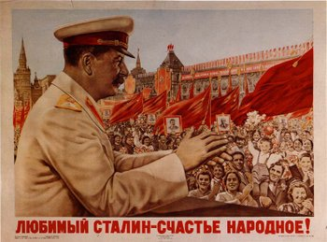
Stalin Propaganda Poster

Slide 12
China : the Downfall of the Dynastic Rule

Slide 13
Long Term Causes
19th Century European influence
Opium Wars
Unequal treaties
Political upheaval
Taiping Rebellion
Peasant land reform movement
20 to 30 million lives lost
Self Strengthening movement
Laid foundation for industrialization
Hundred Days
Reform educations, encourage foreign influence, modernize military, guarantee civil liberties
Nullified by Empress Dowager Cixi
Boxer Rebellion

Slide 14
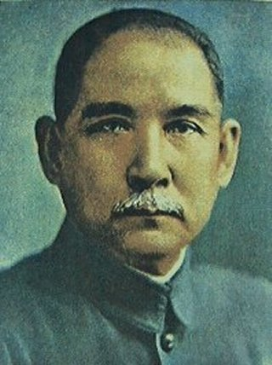
Sun Yat Sen
Revolution in 1911 forces Emperor to abdicate
Sun Yatsen (1866-1925) proclaims Republic of China in 1912
Created Nationalist People’s Party (Guomindang)
Gov’t fell into anarchy and economic decline
Warlords increase power

Slide 15
Chinese Nationalism
May Fourth Movement
Students, urban intellectuals protest foreign interference
Especially Japanese interference
Marxism increases in popularity
Chinese Communist Party founded in Shanghai (1921)
Mao Zedong
(1893-1976)

Slide 16
Civil War
(Chiang Kai-Shek, 1887-1975) takes over after death of Sun Yatsen
Launches military expedition to unify China, turns against communist allies
Nationalists vs. Warlords
Nationalists vs. Communists
Communists flee
6,215 miles to north-west China
Called The Long March
Suspended by World War II

Slide 18
Mexico: Change and Revolution

Slide 19
Long Term Causes
Political upheaval since independence
(monarch, republic, caudillo rule)
Benito Juarez (1806-1872)
Liberal reform movement called La Reforma
Limits power of military and Roman Catholic Church
Sought to reform land, suffrage
95% of peasants were landless
French occupation
Suspension of loans payments by Juarez
occupation for 5 years

Slide 20
Revolution and Civil War 1911-1920
Revolution
Caused by Francisco Madero’s bid to become president, arrested by Diaz
Middle class joins peasants in fight
Guerilla warfare emerged
Emiliano Zapata
Pancho Villa
Conservatives (Diaz) vs. Liberals (Villa, Zapata)
Several leaders take power during time
Alvaro Obregon arises as a liberal and takes government via coup in 1920
2 million killed in civil war

Slide 21
Effects and Results
Constitution of 1917
Supported by Obregon
Land redistribution
Universal suffrage
State supported education
Minimum wages
Restrictions on foreign ownership
Civil liberties
Nationalized oil industry in 1938

Slide 22
Developements
Lázaro Cárdenas (1895-1970) nationalizes Mexican oil industry
Previously controlled by US, British interests
Roosevelt convinces US, British businesses to accept $24 million in compensation ($260 sought)
US wants to retain support of Mexico with approaching war (WWII)
Increasing dependence on Mexican immigrant labor

