Slide 1
Societies at Crossroads

Slide 2
Ottoman Empire

Slide 3
Statebuilding: The Ottoman Empire
reaches peak of military expansion in late 17th century
inferior largely due to European advances in technology and strategy
semi-independent warlords have power
Territorial losses from Russia and in Balkans
Napoleon’s unsuccessful attack on Egypt spurs local revolt against Ottomans under

Slide 4
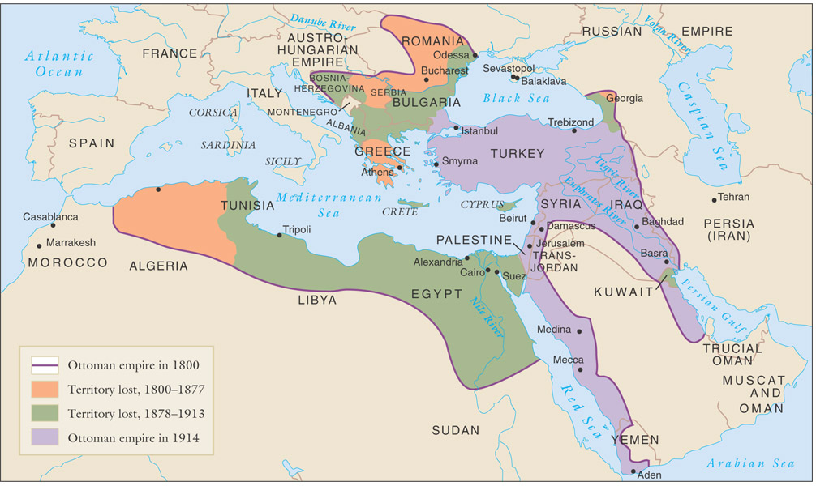
Territorial losses of the Ottoman empire, 1800-1914

Slide 5
Economy
Imports of cheap manufactured goods
place stress on local artisans, urban riots result
Export-dependent Ottoman economy increasingly relies on foreign loans
unable to pay even interest on loans, forced to accept foreign administration of debts
Capitulations: agreements that exempted Europeans from Ottoman law

Slide 6
Statebuilding: Early Reforms
taxation, increase agricultural output, and reduce corruption
Sultan Selim III remodeled army on European lines
Janissaries revolt, kill new troops, imprison Sultan
Sultan Mahmud II (r. 1808-1839), has Janissaries massacred
reforms schools, taxation, builds telegraph, postal service

Slide 7
Statebuilding: Tanzimat Era (1839-1876)
Pace of reform accellerated
Drafted new law codes
Undermined power of religious elite
Fierce opposition from religious conservatives, bureaucracy
opposition from radical Young Ottomans, who wanted constitutional government

Slide 8
Statebuilding: Young Turk Rule
Founded by Ottomans in exile in Paris
Called for rapid, secular reforms
Attempted to establish Turkish hegemony over far-flung empire
Turkish made official language, despite large numbers of Arabic and Slavic language speakers

Slide 9
Russia

Slide 10
Statebuilding: Russian Empire in Decline
Russia a massive, multi-cultural empire
Only approximately half speak Russian, observe Russian Orthodox Christianity
Romanov Tsars rule autocratic empire
Powerful class of nobles exempt from taxation, military duty
Exploitative serfdom

Slide 11
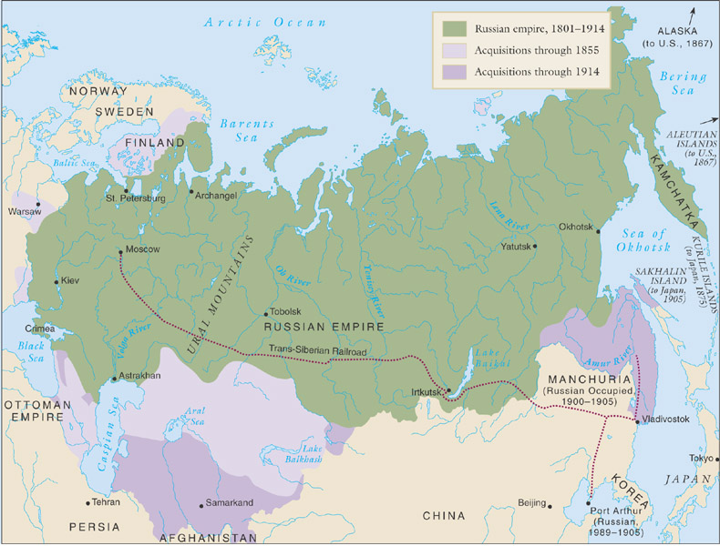
The Russian empire, 1801-1914

Slide 12
Statebuilding: The Crimean War, 1853-1856
Russian expansion into Caucasus in larger attempt to establish control over weakening Ottoman empire
Threatens to upset balance of power, Europeans become involved
Russia driven back from Crimea in humiliating defeat
Demonstration of Russian weakness in the face of western technology, strategy

Slide 13
Statebuilding: Reform
Emancipation of the Serfs
Serfdom source of rural instability and peasant revolt
Tsar Alexander II emancipates serfs in 1861, without alleviating poverty, land hunger
Forced to pay for lands they had farmed for generations
Limited attempts to reform administration, small-scale representative government
Network of elected district assemblies called zemstvos

Slide 14
Economy
Industrialization
Count Sergei Witte, minister of finance 1892-1903
Massive railroad construction
Trans-Siberian railroad
But massive industrial discontent
Peasants uprooted from rural lifestyle to work for low wages, long hours

Slide 15
Statebuilding
Spread of radical ideas for social change
Socialists, anarchists
Terror tactics, assassinations
Attempt to connect with the mistrustful peasantry in 1870s
Tsarist authorities turn to censorship, secret police
Nationalist sentiment seething in Baltics, Poland, Ukraine, Georgia, central Asia

Slide 16
Statebuilding: Radicalization
1881 radical People’s Will movement assassinates Tsar Alexander II
Prompted widespread pogrom attacks on Jews
Increased repression
Nicholas II (r. 1894-1917) enters into war with Japan (1904-1905)
Humiliating defeat exposes government weaknesses
Social discontent boils over in Revolution of 1905
Strikes force government to make concessions

Slide 17
China

Slide 18
Economy
Since 1759, European commercial presence limited to one port
Foreign merchants forced to deal solely with licensed Chinese firms
currency of trade: silver bullion
British East India Company heavily involved in opium trade
Opium grown in India, sold in China for silver, silver used to buy other Chinese products
Opium War

Slide 19
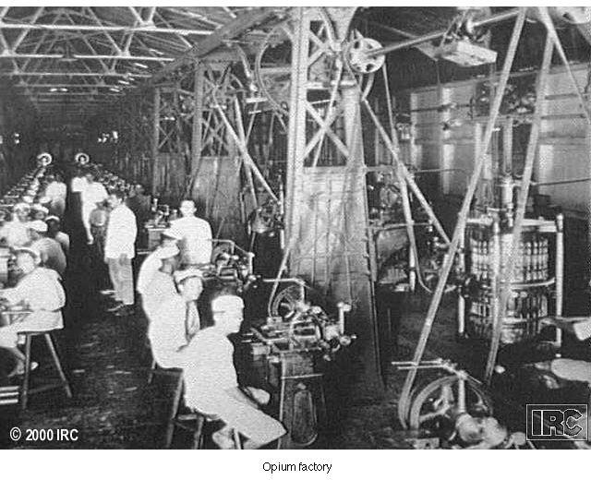
Opium Factory

Slide 20
Statebuilding: Unequal Treaties
forced into a series of disadvantageous treaties
Hong Kong ceded to British in Treaty of Nanjing (1842), ports opened to British traders
Extraterritorial status to British subject
Other countries conclude similar treaties

Slide 21
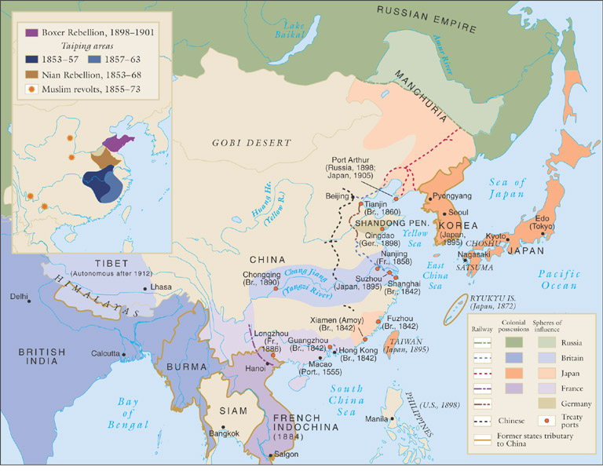
East Asia in the 1800s

Slide 22
Society
Large-scale rebellions in later 19th century reflect poverty, discontent of Chinese peasantry
Population rises 50% between 1800-1900, agriculture remains stagnant
Nian Rebellion (1851-1868), Muslim Rebellion (1855-1873), Tungan Rebellion (1862-1878), and the Taiping Rebellion (1850-1864)

Slide 23
Statebuilding: Taiping Rebellion
led by Hong Xiuquan, schoolteacher, called for destruction of Qing dynasty
Platform
Abolition of private property
Creation of communal wealth
Prohibition of footbinding, concubinage
Free public education, simplification of written Chinese, mass literacy
Defeat came in 1864 via regional militaries

Slide 24
Statebuilding: The Self-Strengthening Movement (1860-1895)
Blend of Chinese cultural traditions with European industrial technology
Shipyards, railroads, academies
Change to Chinese economy and society superficial
Empress Dowager Cixi (1835-1908)
diverted funds for her own aesthetic purposes

Slide 25
Spheres of Influence
Qing dynasty loses influence in south-east Asia, losing tributary states to Europeans and Japanese
Vietnam: France, 1886
Burma: Great Britain, 1885
Korea, Taiwan, Liaodong Peninsula: Japan, 1895
China itself divided into spheres of influence, 1895

Slide 26
Hundred Days Reforms (1898)
Interpreted Confucianism to allow for radical changes to system
Pro-industrialization
Emperor Guangxu attempts to implement reforms
Empress Dowager Cixi nullifies reforms, imprisons emperor

Slide 27
Society: The Boxer Rebellion
Cixi supports Boxers
anti-foreign militia units
Misled to believe European weapons would not harm them, 140,000 Boxers besiege European embassies in 1900
Crushed by coalition
China forced to accept stationing of foreign troops

Slide 28
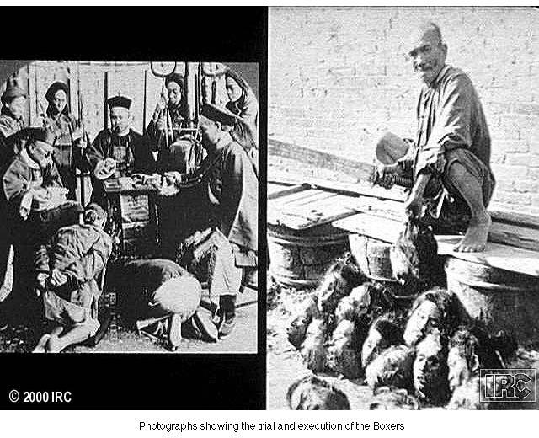
Boxers

Slide 29
Death of the Dowager Empress
Emperor dies a mysterious, sudden death
Cixi dies one day later, November 1908
2-year old Puyi placed on the throne
Revolution in 1911
Puyi abdicates, 1912

Slide 30
Japan

Slide 31
Transformation
Japanese society in turmoil
Poor agricultural output, high taxes
Daimyo, samurai classes decline, peasants starve
Tokugawa government attempts reforms, 1841-1843
Cancelled daimyo, samurai debts
Compelled peasants to return to cultivating rice
Reforms ineffective
Japan only allowed Dutch presence in Nagasaki
1853 Matthew Perry forces Japanese to open port

Slide 32
Statebuilding: The Meiji Restoration (1868)
Brief civil war between imperial and Tokugawa forces
1868 Emperor Mutusuhito (Meiji, 1852-1912) takes power
Goals of prosperity and strength: “rich country, strong army”
Resolved to learn western technology

Slide 33
Meiji Reforms
Travelers Fukuzawa Yukichi (1835-1901) and Ito Hirobumi (1841-1909) travel to U.S., Europe
Argue for adoption of western legal proceedings, technology
Meiji government removes privileges for daimyo, samurai
Conscript army replaces samurai mercenaries
Samurai rebellion crushed by national army
Tax reform: payment in cash, not kind

Slide 34
Statebuilding: Constitutional Government
1889 constitution promulgated
Conservative: only 5 % of male population allowed to vote in 1890 election
Economic reforms to promote rapid industrialization
Dramatic improvement in literacy rates
Government holdings sold to private investors

