Slide 1
Bronze- A history 4000 BCE-1800 CE
The First Alloy Metal
By Vince Lombardi, Paul Bryant, and Rodney Floyd

Slide 2
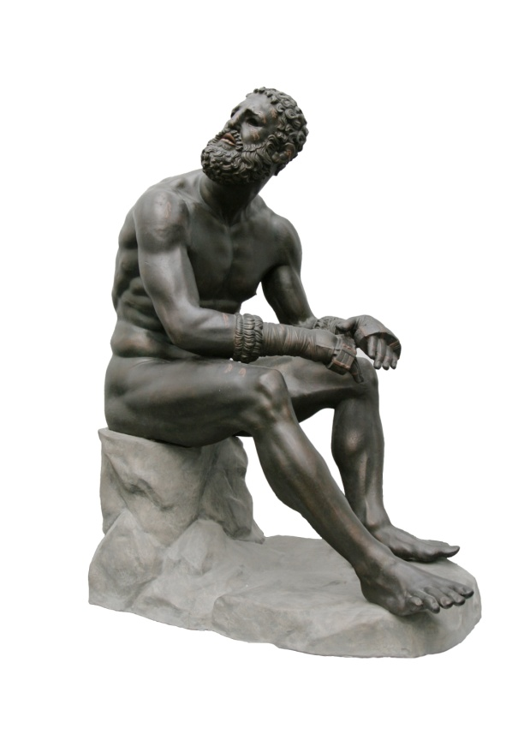
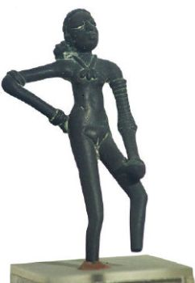
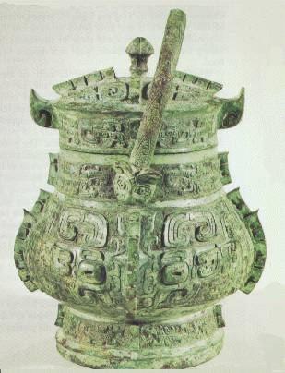
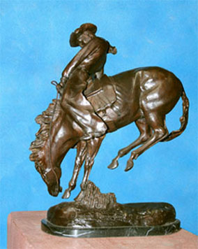
Artistic Uses of Bronze
Greek
China
Harappa
Modern Remington

Slide 3
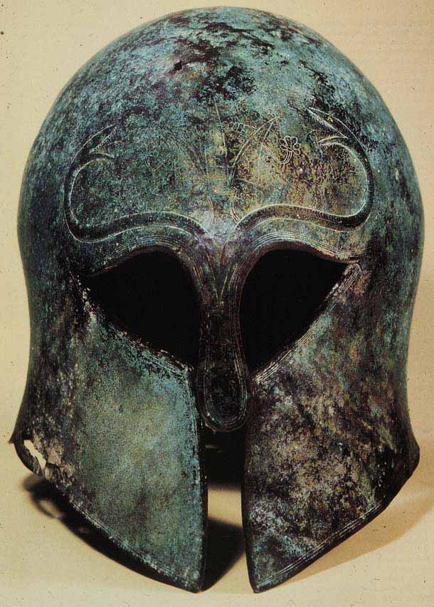
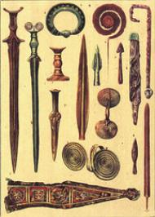
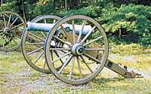
Military Uses of Bronze
Greek helmet
Swords, spear tips, tools
Civil War cannon circa 1800s

Slide 4
Chronology
4000 BCE- Artisans add a small amount of tin which adds luster and strength.
3500 BCE- start of the Bronze Age due to new significance of bronze in tools, weapons, and art works.
3000 BCE- Bronze used in Anatolia (Turkey)
3000 BCE- Bronze weapons used to unite Upper and Lower Egypt
2500 BCE- Bronze used in Aegean region and Greece
2000 BCE- Evidence of bronze use in Europe
2000 BCE- Used in Harappa ( India)
2000 BCE- Chinese develop “lost wax” technique which allows intricate works of bronze art.
1700 BCE- In Thailand, bronze used for religious purposes
1200 BCE- Bronze regulated to artistic works and armor as iron is introduced by the Hittites.
800s BCE- Etruscans introduce bronze into Italy.
500s BCE- Greek artists create detailed bronze statues.
1400s- Used by Renaissance artists in sculptures
1500s- Benin in sub-Saharan Africa is creating bronze art and tools.
1700s - Used to cast cannons (made them lighter)

Slide 5
Regional Impact- East Asia
Near East
Political In China bronze was used by the elite class and warriors had bronze weapons which gave the aristocracy (warrior class) an decisive edge in maintaining power over the masses. | Intellectual Bronze inspires religious concepts of heaven and also the knowledge of smelting and forging.
Religion Was use for religious ceremonies. Very ornate urns and vases created. | Art/Architecture Very beautiful sculptures, vases, and urns created from bronze. Lost wax technique used by
Technology Metallurgy had to be attained to create bronze from tin and copper. Skills gained from smelting and forging bronze later allow China to also create steel. | Economy Eventually, bronze is one of those products used in long distance trade between China and central/south Asia. Also led to the rise of skilled specialists who plied their trade.
Society Due to its uniqueness, bronze was reserved for the elite classes such as priests and nobles. It was one of those things that reinforced social stratification.

Slide 6
Regional Impact- Africa
Africa
Political Egypt was one of first areas in world to create bronze. Allowed for the elite to maintain power through superior weapons made of bronze and bronze armor. | Intellectual Knowledge of smelting and forging discovered.
Religion .Used for adornments in tombs and for amulets. | Art/Architecture Used in simple works of art but not to the degree seen in Asia. Gold was more preferred for this than bronze in Egypt. Benin in the 16th century does use bronze for complex and intricate works- so much so that the Benin kings kept the skilled artisans very close.
Technology .Metallurgy is discovered in order to properly forge and smelt copper and tin together. | Economy For Benin, it became a major trade item that Benin kings profited from.
Society Used by the elite mostly but was also found in the lower classes in amulets.

Slide 7
Change Over Time
Bronze began as a better and lighter tool and weapon than polished stone had been.
By 1000 BCE bronze was in use in all the river valley civilizations and Europe. Due to its heavy use, the Bronze Age is created by historians as a tag for the period 3500-1200 BCE.
After 1000 BCE iron introduced by the Hittites becomes the dominant metal for tools and weapons and bronze becomes regulated to use for artistic pieces, religious rituals, and as armor (lighter than iron).
Bronze will be used in art especially for statues beginning with the Greeks and Indus Valley people and continuing to today. Especially was at it’s peak during the Italian Renaissance in the Medieval period.
Bronze comes back into play as a weapon when gunpowder is invented because it could be used to create lighter, more mobile cannons (Napoleon).

Slide 8
Comparisons
Bronze develops independently in China, Egypt, and Greece and is spread through trade and conquest (cultural diffusion).
Rome, Greece, Harappa. and early China were especially fond of using bronze for artistic or religious purposes. The Chinese and Greeks were able to create fantastically intricate works of art such as statues and vases using molds. The Chinese were especially known for their “lost wax” technique.
The people of the pre-Columbian Americas however never developed the alloy of bronze and were still using stone weapons when the Europeans arrived.
Until the advent of iron and steel in the Near East and East Asia, bronze was the primary tool and weapon because it was light and maintained a razor sharpness. This is evident in Greece, Egypt, and China.
Bronze was used in armor as helmets, breast plates, and shin greaves all the way into the Middle Ages in Asia and Europe.

Slide 9
Uses in the World Today
Today bronze is used for parts around flammable materials because it does not spark such as bearings, bushings, and springs.
Aluminum bronze is used for aircraft.
Bronze is still used as an art form. Certain bronze works by the modern artist Fredric Remington are highly prized by collectors today.
Bronze is fairly cheap to create so when a durable metal is required but not necessarily with strength of steel, bronze is many times selected.
In many athletic contests, the value of the metal of bronze is recognized in that third place winners at the Olympics receive bronze medals. The Heisman Trophy is bronze.

